Slide 2
Signaling between neurons is a ______ signal, whereas hormone signaling to a target cell is a _______ signal
A. short distance; long distance
B. long distance; short distance
C. excitatory; inhibitory
D. inhibitory; excitatory
Notes:
Answer: A

Slide 3
X
What type of hormone is X ?
A. Protein hormone
B. Steroid hormone
Notes:
Ans: B

Slide 4
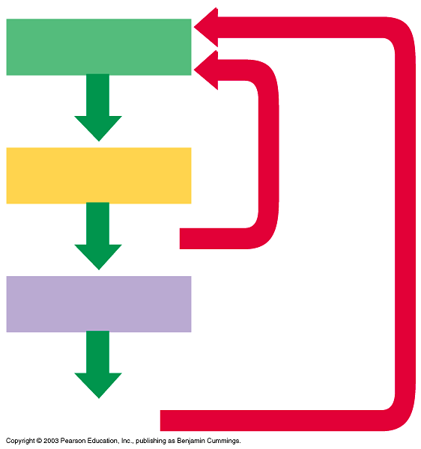
Usually, when thyroxine levels increase, the negative feedback mechanism will ______ TSH secretion.
Increase
Decrease
Not have an effect on the TSH secretion
Hypothalamus
TRH
Negative
Feedback
Inhibition
Anterior pituitary
TSH
Thyroid
Thyroxine
Notes:
Ans: B

Slide 5
Iodine is important to make thyroxine. If there is no iodine in your diet, then the amount of Thyroid releasing hormone (TRH) ___. Use the figure to help answer
Hypothalamus
Increases
Decreases
Does not change
TRH
Negative
Feedback
Inhibition
Anterior pituitary
TSH
Thyroid
Thyroxine
Notes:
Ans: A

Slide 6
Too little calcium in your diet can lead to osteoporosis (brittle, thinning bones). What hormone contributes to this problem?
A. ParaThyroid Hormone (PTH)
B. Thyroxine
C. Calcitonin
D. Growth hormone
Notes:
Ans: A

Slide 7
Ok– you tell me: Not making enough insulin prevents glucose _______ the blood.
A. removal from
B. release into
C. both of the above
Notes:
Ans: A

Slide 8
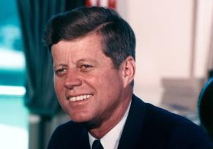
President Kennedy had Addison’s disease (low levels of cortisol). Therefore he would have ___ levels of ACTH
High
Normal
Low
Hypothalamus
CRH
Negative
Feedback
Inhibition
Anterior pituitary
ACTH
Adrenal
Cortisol
Notes:
Ans: A

Slide 9
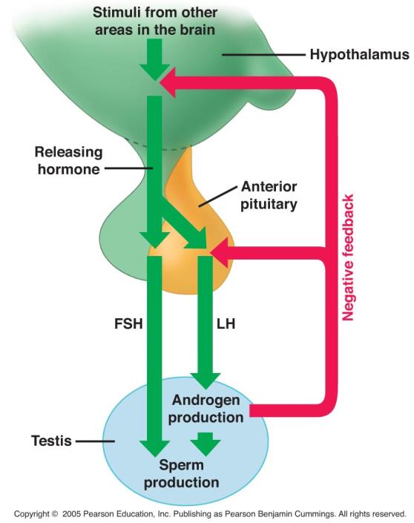
Rise of estrogen will ___
Decrease GnRH
Decrease LH
Increase GnRH
Increase both GnRH and LH
Decrease both GnRH and LH
GnRH
Sex Organs
Spermatogenesis
Oogenesis
Sex hormones
Notes:
Ans: E

Slide 10
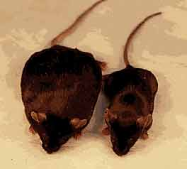
Which mouse got the myostatin inhibitor?
Mouse A
Mouse B
A
B
Notes:
Ans: A
Myostatin inhibitors can be used as a drug to inhibit myostatin or prevent the production of myostatin.

Slide 11
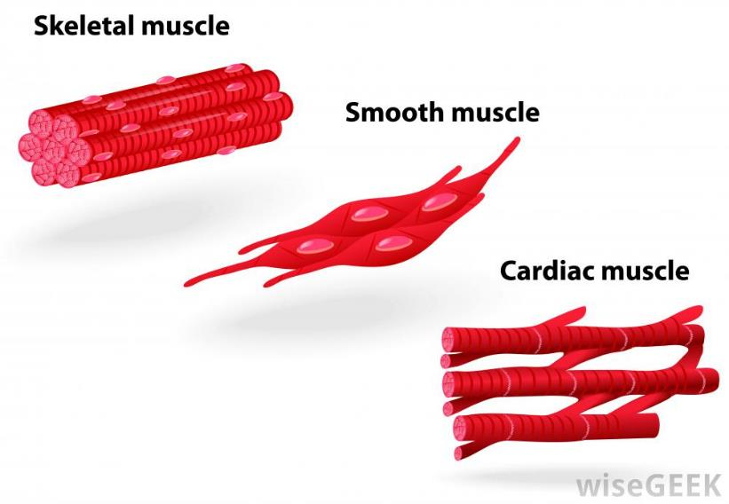
What type of muscle is shown here?
Skeletal muscle
Cardiac muscle
Smooth muscle
Notes:
Ans: B

Slide 12
A motor unit is ____
All the fibers in one muscle
All the fibers in one fasciculus (one bundle)
All the muscle fibers innervated by a single motor neuron
All the nerves that innervate one muscle fiber
Notes:
Ans: C

Slide 13
Given these events:
1. active sites on actin myofilament are exposed
2. actin myofilament slides over myosin myofilament
3. Calcium ion binds to troponin
4. myosin heads move
5. cross bridges form
Choose the correct order of events
A) 4,3,2,1,5
B) 3,1,5,4,2
C) 3,2,5,4,1
D) 2,4,3,5,1
E) 1,2,3,4,5
Notes:
Ans: b

