Slide 1
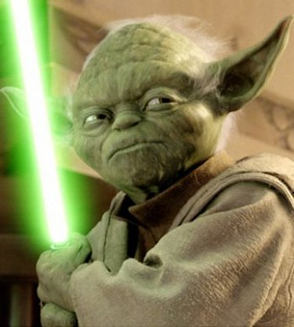

Biotechnology and Genetic Research
Friend or Foe?

Slide 2
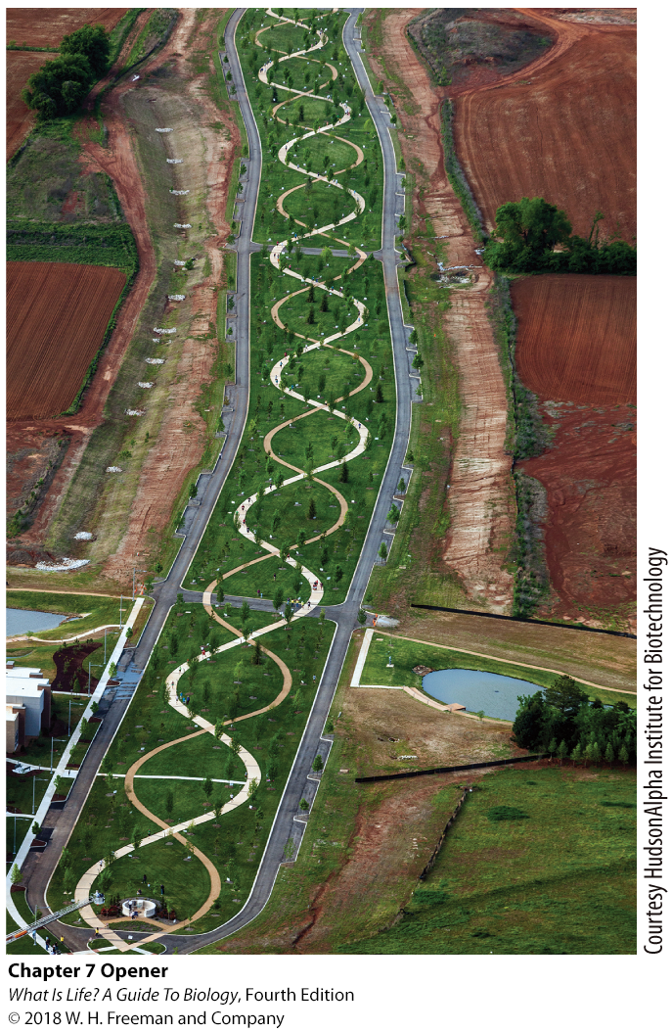
Chapter 7: Biotechnology
Harnessing the genetic code for medicine, agriculture, and more

Slide 3
Learning Objectives
Understand how DNA technology solves crimes.
Describe biotechnology and its implications for human health.
Discuss biotechnology in agriculture.
Argue the benefits and drawbacks of genetically modifying food.
Distinguish between embryonic and adult stem cells and describe the process of cloning.

Slide 4
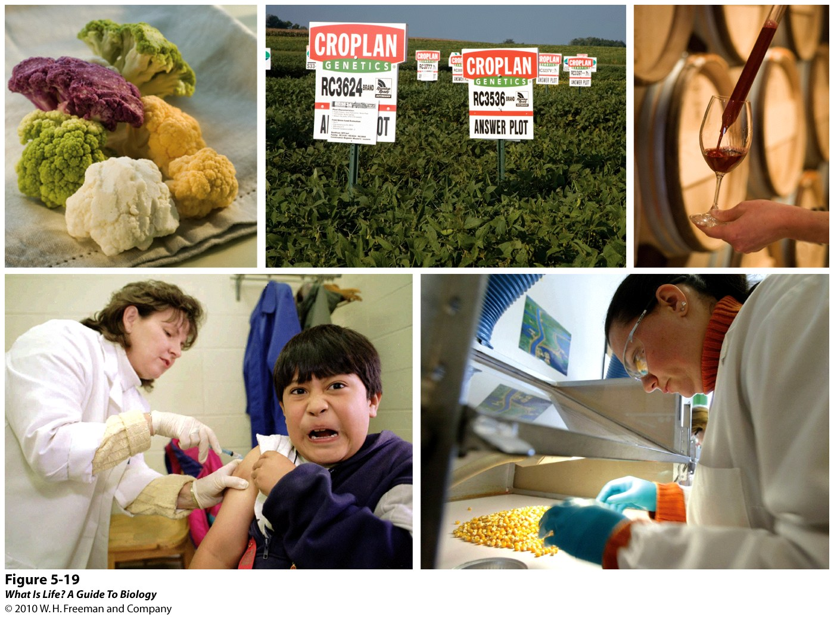
What is biotechnology?
Notes:
4

Slide 5
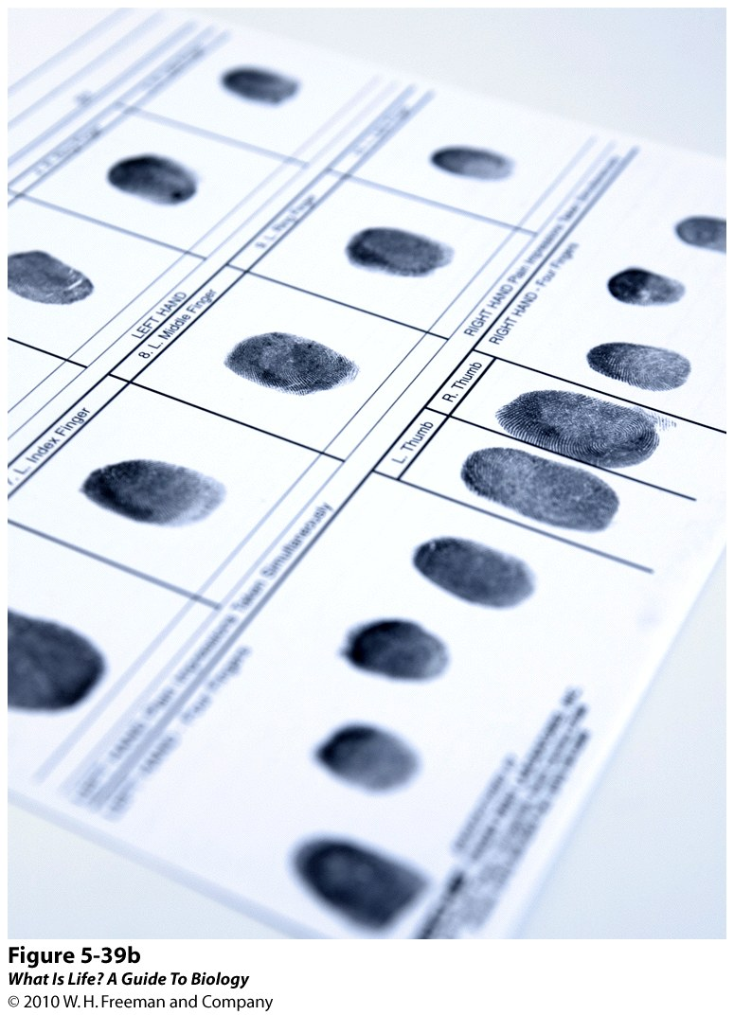
DNA fingerprinting: DNA as an ________ identifier
Notes:
5

Slide 6
Which of the following have identical DNA?

Slide 7
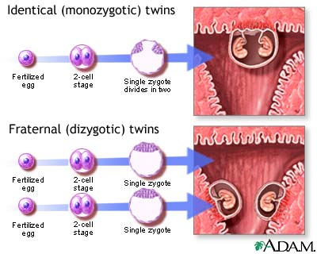

Slide 8
Every somatic cells has a complete set of DNA (i.e. all of your DNA).

Slide 9
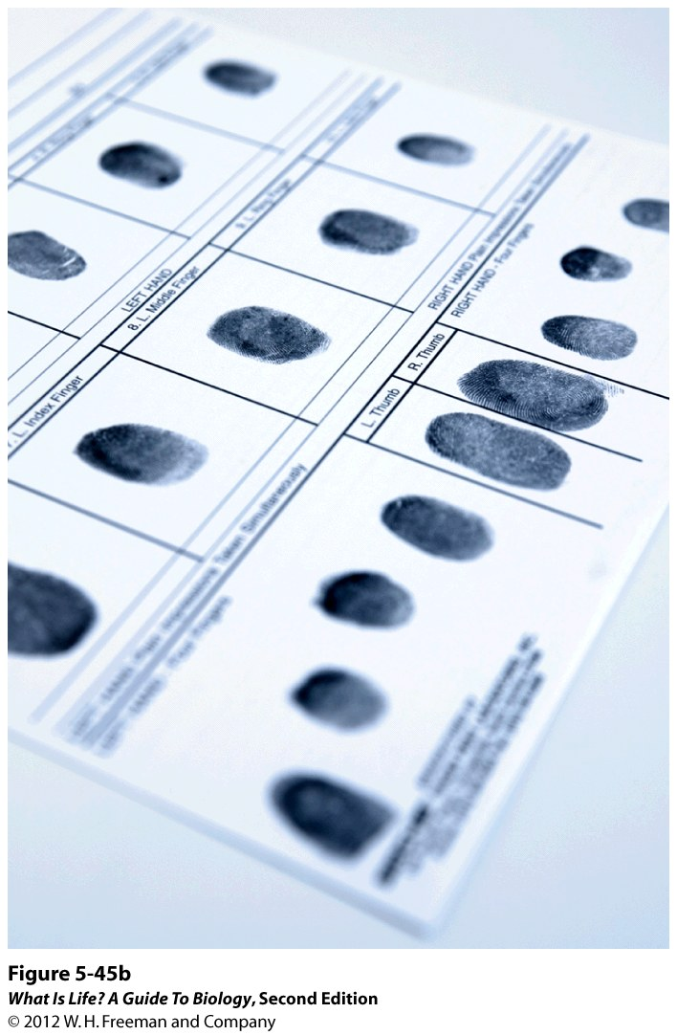
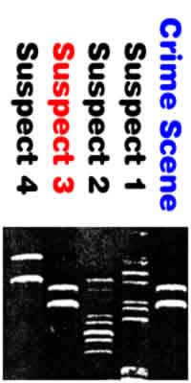
_____ _____________: DNA as an individual identifier
Analysis of DNA
Unique to the person tested
Notes:
9

Slide 10
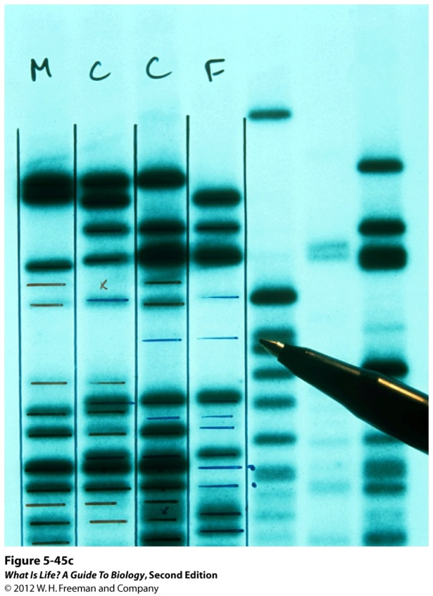
DNA Fingerprinting
Fingerprinting looks at the combination of ridges and the patterns they make.
DNA Fingerprinting looks at the patterns of segments of ______

Slide 11
DNA Fingerprinting
_________ Enzymes – used to cut DNA at specific sites

Slide 12

T
T
A
C
T
G
A
T
C
A
C
A
T
T
A
A
A
T
G
A
C
T
A
G
T
G
T
A
A
T

Enzyme 1: Cuts between G and A

T
T
A
C
T
G
A
T
C
A
C
A
T
T
A
A
A
T
G
A
C
T
A
G
T
G
T
A
A
T


Enzyme 2: Cuts between T and G

Slide 13
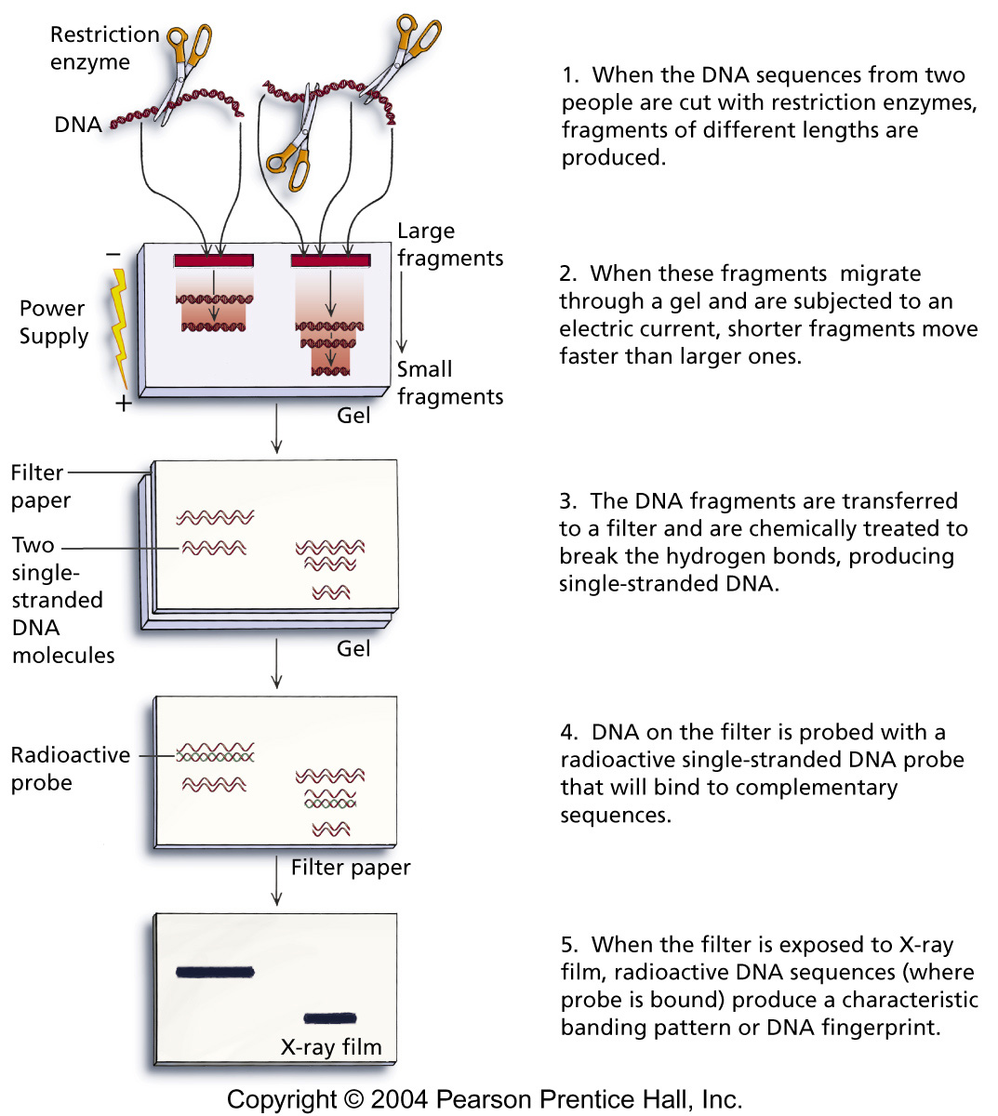
Gel electrophoresis – separates DNA fragments of different ____

Slide 14
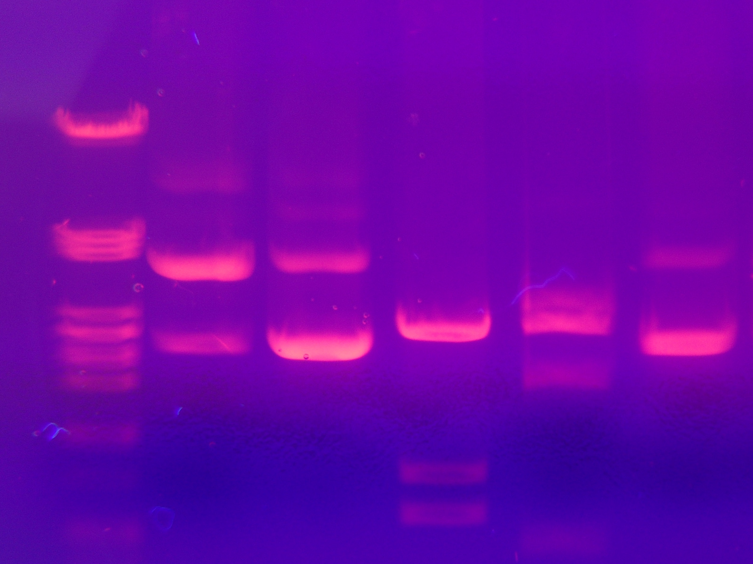
A
C
B
D

Slide 15
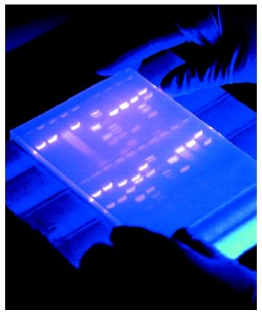
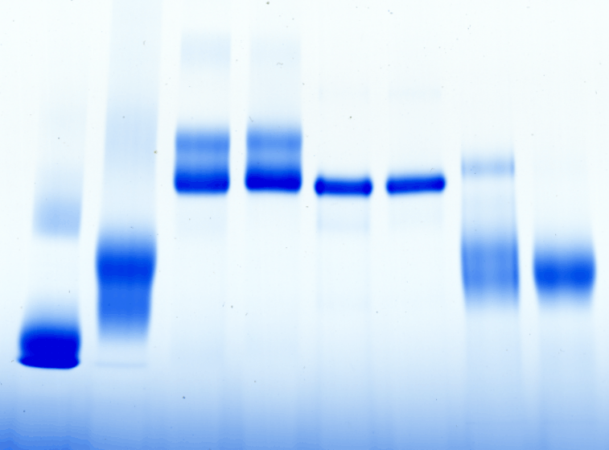
Protein vs. DNA gels

Slide 16
Using the DNA fingerprint information below, determine which suspect was present at the crime scene?
Notes:
16
16

Slide 17
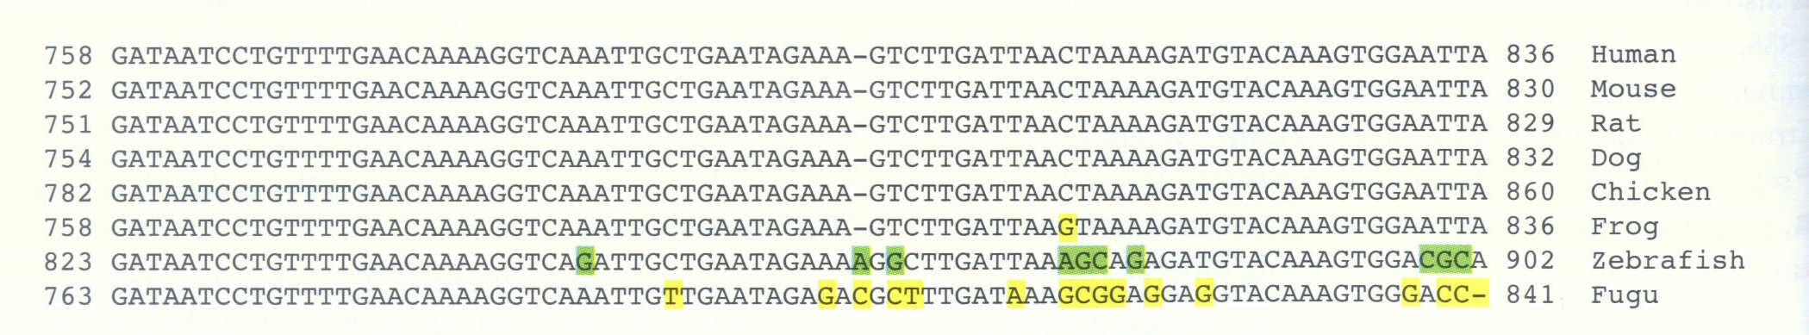
Similarities in our genome
With these similarities and the size of our genome (i.e. billions of bases), how useful is DNA fingerprinting?

Slide 18
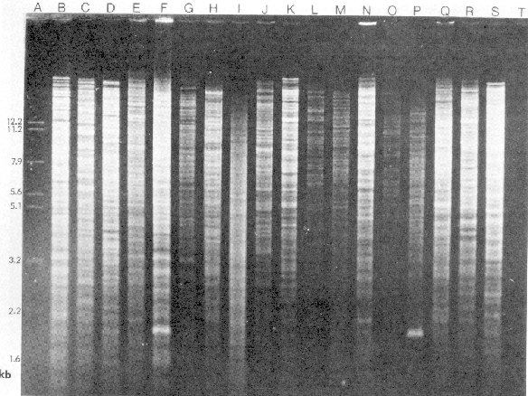

Slide 19
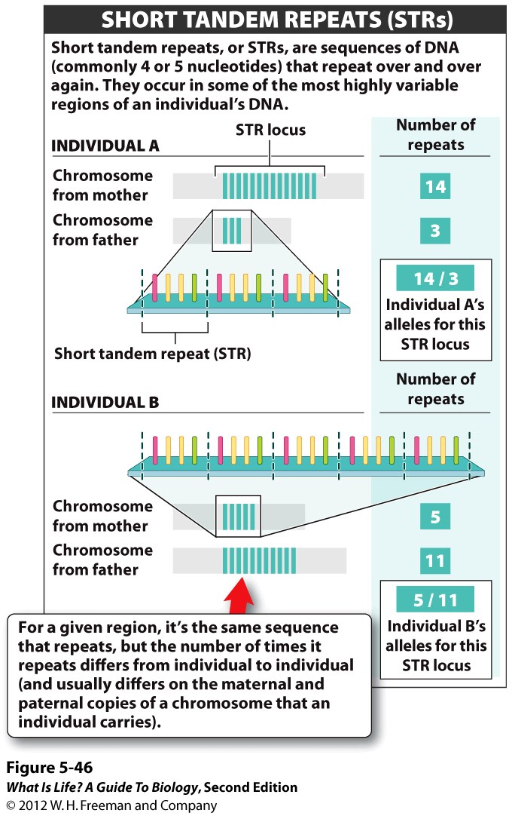
Notes:
19

Slide 20
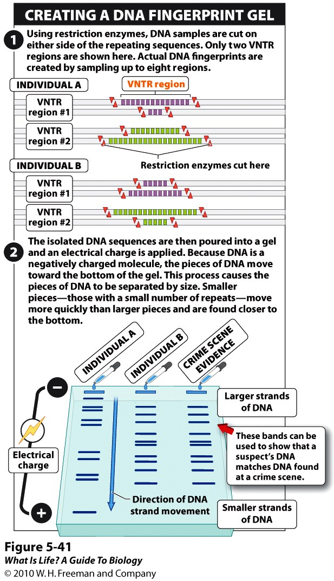
What is a DNA fingerprint?
Notes:
20

Slide 21
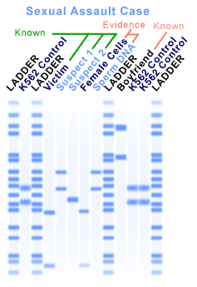

Slide 22
Which of the following is an additional application of DNA fingerprinting?

Slide 23
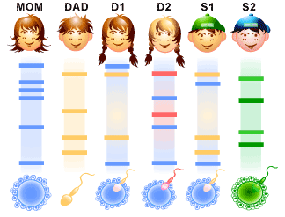

Slide 24
What is ______ _______?
Adding, deleting, or transplanting genes from one organism to another, to alter the organisms in useful ways
  Treating diseases
  Making medicines
  Producing better crops
Notes:
24

Slide 25
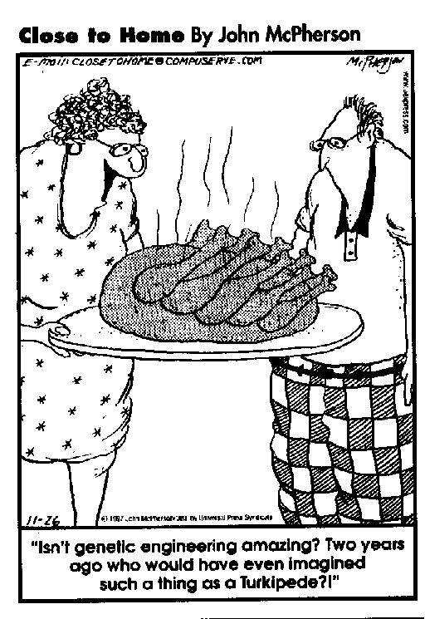
Recombinant DNA – combination of DNA from _____ or more sources
_________ organism – bioengineered organism that carries the genes of two or more organisms

Slide 26
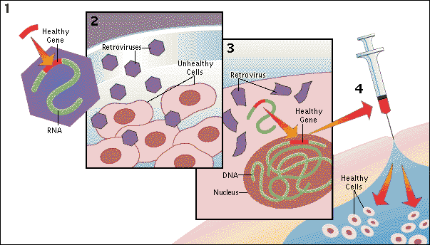
Gene Therapy revisited
Recombinant DNA
&
Transgenic organism

Slide 27
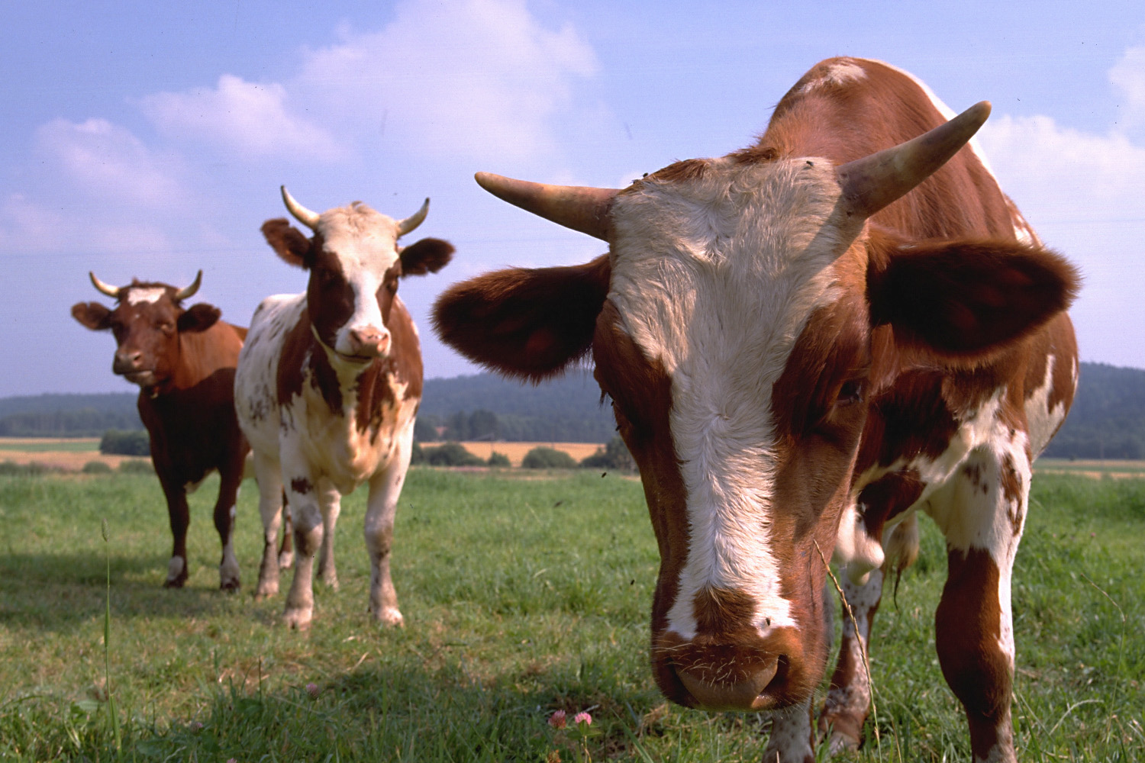
Growth hormones (steroids)

Slide 28
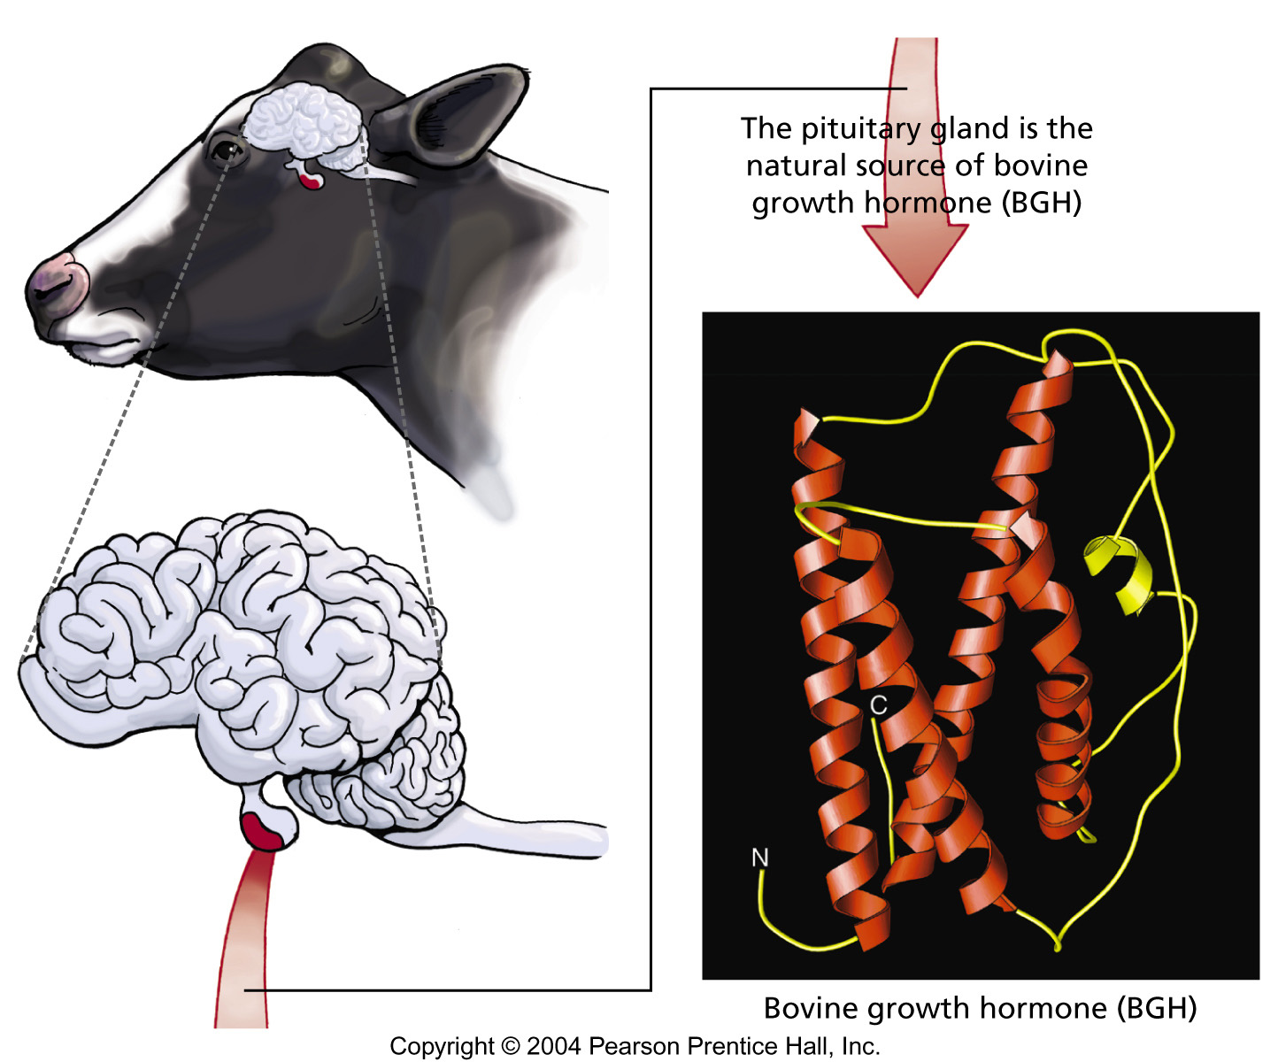
“BGH” - PROTEIN
BGH – harvesting of hormone from pituitary gland
rBGH – laboratory production
recombinant – manipulate DNA

Slide 29
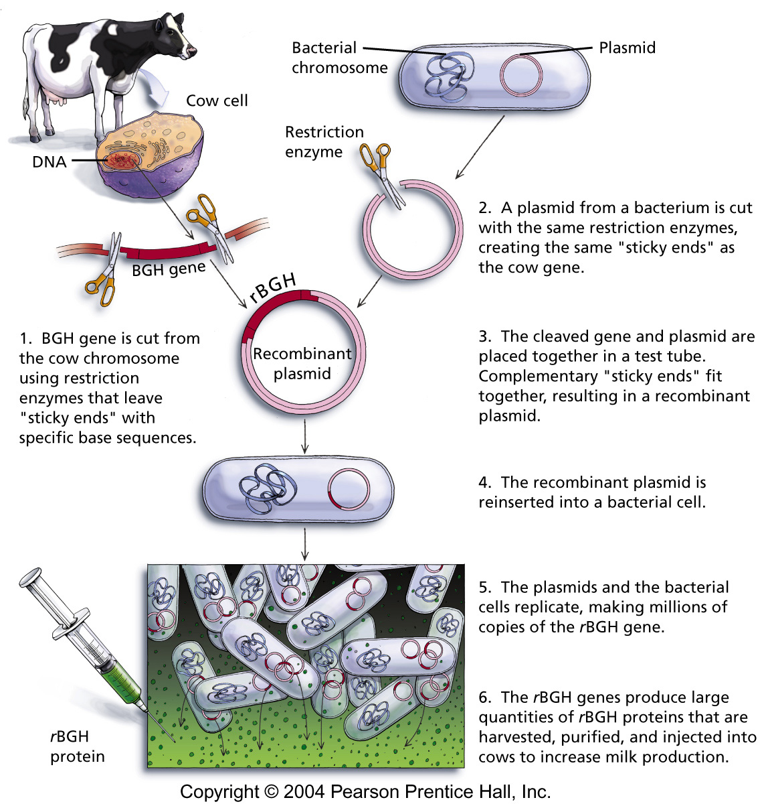

Slide 30
____ cuts DNA at a specific sequence.

Slide 32

T
T
A
C
T
C
G
T
A
C
G
A
T
T
A
A
A
T
G
A
G
C
A
T
G
C
T
A
A
T

Restriction enzymes cut DNA at specific sequence (CGTACG)
Cuts after the first C in sequence

Slide 33

T
G
T
A
C
T
A
C
T
B G H Gene
C
G
T
A
C
G
A
T
T
A
A
A
T
G
A
B G H Gene
A
T
G
G
C
A
T
G
C
C
T
A
A
T

Restriction enzyme recognizes sequence CGTACG
Cuts after the first C in sequence
Bonds in sequence broken, leaving “sticky ends”
Bacterial plasmid (DNA) cut with the same restriction enzyme (same bases on the “sticky ends”) can be joined with the first.

Slide 34
“recombinant” gene
gene is replicated – protein produced

Slide 35
Which is the transgenic organism?

Slide 36
Are you diabetic or know someone who is diabetic and takes insulin?

Slide 37
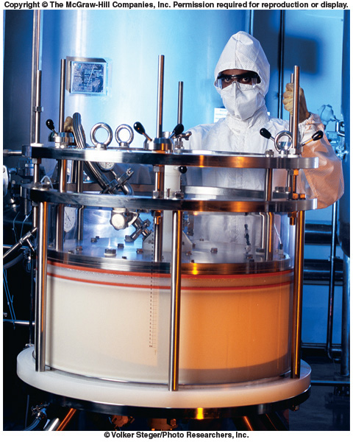
Transgenic E. coli Produces Insulin

Slide 38
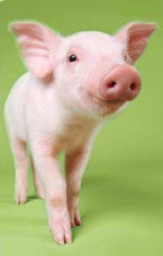

Until the ’80’s – insulin from cows and pigs
What are some problems associated with getting insulin from cows & pigs?

Slide 39
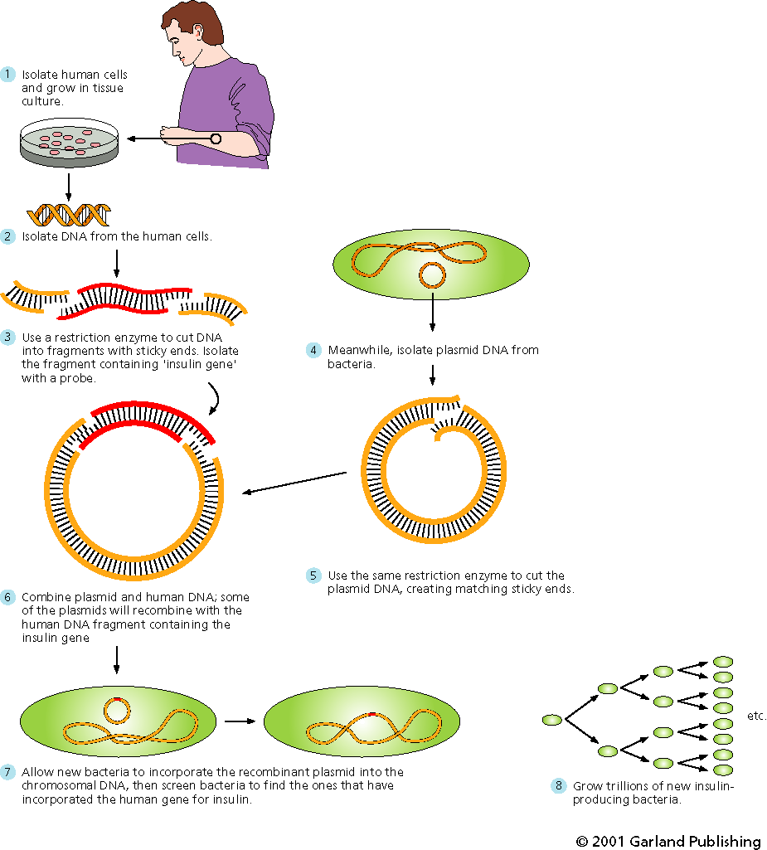
Gene Cloning: Mass produce insulin
Insert human insulin gene into bacteria
Harvest insulin for diabetics from the bacteria

Slide 40
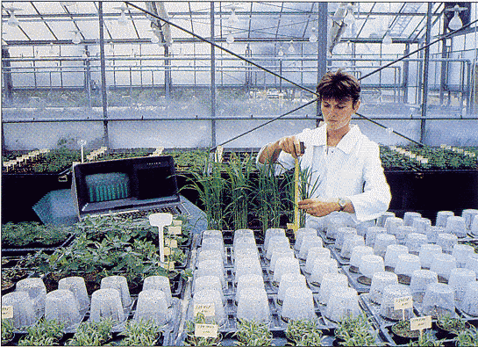
__________ __________ ORGANISMS
manipulation of genetic material for a specific purpose, such as higher yields (more and larger fruit), faster growth, higher nutrient amounts, disease resistance, drought resistance, pest resistance, less waste products from animals. . .
Green revolution

Slide 41
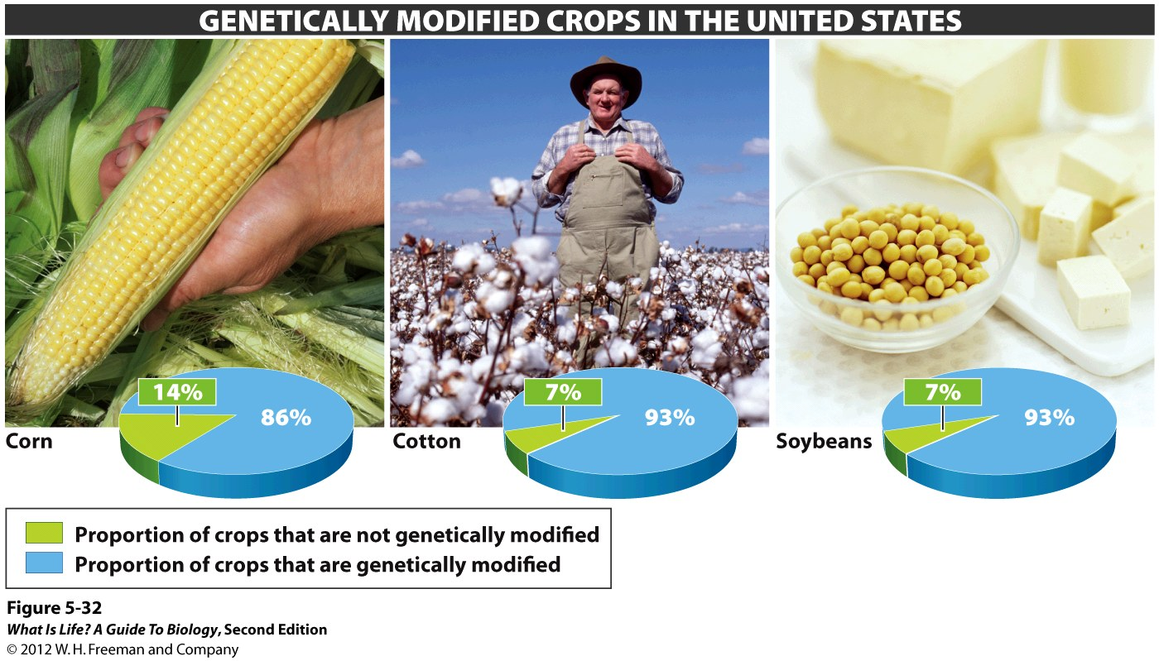
Almost everyone in the U.S. consumes genetically modified foods regularly without knowing it.
Notes:
41

Slide 42
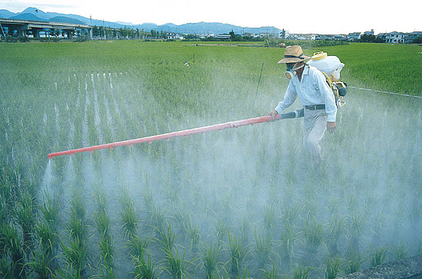
Reasons for the adoption of GMO
Engineer insecticides and herbicides into plants, thereby reducing the amounts of these chemicals used
Herbicide- and insecticide-resistant plants reduce the amount of plowing to remove weeds, reducing costs and loss of topsoil to erosion

Slide 43
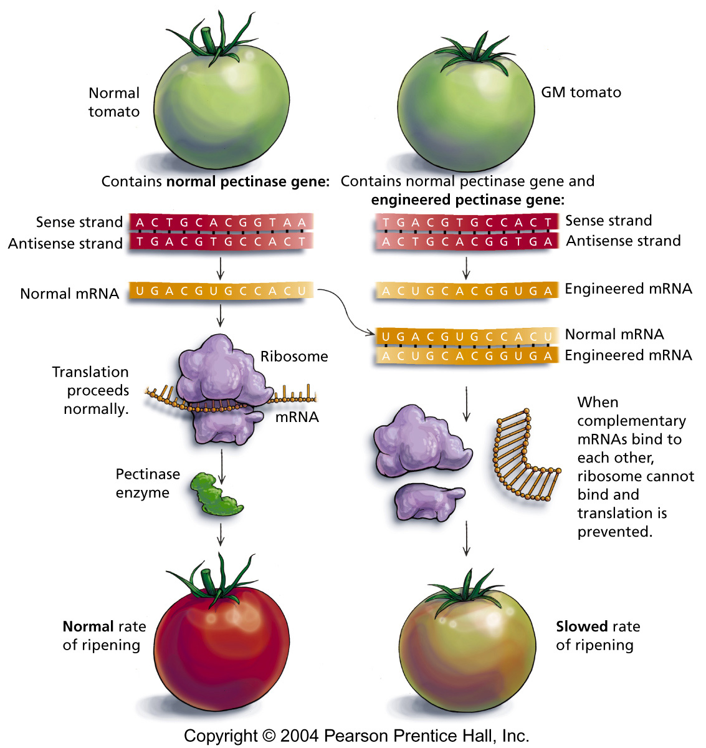
soften & ripen more slowly
pectinase
Engineered mRNA binds to normal mRNA
stops translation

Slide 44
Which of the following apply to the tomato example?

Slide 45
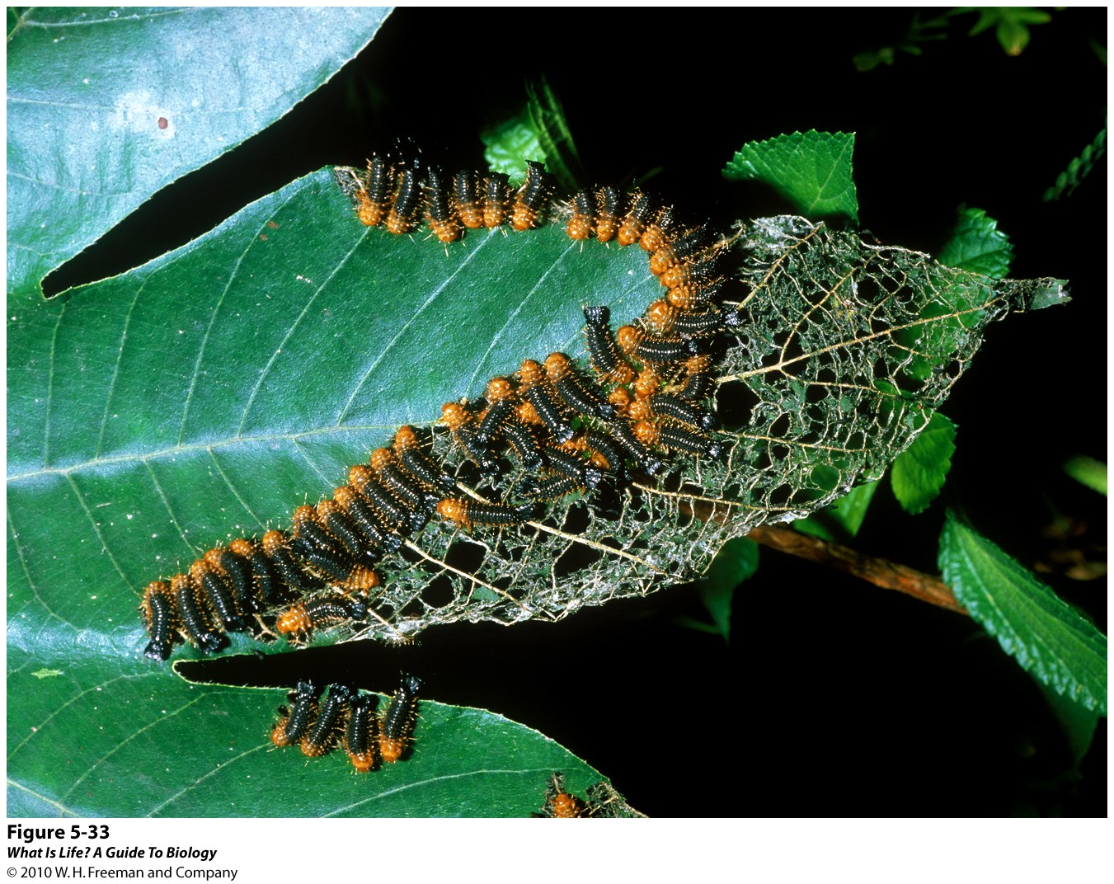
Insect Resistance
Notes:
45

Slide 46
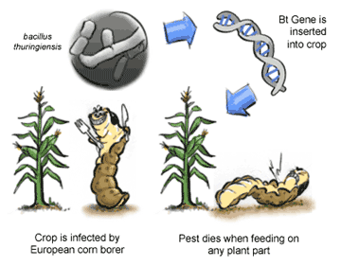
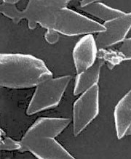
Bt corn

Slide 47
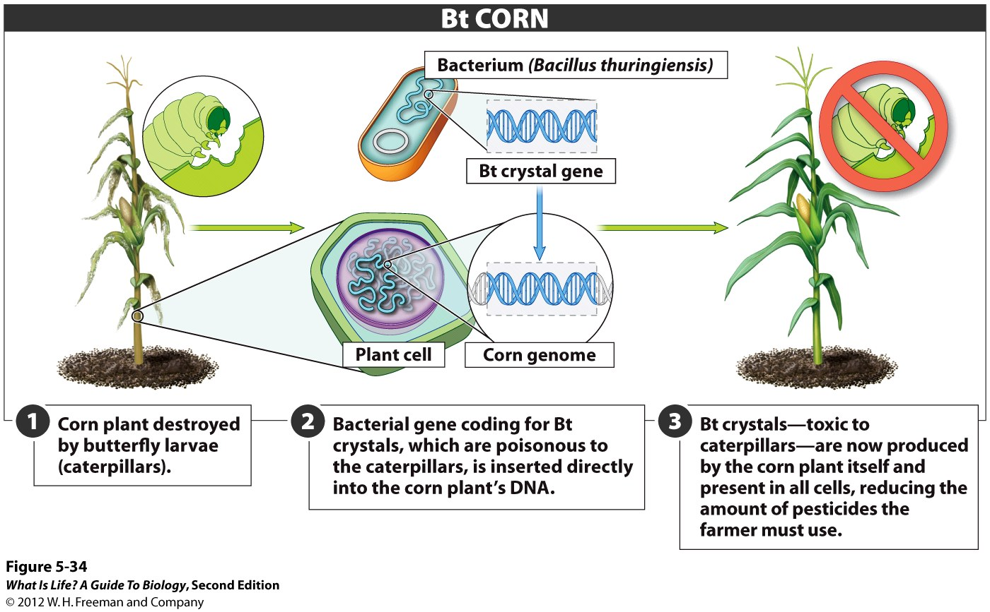
Notes:
47

Slide 48
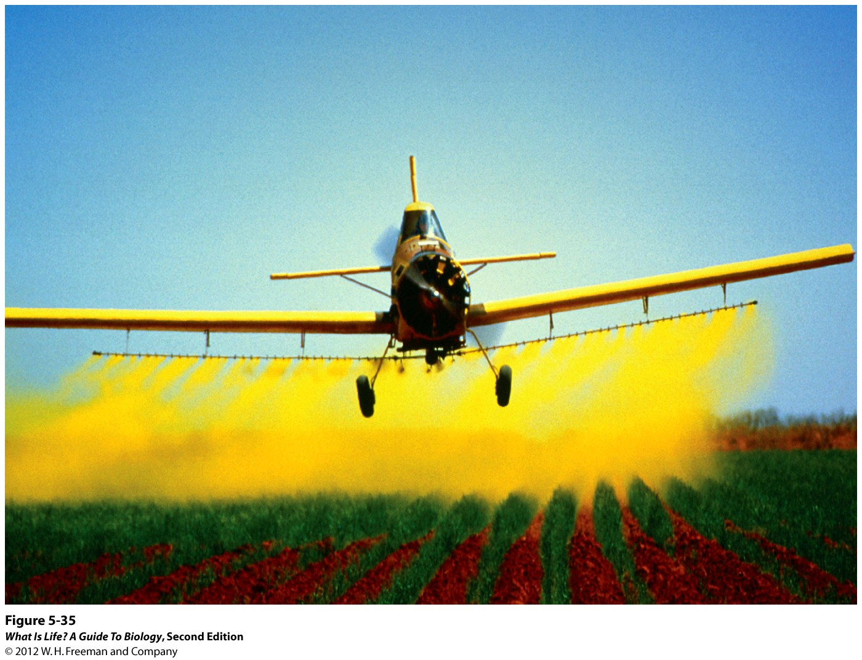
Herbicide Resistance
Notes:
48

Slide 49
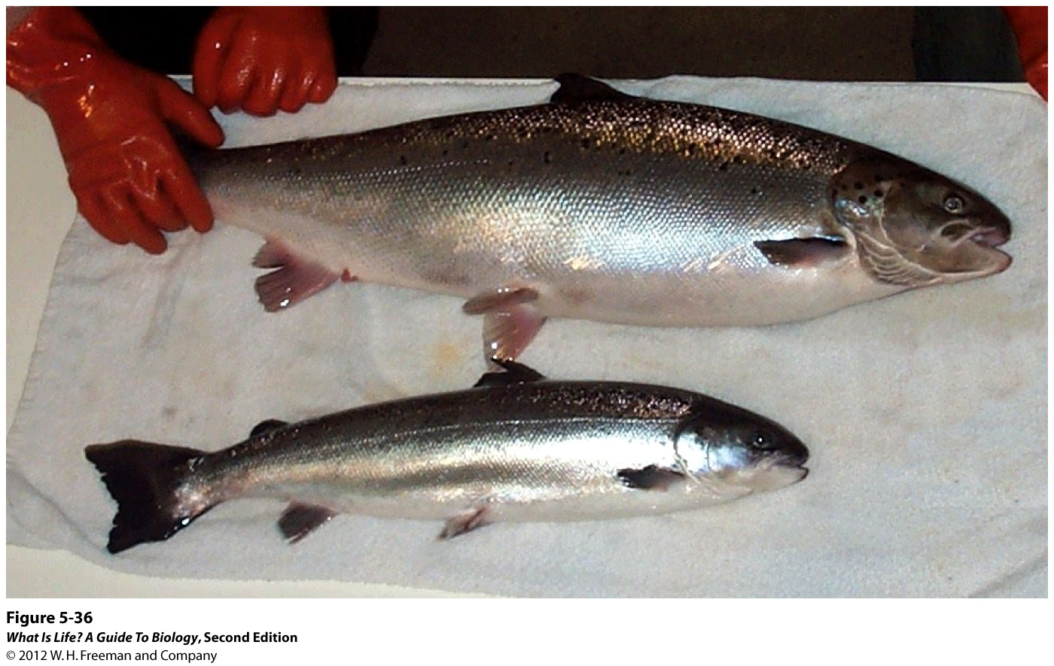
Faster Growth and Bigger Bodies
Notes:
49

Slide 50
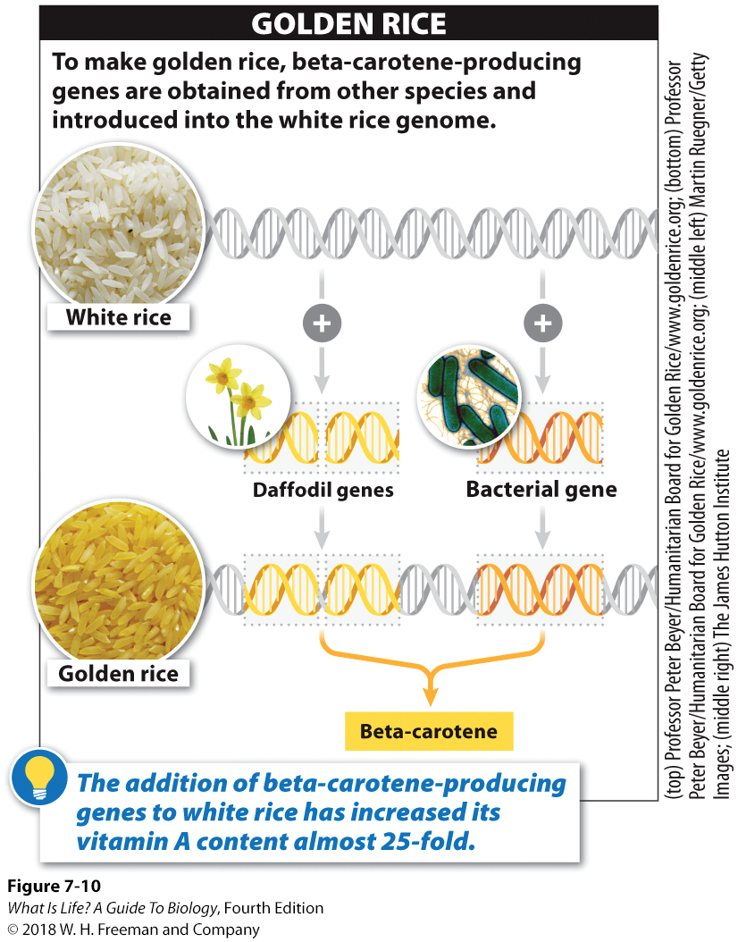

Slide 51
GMO involves

Slide 52

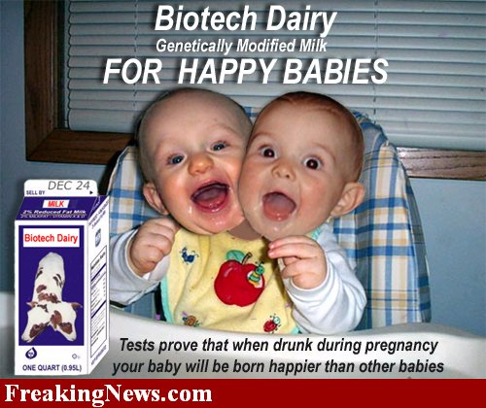
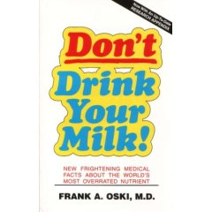
Fears and risks: the safety of genetically modified foods
1994 Monsanto's synthetic growth hormone (rbGH), Bovine Somatotropin, is legalized.
It can increase milk production by 20%

Slide 53
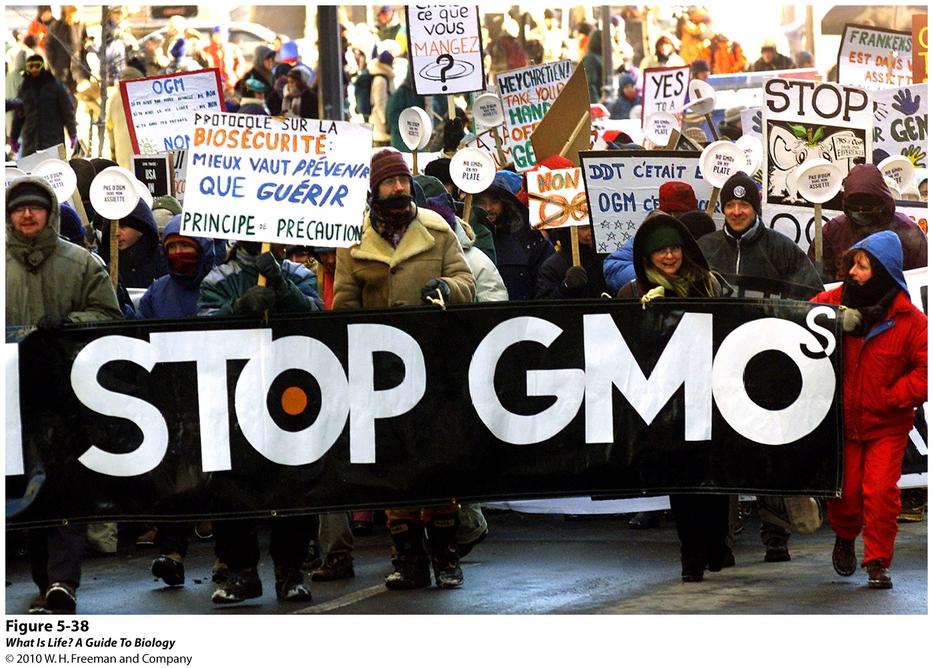
Fear #1. Organisms that we want to kill may become ___________.
Fear #2. Organisms that we don’t want to kill may be killed inadvertently.
Fear #3. Genetically modified crops are not tested or regulated adequately.
Notes:
53

Slide 54
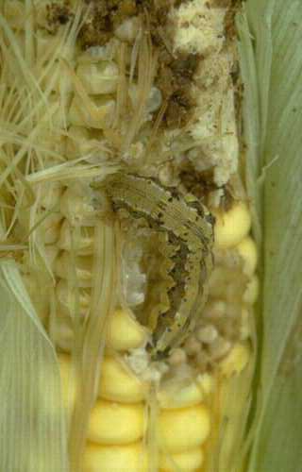
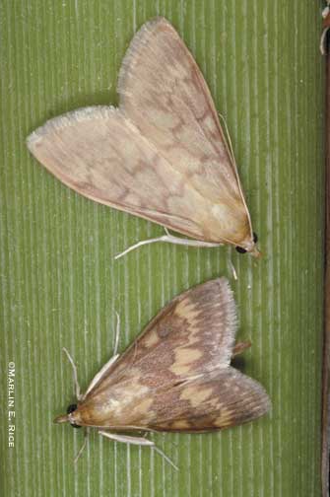
Can the corn borer develop resistance to Bt?

Slide 55
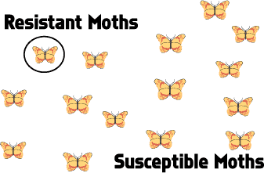
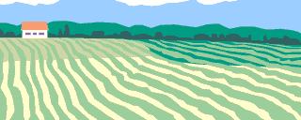
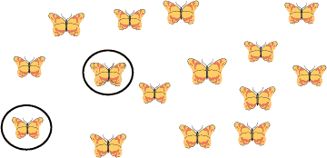
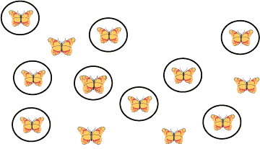
Example of RESISTANCE
No Bt
introduce Bt
widespread use of Bt

Slide 56
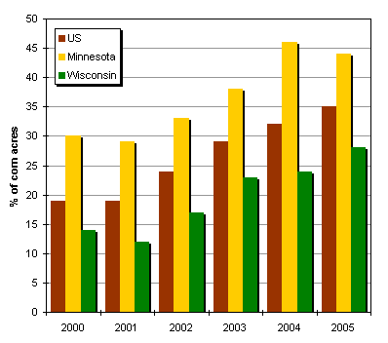
Bt Corn Adoption in the US
USDA ERS 2005

Slide 57
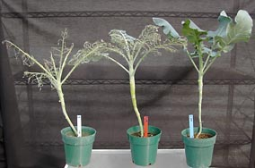
Survey: You are a farmer. You know about pests gaining resistance. Which strain of broccoli would you prefer to plant?
1 Bt gene
2 Bt genes
No Bt gene
B
C
A

Slide 58
Fear #1. Organisms that we want to kill may become invincible.
Fear #2. Organisms that we don’t want to kill may be killed inadvertently.
Fear #3. Genetically modified crops are not tested or regulated adequately.
Notes:
58

Slide 59
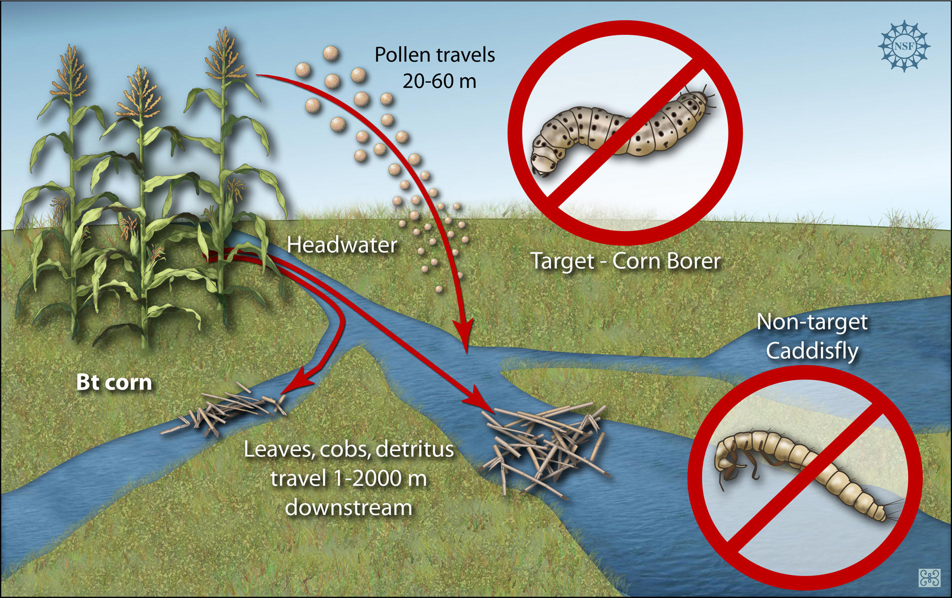

Slide 60
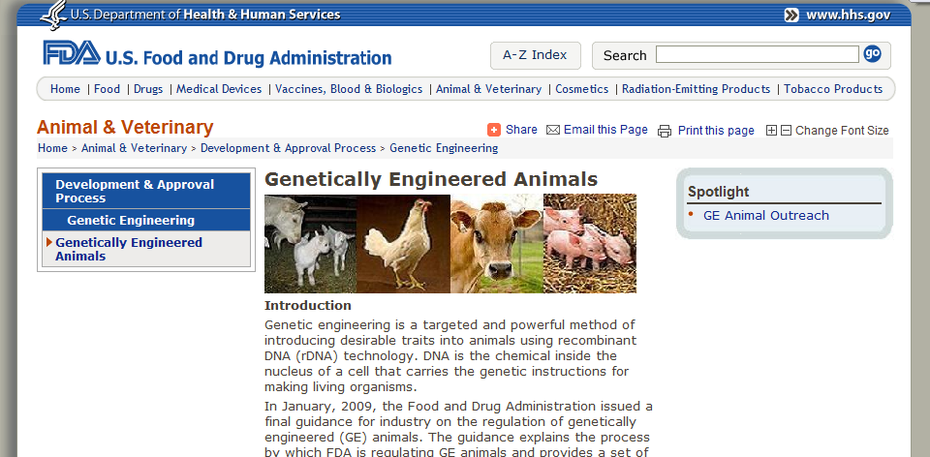



There are regulations.

Slide 61

Fear #4. Eating genetically modified foods is __________.
Fear #5. Loss of genetic _____ among crop plants is risky.
Fear #6. Hidden _____ may reduce the financial advantages of genetically modified crops.
Notes:
61

Slide 62

GMO feeding the future

Slide 63
Jurassic Park is possible in theory but not in reality. Why?

Slide 64


Extinct Wooly Mammoth’s DNA sequenced (Nature, Nov 2008)
a ball of permafrost-preserved mammoth hair containing thick outer-coat and thin under-coat hairs.
Penn State scientists sequenced DNA from a 20,000 and 60,000 year old frozen mammoth’s hair

Slide 65
What is a clone?

Slide 66

Cloning is the process of making a genetically _______ organism through nonsexual means
Identical twins are natural clones

Slide 67
Three types of Cloning:
1. _____ Cloning
      Copying of DNA for sequencing
2. ________ Cloning
      Production of a fully-developed, cloned individual
3. Therapeutic Cloning
      Development of cells or tissues used to treat disease

Slide 68

DNA Cloning

Slide 69

Reproductive and Therapeutic Cloning

Slide 70
Which of the following is an example of therapeutic cloning?

Slide 71







Cloned Animals

Slide 72

Noah (cloned gaur) was the first
endangered animal to be cloned.

Slide 73


Bucardo, Pyrenean ibex

Slide 74
Drawbacks of Cloning
High failure rate
Problems during later development
Abnormal gene expression
Decline in genetic diversity
Premature aging

Slide 75

Other Issues in Cloning
Ethical, Legal and Social issues
Lots of questions to ponder…
  Who is the parent?
  Is cloning playing God?
  How should cloning research be regulated? By whom?
  Does therapeutic cloning justify destroying human embryos?

Slide 76
To clone or not to clone?
Remember:
Cloning can be reproductive producing a whole organism
or cells only
As a way for parents who both carry the gene for a genetic disease (and who will not accept abortion of a diseased fetus) to have a genetically related child guaranteed to be free of the disease.
As a way to generate cells that could help heal a person suffering from a severe brain or spinal cord injury.
As a way for homosexuals to have genetically related children.

Slide 77
What are stem cells?

Slide 78

Stem Cell Research
Stem Cells – undifferentiated cells (can _____ and become many _________ kinds of cells)
stem cells can be harvested from many sources and can be chemically “pushed” in a particular direction
Potential uses? “grow” organs or cells for replacement of damaged or diseased ones

Slide 79
Types of stem cells
__________
Fetal stem cells
Umblical cord stem cells
Placental stem cells
______ stem cells
blastocyst
aborted fetuses
umblical cord blood of newborns
Placenta and amniotic fluid
Adult tissues (bone marrow, fat etc)

Slide 80
All stem cells are not created equal
Totipotent
Pluripotent
Multipotent
Oligopotent
Unipotent

Slide 81

Stem Cell Therapy

Slide 82

Why aren’t these diseases treated?
When and which genes to turn on/off
Transplant rejection
Integrate into the surrounding tissue

