Slide 1
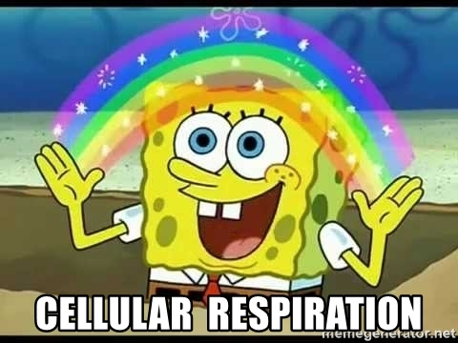

Slide 3
Cellular respiration uses the oxygen produced by photosynthesis!!

Slide 4
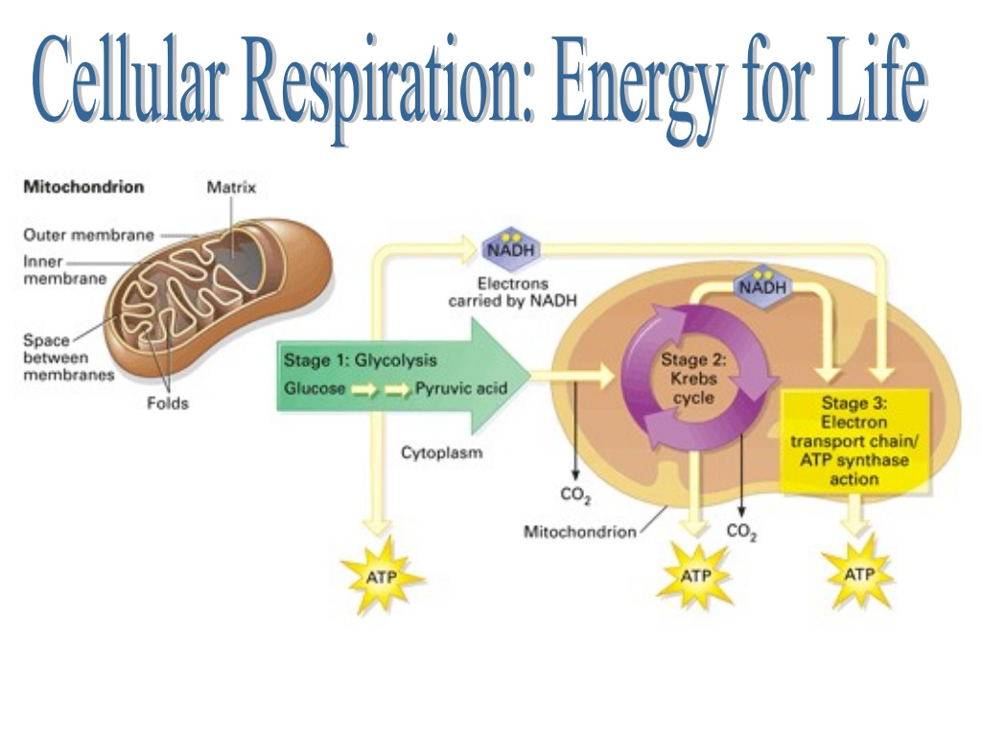
https://www.youtube.com/watch?v=V_xZuCPIHvk

Slide 7
ATP is adenosine triphosphate and is like a charged battery
ADP is called adenosine diphosphate and is like an uncharged battery

Slide 11
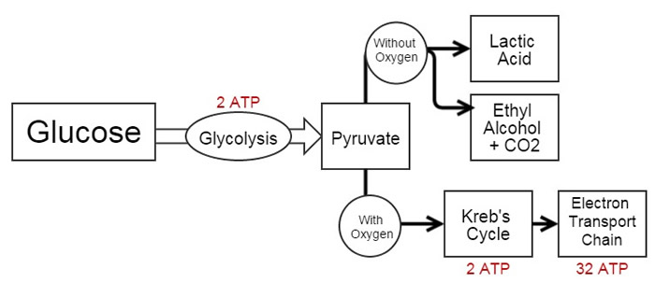
Cellular Respiration can occur with or without oxygen
Aerobic- with oxygen
Anaerobic- without oxygen

Slide 13
Aerobic Cellular Respiration Occurs in the Mitochondria

Slide 14
Aerobic Cellular Respiration Occurs in the Mitochondria

Slide 15
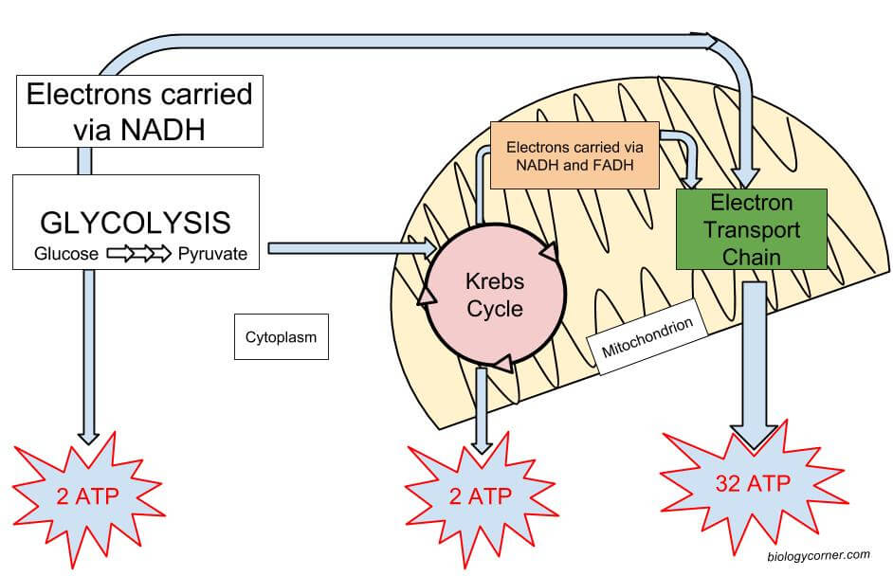
The 3 Main Stages of Aerobic Cellular Respiration
1) Glycolysis
2) Kreb’s Cycle
3) Electron Transport Chain

Slide 17
Glycolysis “Glucose Splitting”
https://www.youtube.com/watch?v=EfGlznwfu9U
Main objective: splits glucose into pyruvic acid and makes ATP
Location: cytoplasm
Reactants: glucose, ADP
Products: ATP and NADH
**Uses 2 ATPs but produces 4 ATP---- 2 net ATPs produced!!!

Slide 19
Intermediate Reaction
Converts pyruvate to Acetyl CoA
*** requires oxygen!

Slide 20
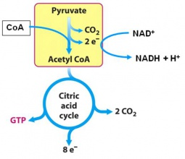
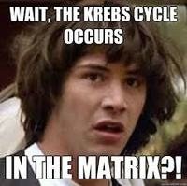
Kreb’s Cycle (AKA Citric Acid Cycle)
Requires oxygen!
Occurs in the matrix of the mitochondria
Main objective: To make high energy molecules to send to the Electron Transport Chain

Slide 21
Kreb’s Cycle
https://www.youtube.com/watch?v=0NdYYAE3Wd0
Location: mitochondria
Reactants: Products:
Acetyl CoA
ADP+ P ATP
NAD NADH- goes to ETC
FAD FADH2-goes to ETC
Oxygen **CO2- breathed out

Slide 23
Electron Transport Chain (ETC)
Location: mitochondria
Main objective: To make lots of ATP
Reactants: Products:
ADP+ P 34 ATP!!!
NADH NAD
FADH2 FADH
Oxygen

Slide 25
ATP Totals
Stage | ATP Produced
Glycolysis | 2
Kreb’s Cycle | 2
Electron Transport Chain | 34

Slide 26
Review Videos
https://www.youtube.com/watch?v=4Eo7JtRA7lg
https://www.youtube.com/watch?v=7J4LXs-oDCU

Slide 27
Anaerobic Respiration
Does not require oxygen
Starts with Glycolysis!
https://www.youtube.com/watch?v=YbdkbCU20_M
After glycolysis, fermentation occurs to regenerate NAD+
Two Types
Lactic Acid Fermentation
Alcoholic Fermentation

Slide 29
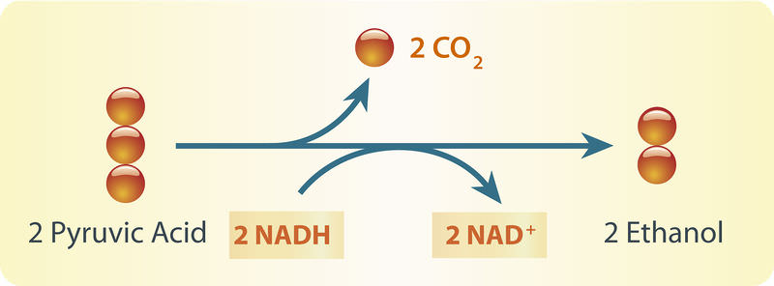
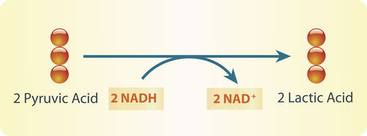
Fermentation
After glycolysis, fermentation regenerates NAD+ to be used in another glycolysis cycle.

Slide 30
Lactic Acid Fermentation
bacteria, plants and most animals
Steps:
1) Glycolysis
2) Fermentation: pyruvate is broken down into lactic acid and NAD is produced
Sometimes happens in your muscles, cramps-----Exercise

Slide 32
Alcoholic Fermentation
Bacteria and fungi (yeast)
Steps:
1) Glycolysis
2) Fermentation: pyruvate is broken down into ethyl alcohol and CO2 and NAD is produced
Main byproduct: Alcohol
Process used to form beer, wine, and other alcoholic beverages
Also used to raise dough, bread

