Slide 1
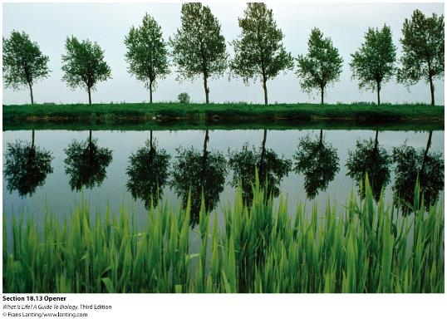
Chapter 18
Plants have two types of growth, usually enabling lifelong increases in length and thickness.

Slide 2
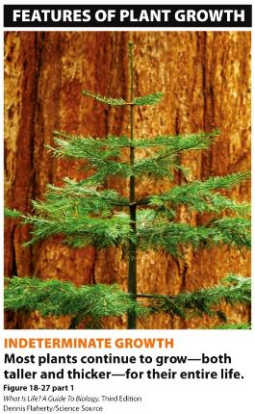
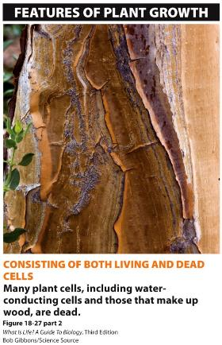
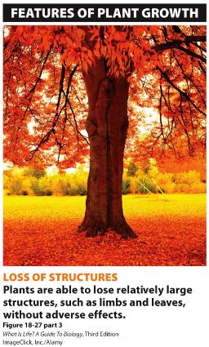
Plants grow differently from animals
In animals, growth is determinate (growth comes to an end).
Plants show indeterminate growth.

Slide 3
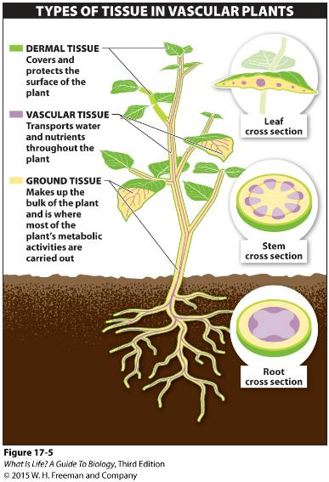
17.3 Plants are organized into tissues, each with specific functions.
There are three main tissue types in plants:
dermal tissue
vascular tissue
ground tissue
Notes:
Vascular plants, which we focus on in this chapter, are all organized around the same basic body plan and built up from the same three types of tissues. Leaves, stems, roots, and flowers—all consist of these tissue types

Slide 4
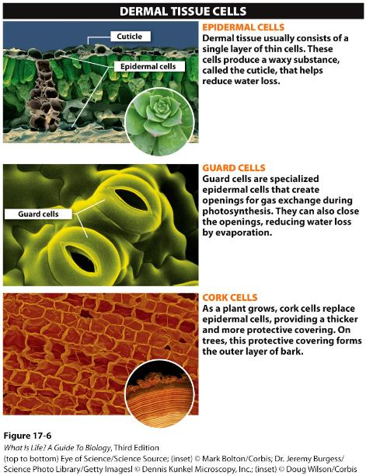
Dermal Tissue
Dermal tissue covers and protects the surface of the plant.
Dermal tissue includes a thin epidermis, a waxy cuticle, and specialized guard and cork cells.

Slide 5
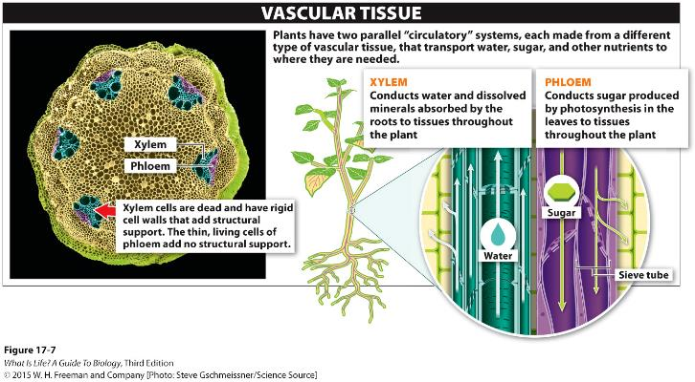
Vascular Tissue
Vascular tissue is a system for getting nutrients to, and removing waste products from, all parts of the plant.
Sap is moved in tissue called xylem and phloem.
Notes:
When they are large, plants must have a system for getting nutrients to and removing waste products from all parts of the plant, from the bottommost roots to the topmost leaves. The delivery and movement of these molecules is the function of vascular tissue, which plays a role analogous to that of the circulatory system in animals.
There are two parallel circulatory systems in vascular plants, each made from a different type of vascular tissue and each transporting a fluid called sap.
One type of vascular tissue is called xylem, which is made of dead cells. It conducts xylem sap, containing water and dissolved minerals from the roots, to the rest of the plant body. The other vascular tissue type, called phloem, which is made of living cells). Phleom conducts phloem sap, consisting mostly of water but also containing sugar—the plant’s fuel source—and some minerals, to all the tissues that need sugar to fuel their activities.

Slide 6
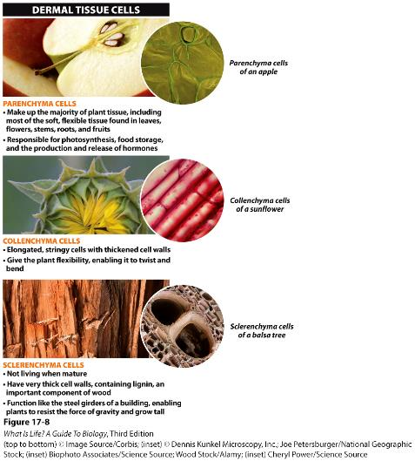
Ground Tissue
Ground tissue comprises most of the plant body.
Three types of cells—parenchyma, collenchyma, and sclerenchyma—are found in ground tissue.
Notes:
The third type of tissue found in plants is called ground tissue. Because ground tissue includes everything that is neither the outer covering (dermal tissue) nor the inner vascular tissue (xylem and phloem), it makes up most of the plant body. There are three different types of ground tissue.

Slide 7
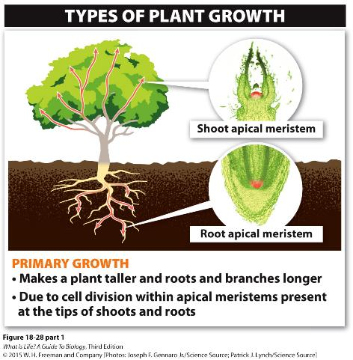
Plants Have Two Methods of Growth
Primary growth allows plants to grow taller.
Growth in stems occurs in meristems (including apical and lateral meristem)

Slide 8
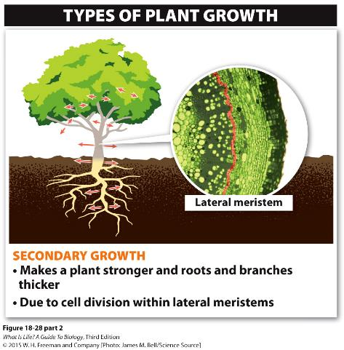
Plants Have Two Methods of Growth
Secondary growth allows plants to grow thicker.

Slide 9
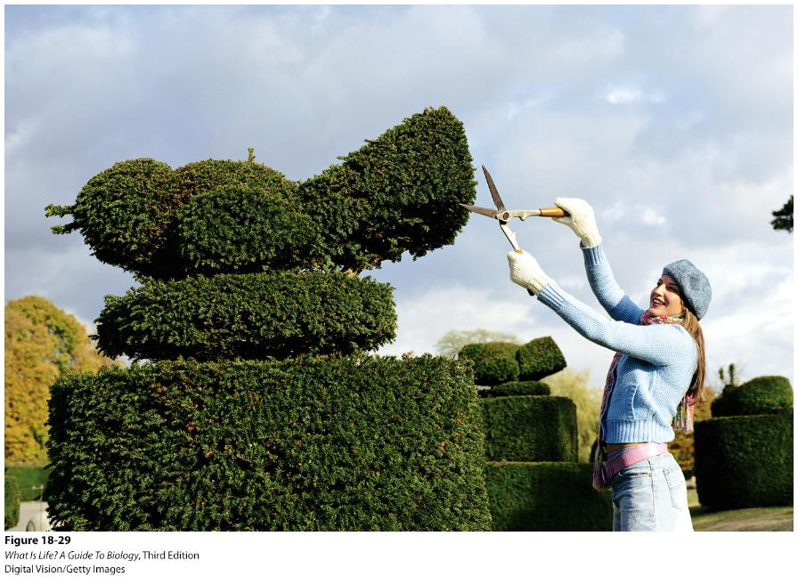

Slide 10
Growth – occurs from areas called ____
Two types of growth:
1. _________ Growth
- increase in length
– apical meristems involved
2. _________ Growth
- increase in width
- _________ involved

Slide 11
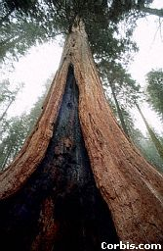
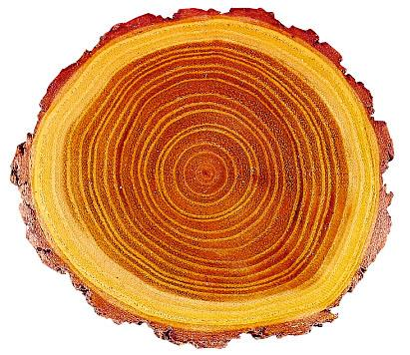
Cross section of a tree
Secondary growth
Wood is an amazing structure. Secondary growth makes wood and causes epidermis to be replaced by woody cork
Tree rings can reveal the age of the tree—in the number of growth rings that are observed

Slide 12
How does secondary growth occur?

Slide 13
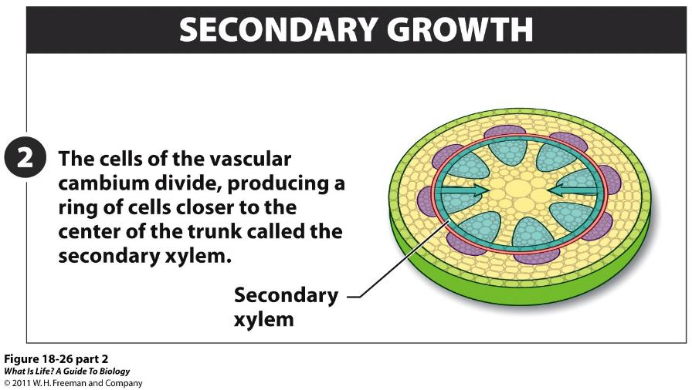
Notes:
FIGURE 18-26 (part 2) Becoming thicker and sturdier: secondary growth.

Slide 14
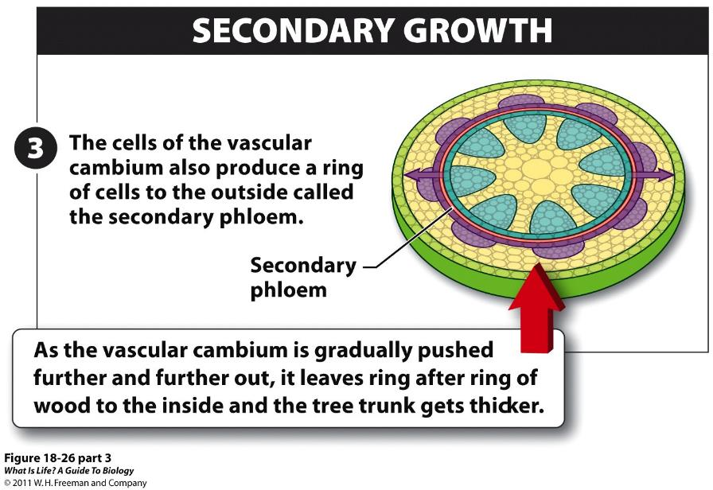
Notes:
FIGURE 18-26 (part 3) Becoming thicker and sturdier: secondary growth.

Slide 15
Notes:
FIGURE 18-27 (part 1) Cross section of a tree trunk. Most of the cells are secondary xylem, also known as wood, and are dead. Secondary growth occurs in a ring called the vascular cambium, a lateral meristem, which produces new xylem on the inside and new phloem to the outside.

Slide 16
A log contains layers of xylem after several years growth
Sapwood
(young xylem)
Heartwood
(old, clogged xylem)

Slide 17
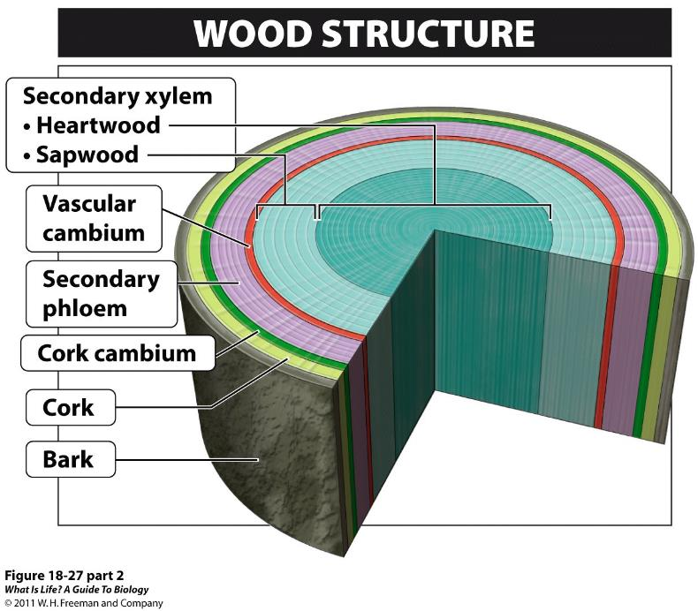
http://bcs.whfreeman.com/thelifewire/content/chp35/35020.html
Notes:
FIGURE 18-27 (part 2) Cross section of a tree trunk. Most of the cells are secondary xylem, also known as wood, and are dead. Secondary growth occurs in a ring called the vascular cambium, a lateral meristem, which produces new xylem on the inside and new phloem to the outside.

Slide 18
Lateral Meristems
Vascular Cambium produces secondary xylem (wood) & secondary phloem (inner bark)
2) Cork Cambium produces cork (outer bark)

Slide 19
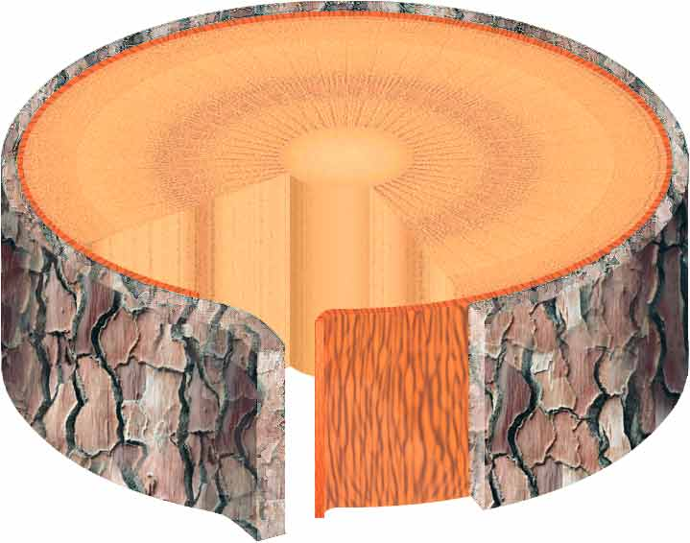
Tree rings show the tree’s age… but how?
year 1
2
3
bark
VASCULAR CAMBIUM

Slide 20
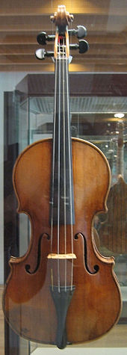
This is the Antonio Stradivari violin of 1703 at the museum in Berlin. It is made of mostly wood. After learning secondary growth you know that “wood” really means _______
A. Primary phloem
B. Cork
C. Epidermis
D. Secondary xylem
E. All of the above
Notes:
Ans: D

Slide 21
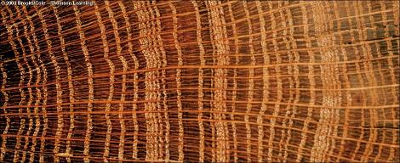
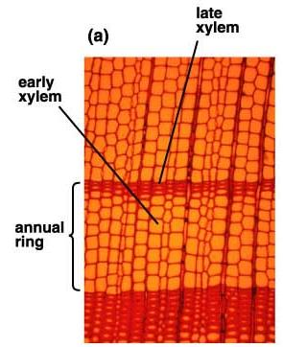
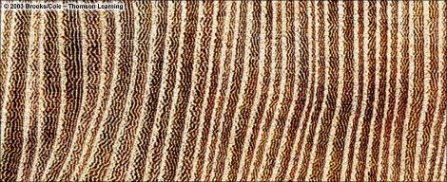
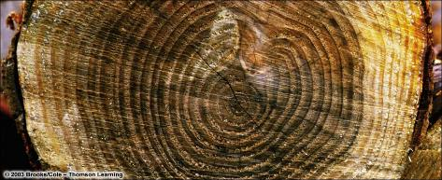
Oak
Elm
Pine
Do not post on Internet

Slide 22
Tree rings are ____
A. Alternating layers of xylem and phloem are made each year.
B. Size of xylem tubes varies in spring and summer
C. Each year a layer of dirt and bark is trapped under new wood.
D. Dead phloem shows up as a visible line.
Notes:
Ans: B

Slide 23
Visible scar
Which year is there a visible scar on the tree core?
1980
1981
1982
1983
Notes:
Ans: 1982

Slide 24
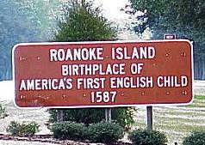
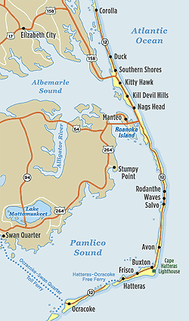
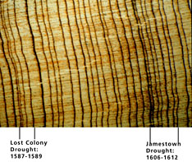

Slide 25
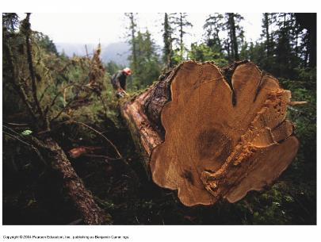
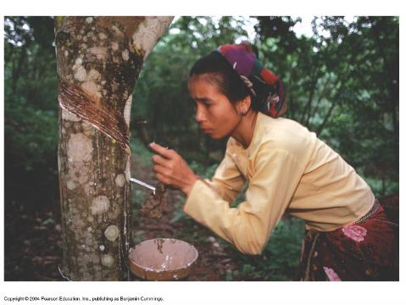
Humans and secondary plant growth
Notes:
Timber. Houses, buildings, ships, firewood, fuel etc

Slide 26
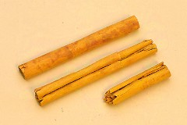
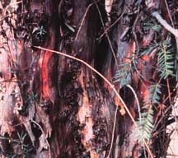
Uses of Bark
Bark of Cinnamon (Cinnamomum verum) : Spice used in cooking, herbal remedy, toothpaste
Taxus brevifolia (Pacific Yew) – Taxol: 1991 - 60,000 lbs. of the dried bark yields about 9 lbs. of taxol drug (12,000 trees)

Slide 27
Girdling (surface scraping) a tree often kills it because___.
A. water transport has been interrupted.
B. food transport has been interrupted.
Notes:
Ans: B

Slide 28
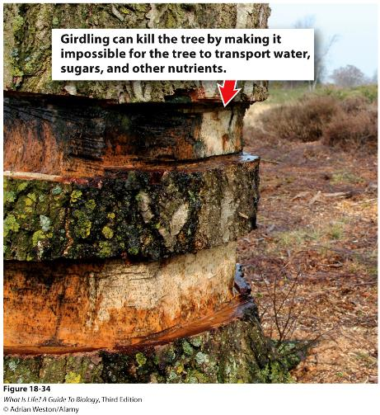
Actions That Damage the Bark of the Tree’s Circumference Are Called “Girdling”
If a thin strip of bark is cut, then only the phloem’s transport will be interfered with.
Notes:
Figure 18-34 Girdling a tree can kill it.

