Slide 1
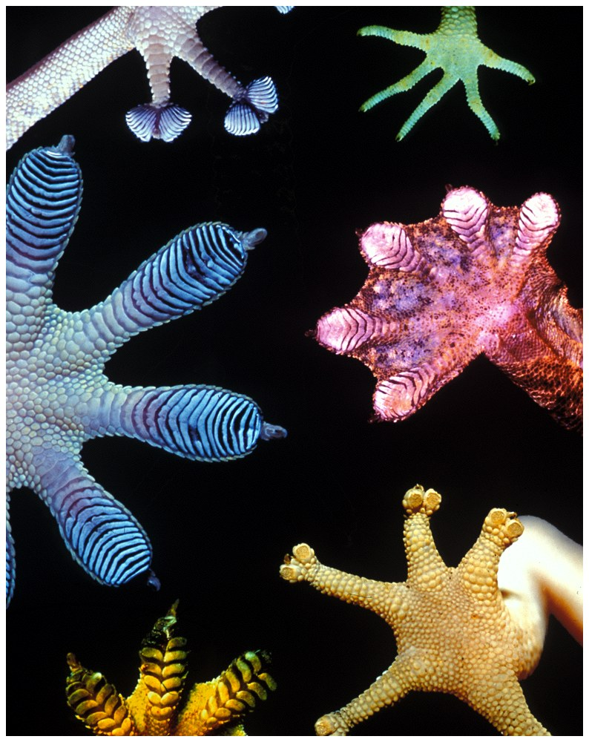
Chapter 12: The Origin and Diversification of Life on Earth
Learning Objectives
Know about:
Basis of classification of life on earth
Know about:
Evolutionary trees;
  what do we learn from them?
Notes:
The earliest life forms that we have evidence of are fossilized bacteria-like cells found in rocks that are 3.4 billion years old. From that initial point at earth’s formation, there now is tremendous biodiversity, the variety and variability among all genes, species, and ecosystems, on the planet.
how we name groups of organisms, what is used to classify organisms, and determine the relatedness of those groups to each another

Slide 2
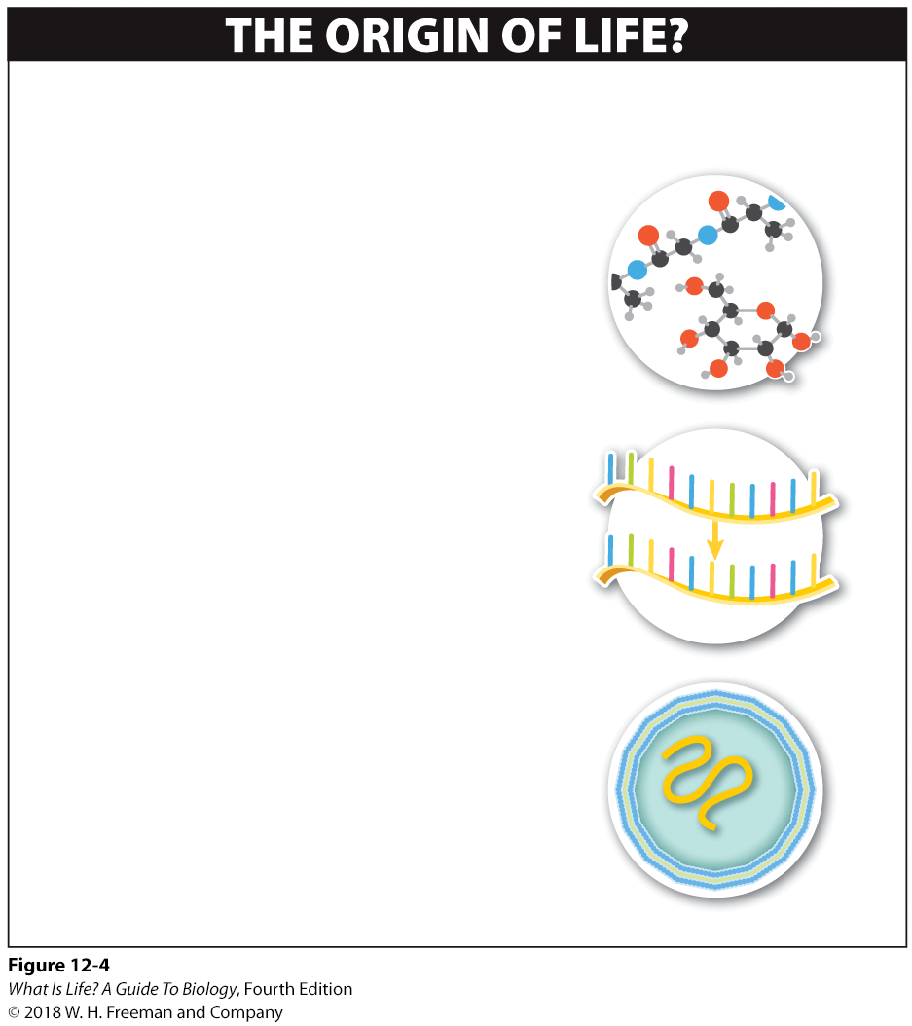
How did life arise?
How did the first organisms on earth arise? Most scientists believe that life originated on earth, probably in several distinct phases.
1
Formation of small molecules containing carbon and hydrogen
2
Formation of self-replicating, information-containing molecules
3
Development of a membrane
Notes:
Some evidence suggests that the first cells may simply have formed spontaneously. Specifically, researchers have found that mixtures of phospholipids placed in water or salt solutions tend to spontaneously form small spherical units that resemble living cells. These units may even “sprout” new buds at their surface, appearing to divide.
Because these cell-like units don’t have any genetic material, however, they cannot be considered to be alive. But if, at some point, units like these incorporated some self-replicating molecules inside, maybe by forming around them, such microspheres might have been important in the third phase in the generation of life from non-life: the compartmentalization of self-replicating, information-containing molecules into cells. If this did occur, the final step in the creation of something from nothing would be complete (Figure 12-4).
The exact process by which life on earth originated is still uncertain, and research continues. What is clear, however, is that life now abounds in great diversity.

Slide 3
12.5 How do we name species?
Organizational system required
Carolus Linnaeus, mid-1700s
Two parts to the scientific name for a species:
  Genus (Homo ______)
  Specific epithet (______ sapiens)
    “Homo sapiens”
  Capitalization and italics are important elements of the Linnaean system.
Notes:
Keeping track of a large group of anything requires an organizational system. To keep track of earth’s rich diversity, biologists use the system developed by the Swedish biologist Carolus Linnaeus in the mid-1700s.
Here’s how it works:
Every species is given a scientific name that consists of two parts, a genus (pl. genera) and a specific epithet.
Linnaeus named humans Homo sapiens, meaning “wise man.” Homo is the genus and sapiens is the specific epithet, and Homo sapiens is the species name.
The genus is capitalized, and both genus and specific epithet are italicized. The redwood tree has the name Sequoia sempervirens.
3

Slide 4
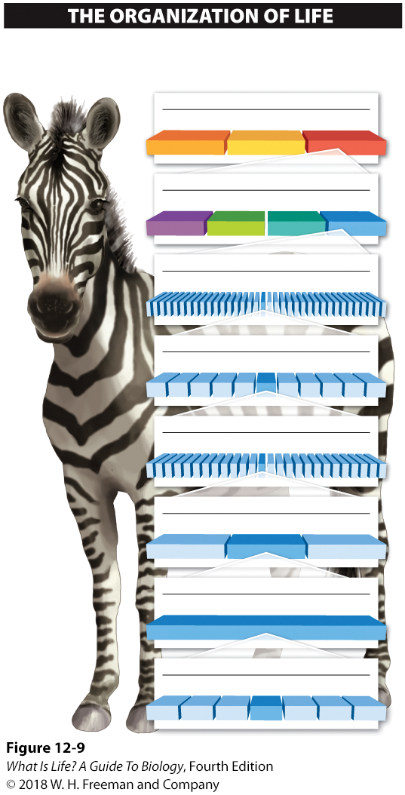
Name that zebra!
Each species on earth, like Equus quagga, is given a scientific name and is categorized according to hierarchical groups.
DOMAIN
Bacteria
Archaea
Eukarya
KINGDOM
Protista
Plantae
Fungi
Animalia
Linnaean system is hierarchical.
Highest order is domain:
  bacteria
  archaea
  eukarya
PHYLUM
Chordata
CLASS
Mammalia
ORDER
Perissodactyla
FAMILY
Equidae
GENUS
Equus
SPECIES
Equus quagga
Notes:
The strength of Linnaeus’s system is that it is hierarchical—that is, each element of the system falls under a single element in the level just above it. The narrowest classification in the Linnaean system is the species. The name for every species within a genus is unique, but many different species may be in the same genus. Similarly, many genera are grouped within a family. And many families are grouped within an order. Orders are grouped within a class. Classes are grouped within a phylum. And, as Linnaeus originally set it up, all phyla were classified under one of three kingdoms: the animal kingdom, the plant kingdom, or the “mineral kingdom.”
Today, many of the species classifications that Linnaeus described have been revised. Some of his designations, such as the “mineral kingdom,” are now left out, while two other kingdoms (fungi and protists) have been added. Also, all of the kingdoms are now classified under an even higher order of classification, the domain. But Linnaeus’s basic hierarchical structure remains, and all life on earth is still named using this system, with all organisms belonging to one of the three domains: the bacteria, the archaea, and the eukarya.
4

Slide 5

12.8 The history of life can be imagined as a tree.
Systematics – classifies species based on common ancestry
Phylogeny – the evolutionary history of organisms
Notes:
Although Carolus Linnaeus’s method for naming species was an important step in categorizing and cataloguing earth’s biodiversity, his classification of organisms into hierarchical groups was based on nothing more than his own evaluation of how physically similar various organisms appeared.
A hundred years later, however, Charles Darwin proposed and documented that species could change and give rise to new species. With Darwin, the classification of species acquired a new goal and a more important function. In The Origin of Species Darwin wrote: “Our classifications will come to be, as far as they can be so made, genealogies.” With these words, Darwin was the first to link classification with evolution.
The modern incarnation of Darwin’s vision of classification is called systematics and has the broader goal of reconstructing the phylogeny, or evolutionary history, of organisms. That is, through systematics, all species—even extinct species—are named and arranged in a manner that indicates the common ancestors they share and the points at which the species diverged. A complete phylogeny of all organisms is like a family tree for all species, past and present.

Slide 6
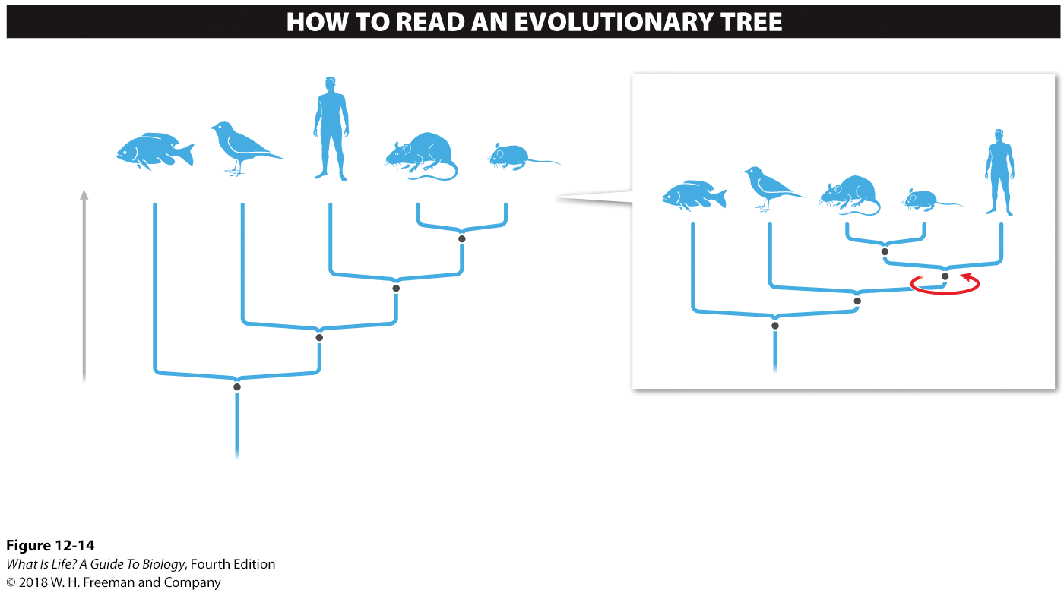

Phylogenetic (Evolutionary) Trees
Phylogenies are hypotheses, which are subject to revision.
Evolutionary trees reveal the evolutionary history of species and the sequence of speciation events that gave rise to them.
The branches of an evolutionary tree can be spun around the point at which they split and still remain accurate.
Fish
Bird
Human
Rat
Mouse
Fish
Bird
Human
Rat
Mouse
Common ancestor of mice and rats
Time
Common ancestor of mice, rats, and humans
Common ancestor of mice, rats, humans, and birds
Common ancestor of mice, rats, humans, birds, and fish
Evolutionary trees do not show which groups are more primitive or advanced, just which groups are more closely related to which other groups.
At this point, a speciation event occurred and the ancestral species split into two species.
Notes:
A phylogenetic tree not only shows the relationships among organisms but also presents a hypothesis about evolutionary history (Figure 12-14). At the beginning of life on earth there was the first living organism, one that could replicate itself. Then a speciation event occurred, after which the population of the first living organism split into independent evolutionary lineages. The phylogenetic tree had its first branch, and there was biodiversity. Over hundreds of millions of years, speciation events continued to occur, and today the tree has branches with millions of tips that represent all the species on earth. Moving up a branch of any evolutionary tree from its trunk toward its tips, we can see when groups split, with each branching point representing a speciation event.
It is important to remember that because phylogenies are hypotheses they are subject to revision and modification. In the next section, we explore how phylogenetic trees are constructed and look at the rich information they convey about the history of life on earth. We also investigate the modern methods of molecular systematics and see how, with new molecular and DNA evidence, biologists are revising many earlier phylogenies that were based on organisms’ physical features.
6

Slide 7
Take Home Message 12.8
The history of life can be visualized as a tree; by tracing from the branches back toward the trunk, we can follow the pathway back from descendants to their ancestors.
The tree reveals the evolutionary history of all species and the sequence of speciation events that gave rise to them.
Notes:
7

Slide 8
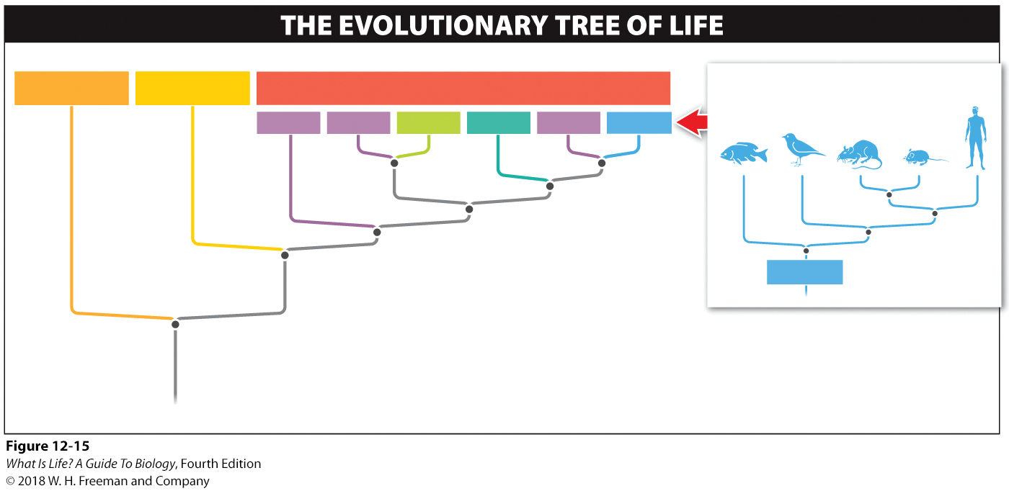
12.9 Evolutionary trees show ancestor-descendant relationships.
Branches on evolutionary trees can be spun around the nodes at which they split and still be accurate.
BACTERIA
ARCHAEA
EUKARYA
In this example, the restriction enzyme recognizes the sequence ATCGAT and cuts between the first A and T.
Protists
Protists
Plants
Fungi
Protists
Animals
Animals
Common ancestor of all life on earth
An evolutionary tree with a branch for each of the millions of species on earth would be incredibly complex.
Notes:
Many human traditions have a sacred Tree of Life. The bodhi tree that the Buddha sat beneath for seven years to achieve the ultimate truth is the Tree of Enlightenment; the apple tree in the Garden of Eden is the Tree of Knowledge. The history of the relationship between all organisms that constitute life on earth is another Tree of Life.
The trunk and branches of an evolutionary tree represent ancestor-descendant relationships that link living organisms with all life that has ever existed on earth. The evolutionary tree of life can be thought of as one giant tree, but as a practical matter, biologists often study only particular branches. These branches can be illustrated as big trees or little trees and can be expanded to include whatever organisms the biologist is studying: the tree might, for example, include all animals or just the rodents.
In evolutionary trees, it does not matter on which side of the tree you put a particular group of organisms. Any branches can be spun around the nodes at which they split. This pinwheel effect means that you cannot assume that rats are more evolutionarily advanced than mice, or vice versa. They are equally advanced in the sense that both groups derived from the same speciation event.
Evolutionary trees do not tell us which groups are most “primitive” and which are most “advanced.” This property of phylogenetic trees can serve to undermine some of our most sacred beliefs, such as the one that humans are the pinnacle of evolution. Many trees can be drawn to support this idea. But notice that if you rotate a part of this tree around any one of its nodes, you can get a number of different trees.
What trees do tell us is which groups are most closely related to which other groups. One of the most interesting revelations of “tree thinking” is that—despite appearances—fungi, such as mushrooms, yeasts, and molds, are more closely related to animals than to plants.
8

Slide 9
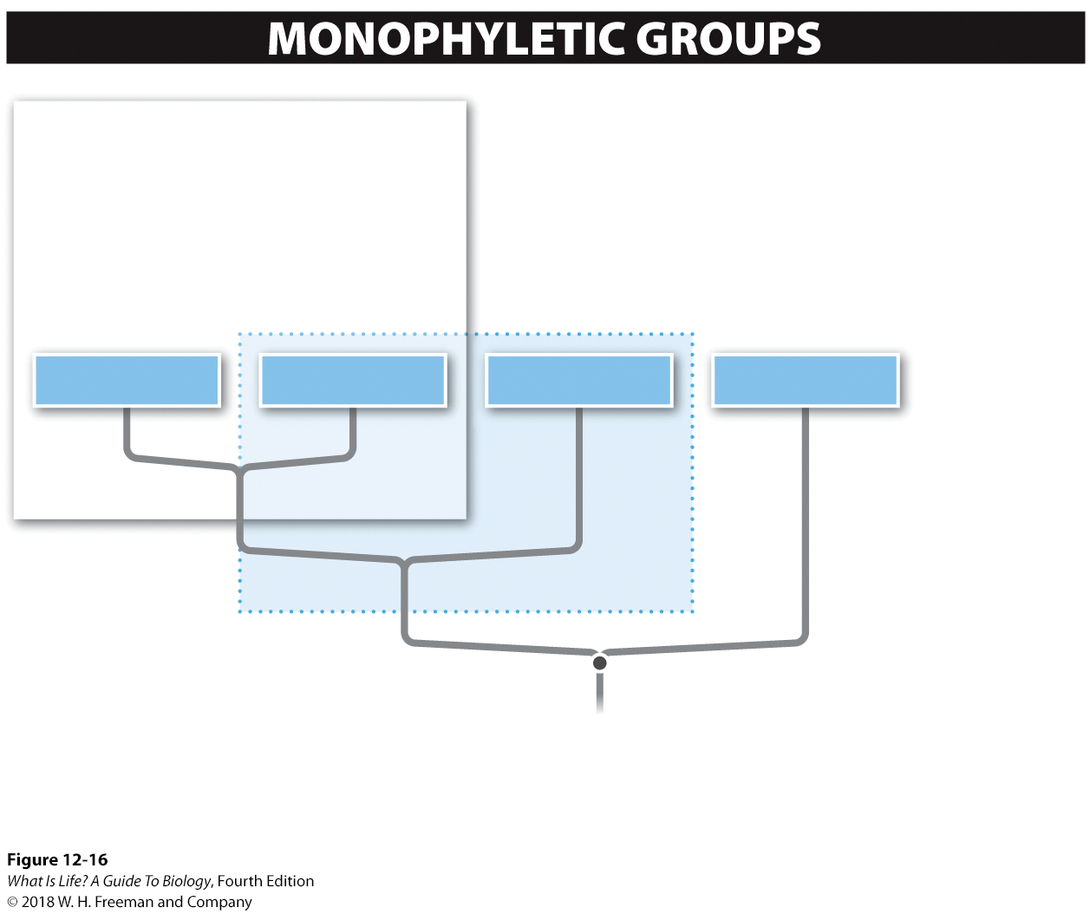
Defining Monophyletic Groups
MONOPHYLETIC GROUP
Members of a monophyletic group share a common ancestor, and the group contains all of the descendants of that ancestor.
Lizards and crocodiles together do not make a monophyletic group: although they share a common ancestor, some descendants of that ancestor are in another group (the birds).
Birds
Crocodiles
Lizards
Mammals
A
B
Members of a monophyletic group are more closely related to each other than to any individuals outside that group.
Notes:
Biologists use the term monophyletic to describe any group in which all of the individuals are more closely related to each other than to any individuals outside that group. Monophyletic groups are determined by looking at the nodes of the trees.
For example, birds and crocodiles, taken together, compose a monophyletic group because they share a more recent common ancestor (designated by node A in Figure 12-16) than either group shares with lizards or mammals.
Lizards and crocodiles, taken together, do not compose a monophyletic group, because their common ancestor (at node B) is also shared by birds. But birds, crocodiles, and lizards, all taken together, do compose a monophyletic group, by virtue of all three sharing the common ancestor at node B. Similarly, birds, crocodiles, lizards, and mammals also compose a monophyletic group.

Slide 10
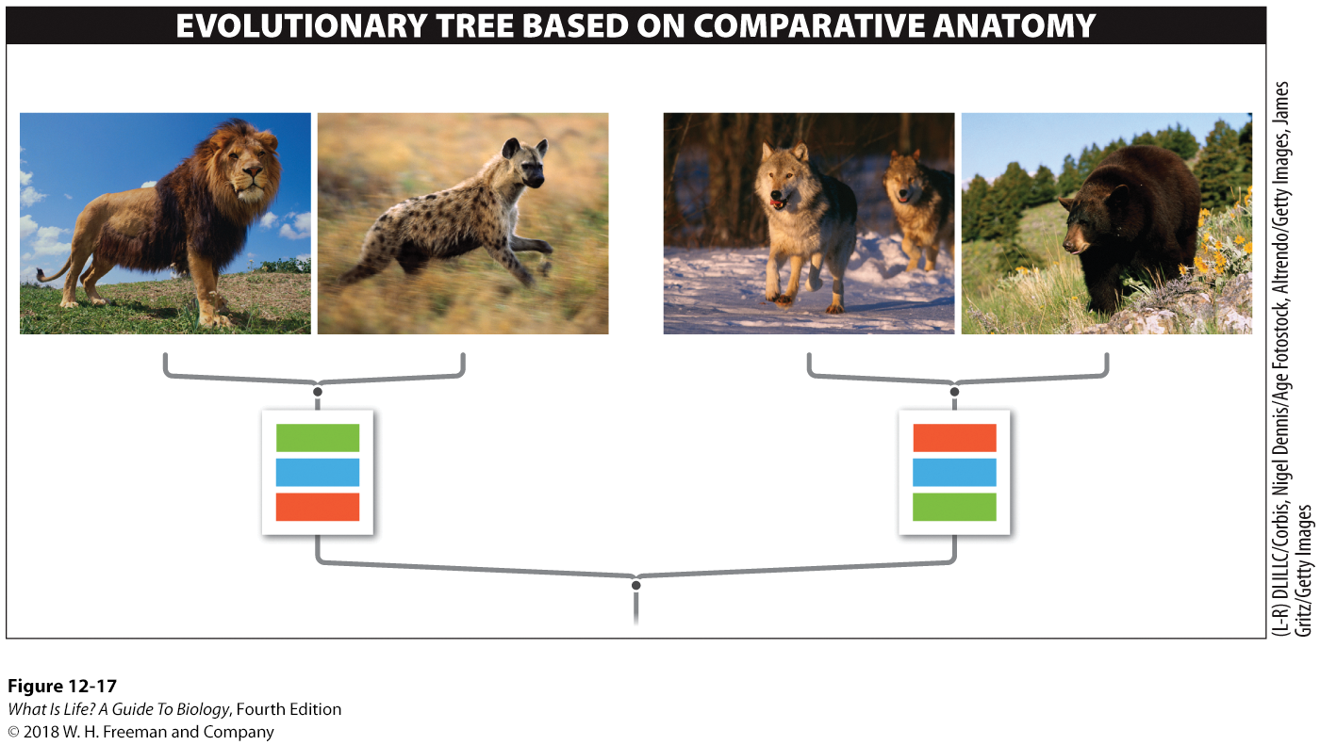
Constructing Evolutionary Trees Using Comparative Anatomy
Before DNA sequencing became available, physical features of species were used to determine evolutionary relatedness.
African lion
Spotted hyena
Gray wolf
Black bear
YES
Possess retractable claws?
NO
2
Number of chambers in the ear bone
1
NO
Does the penis have a bone?
YES
By comparing the physical features of the species shown above, we can construct an evolutionary tree.
Notes:
Reading an evolutionary tree reveals which groups are most closely related and approximately how long ago they shared a common ancestor. But how are evolutionary trees—which might hypothesize historical events such as the cat-dog split that happened 60 million years ago—constructed in the first place?
Until recently, these trees were assembled by looking carefully at numerous physical features, or traits, of species and generating tables that compared these features across the species.
Figure 12-17 is a simple example of such a table, showing a clear split between the characteristics of the lion and the hyena, on the one hand, and those of the wolf and the bear, on the other. For most of the 20th century, biologists classifying organisms would often use 50 or more traits to generate a tree.
10

Slide 11
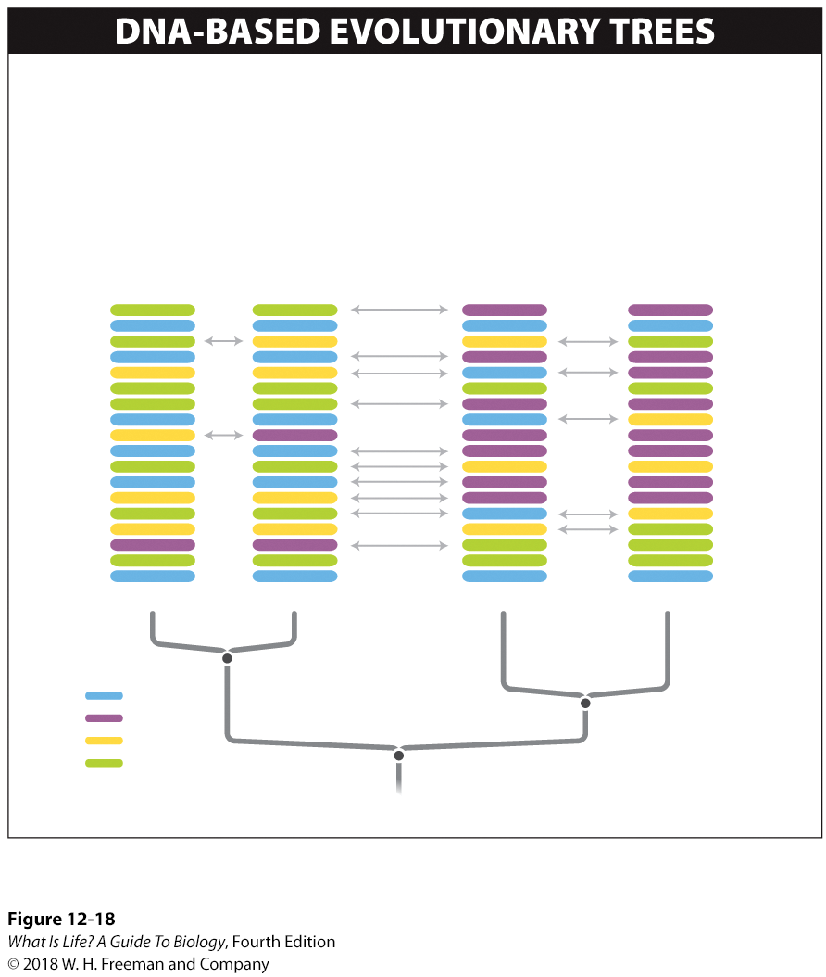
Comparing DNA Sequences to Create Evolutionary Trees
By comparing how similar the DNA sequences are between two groups, we can estimate how long it has been since they shared a common ancestor.
Species 1 and 2 are more similar to each other than they are to either species 3 or 4. This is because they probably share a more recent common ancestor.
Difference in DNA base pairs
Species 1
Species 2
Species 3
Species 4
A
T
C
G
The more similar their DNA sequences, the more closely two species are related.
Notes:
Beginning in the 1980s, biologists began using molecular sequences rather than physical traits to generate evolutionary trees. The rationale for this approach is that organisms inherit DNA from their ancestors and so as species diverge, their DNA sequences also diverge, becoming increasingly different. As more time that passes following the splitting of one species into two, the differences in their DNA sequences becomes greater. By comparing how similar the DNA sequences are between two groups, it is possible to estimate how long it has been since they shared a common ancestor.
In theory, using DNA sequences to construct evolutionary trees is not really different from using physical traits. Each DNA base pair can be thought of as a “trait,” and many, many more such “traits” can be compared.
Although most evolutionary trees are now produced by using molecular sequence comparisons, when it comes to actually naming species we still use Linnaeus’s system, assigning a species name and fitting the new species within the other categories such as kingdom, class, and family. This can be difficult, because there is no objective way to assign groups above the level of species—for example, deciding whether multiple genera should be grouped in the same or different families, or whether multiple families should be grouped in the same or different orders.
11

Slide 12
Below are genetic sequences for a gene found in four different species. Species ___ and species ____ are the most closely related
Species A: AGT-CTA-CTT-ACT-ATC-CTA
Species B: AGT-CTA-CTT-ACC-ATC-CTA
Species C: AGT-AAA-CTT-ACC-ATC-CTA
Species D: AGA-CTA-TTT-ACC-ATG-CTA
Food for thought ……
Notes:
12

Slide 13
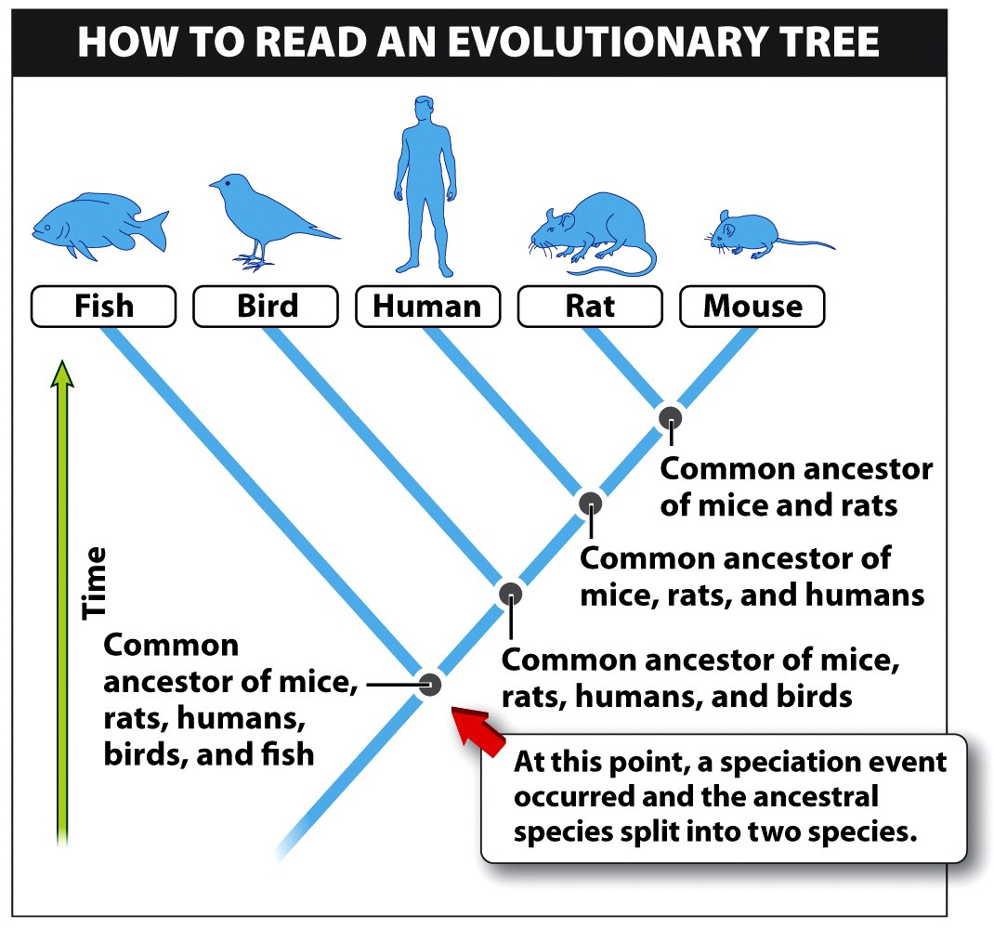
Are birds more closely related to fish or to mice?
Notes:
Look at the time line. The base of the tree is the past and the tips of the branches are the recent or present times. If species have a common ancestor higher up the trime line then they have a more recent common ancestor and they would be closely related
Evolutionary trees tell us which groups are most closely related to which other groups. Birds share a more recent common ancestor with the mice than with the fish and therefore the birds are closely related to mice and not to ish

Slide 14
Are humans more advanced, evolutionarily, than Fish? Are humans more advanced, evolutionarily than mice?
Notes:
Evolutionary trees tell us many things, but one thing they do not tell us is which groups are most “primitive” and which are most “advanced.” This property of phylogenetic trees can serve to undermine some of our most sacred beliefs, such as the one that humans are the pinnacle of evolution. Many trees can be drawn to support this idea, including Figure 10-14. But notice that if you rotate this tree around any one of its nodes, you can get a number of different trees.

Slide 15
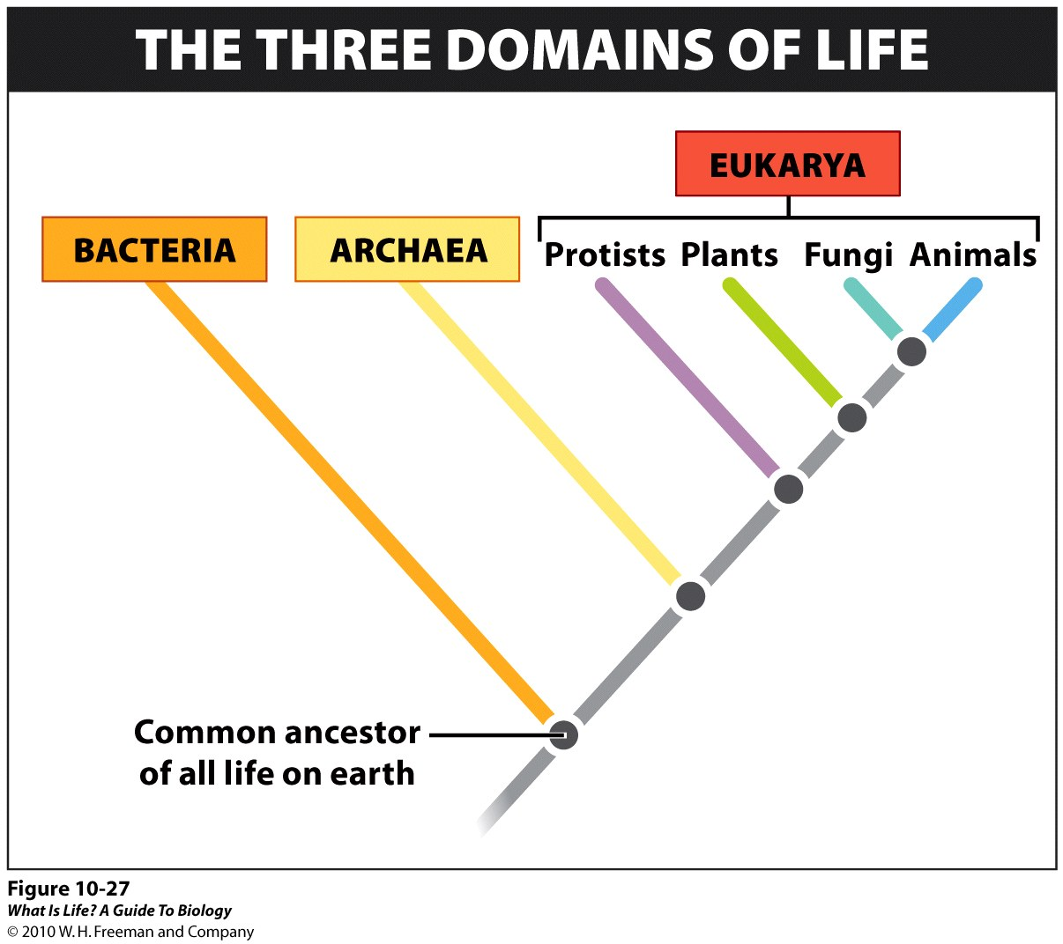
At present, there are 4 groups under Eukarya. But if there were only two groups (namely plants and animals) under Eukarya, which group would you place fungi (use the phylogenetic tree shown, to help answer)
Plants
Animals
Notes:
Ans: B

Slide 16
Take Home Message 12.9
Evolutionary trees constructed by biologists are hypotheses about the ancestor-descendant relationships among species.
The trees represent an attempt to describe which groups are most closely related to which other groups.

Slide 17
Five-Kingdom System of Classification
1960s: five-kingdom system is devised
Classifications based on appearance
Prokaryotes
  One kingdom
Eukaryotes
  Four kingdoms
Five-kingdom system discarded in the 1970s–1980s
Notes:
The two-kingdom system gave way in the 1960s to a five-kingdom system. At its core, the new system was a division based on the distinction between prokaryotic cells (those without nuclei) and eukaryotic cells (those with nuclei).
The prokaryotes were put in one kingdom, in which the only residents were the bacteria: single-celled organisms with no nucleus, no organelles, and genetic material in the form of a circular strand of DNA.
The eukaryotes—having a nucleus, compartmentalized organelles, and individual, linear pieces of DNA—were divided into four separate kingdoms: plants, animals, fungi, and protists.
In the 1970s and 1980s, the five-kingdom system was discarded. Until that point, organisms had been classified primarily based on their appearance. But because the ultimate goal of classification had changed to reconstructing phylogenetic trees that reflected the evolutionary history of earth’s diversity, Carl Woese, an American biologist, and his colleagues began classifying organisms by their nucleotide sequences.
17

Slide 18
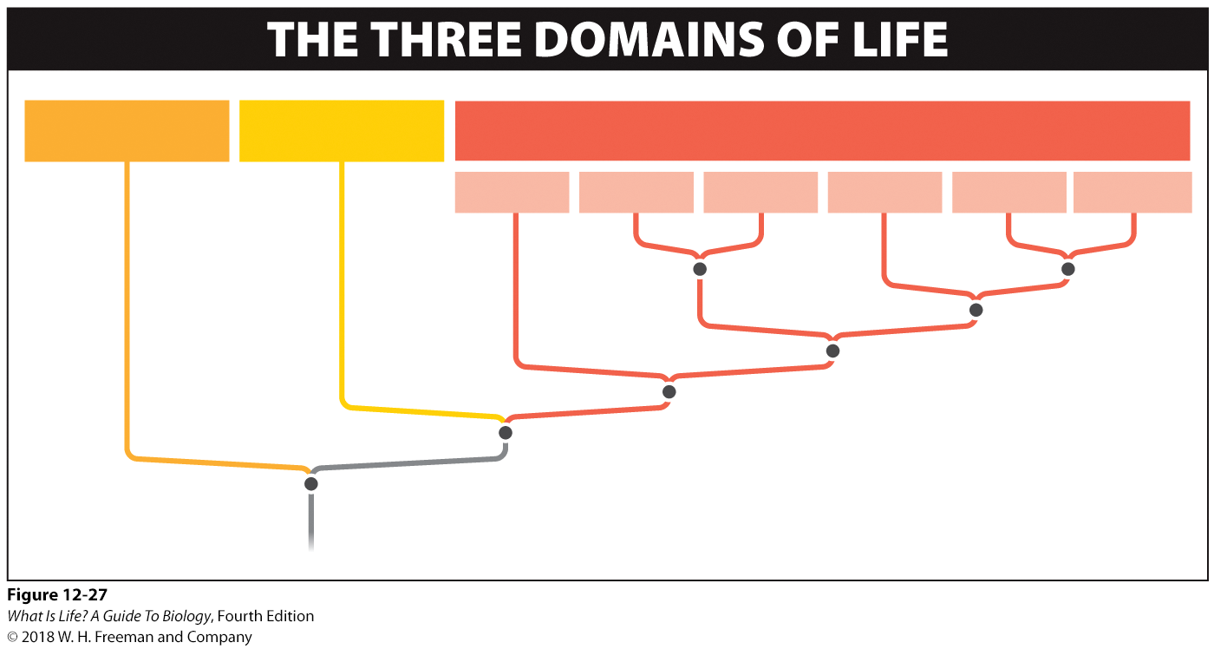
Woese’s Approach to Classification
Carl Woese and colleagues examined nucleotide sequences in ribosomal RNA
They discovered that microbes were quite diverse.
  A “new” prokaryote (archaea) was discovered.
  They are more closely related to eukarya than bacteria.
BACTERIA
ARCHAEA
EUKARYA
Protists
Protists
Plants
Fungi
Protists
Animals
Common ancestor of all life on earth
Notes:
Carl Woese assumed that the more similar the genetic sequences were between two species, the more closely related they were, and he built phylogenetic trees accordingly. The only way Woese could compare the evolutionary relatedness of all the organisms present on earth today was by examining one molecule that was found in all living organisms and looking at the degree to which it
differed from species to species. That molecule is ribosomal RNA. Ribosomal RNA helps translate genes into proteins (see Chapter 6), and it carries out this function in all organisms on earth, almost certainly because it comes from a common ancestor.
Over time, however, its genetic sequence (i.e., the DNA that codes for the RNA) has changed a bit. Tracking these changes makes it possible to reconstruct the process of diversification and change that has taken place.
The genetic sequence data gathered by Woese and colleagues generated some surprising evolutionary trees. First and foremost, the biggest division in the diversity of life on earth was not between plants and animals or between prokaryotes and eukaryotes. The new trees revealed instead that the diversity among microbes was much, much greater than ever imagined.
In fact, a completely new group of prokaryotes was identified. Called archaea, they thrive in some of the most extreme environments on earth and differ greatly from bacteria. The tree of life was revised to show three primary branches, called domains: the bacteria, the archaea, and the eukarya (Figure 12-27). The domain names are often capitalized: Bacteria, Archaea, and Eukarya.
In Woese’s new system, which is the most widely accepted classification scheme today, the domains are above the kingdom level in the Linnaean system. The bacteria and archaea domains each have one kingdom and the eukarya domain has four.
Because both bacteria and archaea are microscopic, it can be hard to believe that the two domains are as different from each other as either domain is from the eukarya. However, each of the three domains is monophyletic, meaning that each contains species that share a common ancestor and includes all descendants of that ancestor. Close inspection even reveals that the archaea are more closely related to the eukarya than to the bacteria.
18

Slide 19
Woese’s Approach Is Imperfect
Protists are not a monophyletic group.
Bacteria sometimes engage in horizontal gene transfer.
  Passing genes between species
Viruses are not included in the tree of life.
  Lack independent metabolism
Notes:
The three-domain, six-kingdom approach is not perfect and is still subject to revision. For example, within the eukarya, the kingdom of single-celled protists has turned out to be much more diverse than initially thought, and protists are not a monophyletic group.
Increasingly, scientists recognize that the protists should be split into multiple kingdoms. Another problem is that bacteria sometimes engage in horizontal gene transfer, which means that, rather than passing genes simply from “parent” to “offspring,” they transfer genetic material directly into another species. This process complicates attempts to determine phylogenies based on sequence data, because it creates situations in which two organisms might have a similar genetic sequence, not because they share a common ancestor, but as a result of a direct transfer of the sequence from one species to another.
Additionally, a fourth group of incredibly diverse and important biological entities, the viruses, is not even included in the tree of life, because they are not considered to be living organisms. Viruses can replicate, but they can have metabolic activity only by taking over the metabolic processes of another organism. Their lack of metabolic activity puts viruses just outside the definition of life that we use in this book, but some scientists do view viruses as living.

Slide 20
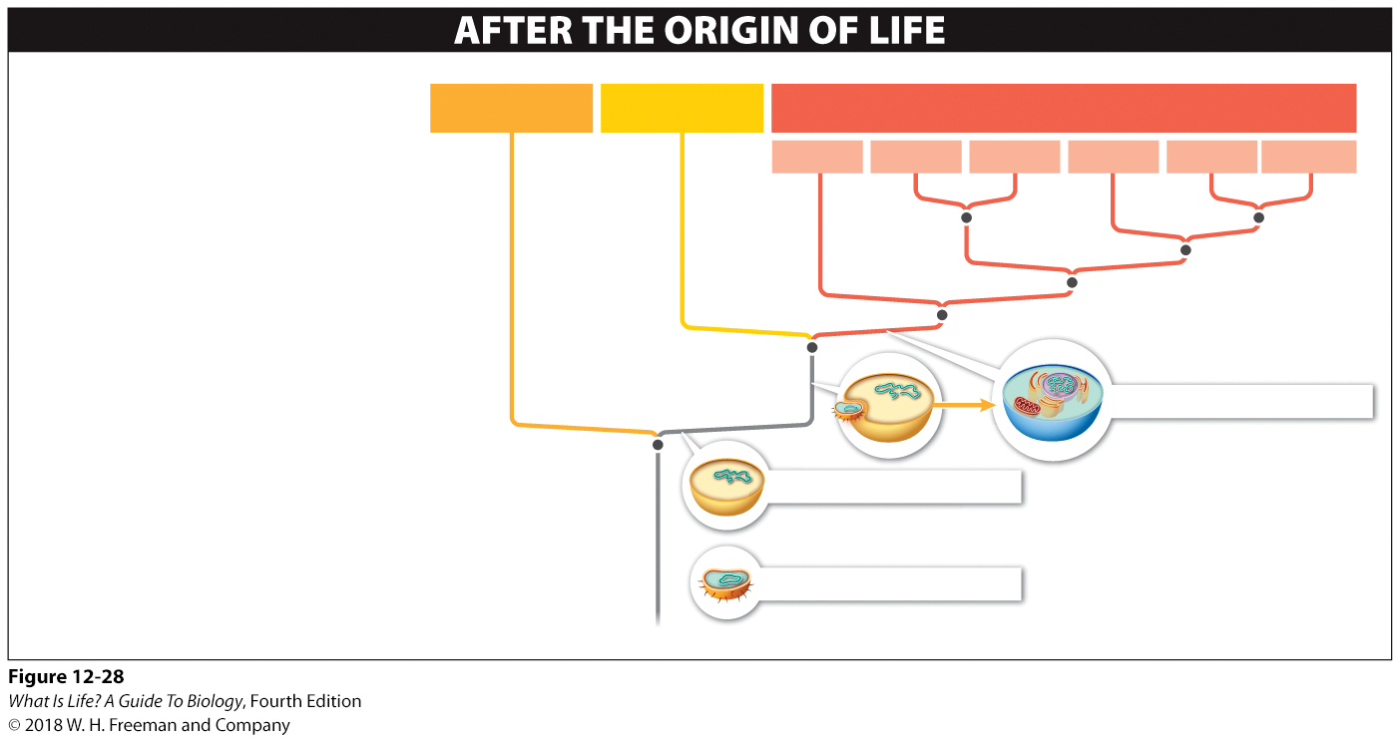
Origin of Life
The most commonly accepted tree of life suggests that after the origin of life, the following sequence of events occurred.
BACTERIA
ARCHAEA
EUKARYA
Protists
Protists
Plants
Fungi
Protists
Animals
1
The bacteria arose from the first self-replicating, metabolizing cells.
3
2
There was a split between the bacteria and a line that gave rise to the archaea and eukarya.
Ancestral eukaryote
2
The fusion of a bacterium and an archaeon-like prokaryote gave rise to the eukarya, which then split from the archaea line.
Ancestral archaeon
3
Ancestral bacterium
1
Notes:
The most commonly accepted tree of life suggests that after the origin of life the following sequence of events occurred:
1) The bacteria arose from the first self-replicating, metabolizing cells.
2) There was a split between the bacteria and a line that gave rise to the archaea and eukarya.
3) The fusion of a bacterium and an archaean-like prokaryote gave rise to the eukarya, which then split from the archaea line.
20

Slide 21
Take Home Message 12.15
All life on earth can be divided into three domains—bacteria, archaea, and eukarya—which reflect species’ evolutionary relatedness to each other.
Plants and animals are just two of the four kingdoms in the eukarya domain, encompassing only a small fraction of the domain’s diversity.
Notes:
21

Slide 22
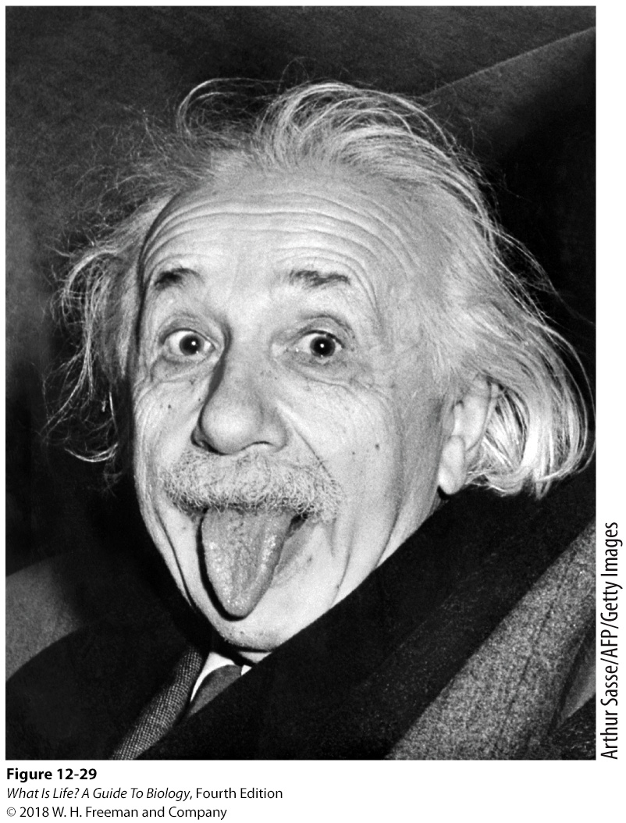
12.16 The bacteria domain has tremendous biological diversity.
Notes:
Morning breath is stinky. You see, when you wake up, your mouth contains huge amounts of bacterial waste products. Bad breath can give us a glimpse into just how diverse and resourceful bacteria are.
At any given time, there are several hundred species of bacteria in your mouth—mostly on your tongue—all competing for resources (Figure 12-29). Some of the bacteria are aerobic, requiring oxygen for their metabolism, and others are anaerobic. At night, the flow of saliva slows down and the oxygen content of your mouth decreases, so that anaerobic bacteria rapidly grow and reproduce. These bacteria metabolize food bits in your mouth, plaque on your teeth and gums, and dead cells from the lining of your mouth. Because proteins are made from amino acids, some of which contain the smelly chemical sulfur, their breakdown leads to the odor in the accumulating waste products.
Once you wake up, you breathe more and produce more saliva, both of which increase the oxygen level in your mouth, making the environment favorable for aerobic bacteria. Because aerobic bacteria prefer carbohydrates as their energy source, and because carbohydrates don’t contain sulfur, the sulfur smell goes away as the aerobic bacteria start to outcompete the anaerobic bacteria.
22

Slide 23
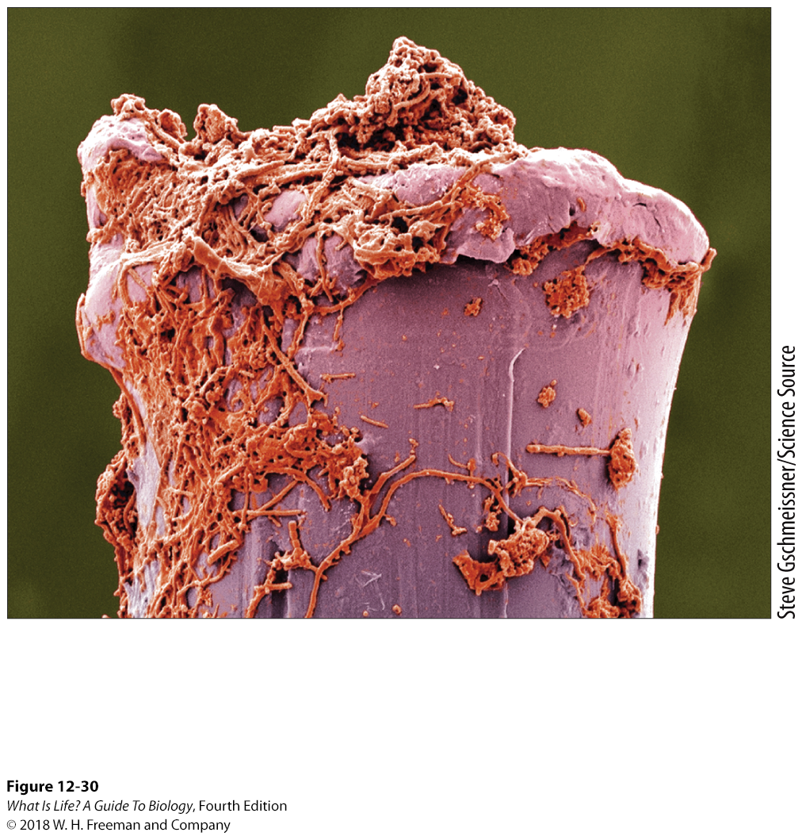
Bacteria
Monophyletic group
Single-celled prokaryotes
Asexual reproduction
Classified by physical appearance or genetic sequence
Some cause disease
Some are essential to our lives
Bacteria—shown here on a toothbrush bristle—thrive in a huge range of habitats and have a biomass greater than that of all the plants and animals on earth.
Notes:
On a small scale, your mouth reveals some of the tremendous biological versatility of the bacteria: hundreds of species can live in a tiny area—a teaspoon of soil, for example, is home to more than a billion bacteria—they can thrive in
a variety of unexpected habitats, they can utilize a variety of food sources, and they can survive and thrive with or without oxygen.
By any measure, this is their planet: the biomass of bacteria (if they were all collected, dried out, and weighed) exceeds that of all the plants and animals on earth (Figure 12-30).
While the various species differ in many ways, the bacteria are a monophyletic group, sharing a common ancestor. For this reason, they all have a few features in common. All bacteria are single-celled organisms with no nucleus or organelles, with one or more circular molecules of DNA as their genetic material, and using several methods of exchanging genetic information. Because they are asexual—they reproduce without a partner, just by dividing—the biological species concept cannot be applied to bacteria. As a consequence, bacteria are classified on the basis of physical appearance or, preferably, genetic sequences.
Although bacteria are responsible for many diseases, including strep throat, pneumonia, anthrax, leprosy, and tuberculosis, disease-causing bacteria are only a small fraction of the domain.
Bacteria are essential to our lives. Bacteria (E. coli) living in your gut help your body digest the food you eat and, in the process, make certain vitamins your body needs. Other bacteria produce antibiotics such as streptomycin.
Still others live symbiotically with plants as small fertilizer factories, converting nitrogen into a form that is usable by the plant.
Bacteria also give taste to many foods, from sour cream to cheese, yogurt, and sourdough bread. Increasingly, bacteria are used in medical and industrial applications, as described in Chapter 7. (We explore the great diversity of the bacteria in more detail in Chapter 15.)
23

Slide 24
Take Home Message 12.16
All bacteria share a common ancestor and have a few features in common:
  All are prokaryotic, asexual, single-celled organisms with no nucleus or organelles.
  All have one or more circular molecules of DNA as their genetic material.
  They use several methods of exchanging genetic information.
Bacteria have a much broader diversity of metabolic and reproductive abilities than do the eukarya.

Slide 25

12.17 The archaea domain includes many species living in extreme environments.
Archaea split from eukarya more recently than their split from bacteria.
Single-celled prokaryotes
Cell walls contain polysaccharides not found in bacteria or eukaryotes.
Geogemma barossii, Strain 121, from a 121° C hydrothermal vent in the Pacific Ocean
Champagne pool,
Waiotapu, New Zealand
Notes:
In a bubbling hot spring in Yellowstone National Park, the temperature ranges from boiling water, at 212° F (100° C), down to a relatively cool 165° F (74° C) at the surface. It would seem a most inhospitable place for life.
Yet researchers have found 38 different species of archaea thriving there. Perhaps even more surprising, the genetic differences among these species are more than double the genetic differences between plants and animals.
In the freezing waters of Antarctica, too, archaea abound. More than a third of the organisms in the Antarctic surface waters are archaea. In swamps, completely devoid of oxygen, and in the extremely salty water of the Dead Sea, the story is the same: where once it was assumed that no life could survive, the archaea not only exist but thrive and diversify.
Analyses of genetic sequences indicate that the archaea and the bacteria diverged about 3 billion years ago and that the eukarya split off from the archaea approximately 2.5 billion years ago.
The archaea are grouped in one kingdom within the domain archaea, but we have no idea how many species exist. Given that they are the dominant microbes in the deep seas, it may very well be that archaea are the most common organisms on earth.
We do know that, like bacteria, all archaea are single-celled prokaryotes. For that reason, under a microscope they look very similar to bacteria. Several physical features distinguish them from the bacteria, however. Specifically, the archaeal cell walls contain polysaccharides not found in either bacteria or eukaryotes. The archaea also have cell membranes, ribosomes, and some enzymes similar to those found in the eukarya.

Slide 26
Archaea are divided into five groups based on physiological features.
Thermophiles – “heat lovers”
Halophiles – “salt lovers”
High- and low-pH tolerant archaea
High-pressure tolerant archaea
Methanogens – methane-producing anaerobes
Notes:
The archaea exhibit tremendous diversity and are often divided into five groups based on their physiological features:
1. Thermophiles (“heat lovers”), which live in very hot places
2. Halophiles (“salt lovers”), which live in very salty places
3. High- and low-pH-tolerant archaea
4. High-pressure-tolerant archaea, found as deep as 4,000 meters (about 2.5 miles) below the ocean surface, where the pressure is almost 6,000 pounds per square inch (compared with an air pressure of less than 15 pounds per square inch at sea level)
5. Methanogens, which are anaerobic and produce methane
There also seem to be large numbers of archaea living in relatively moderate environments that are also commonly home to bacteria. We explore the great diversity of the domain archaea in more detail in Chapter 15.
26

Slide 27
Take Home Message 12.17
Archaea, many of which are adapted to life in extreme environments, physically resemble bacteria but are more closely related to eukarya.
Because they thrive in many habitats that humans have not yet studied well, including the deepest oceans, they may turn out to be more common than currently believed.

Slide 28
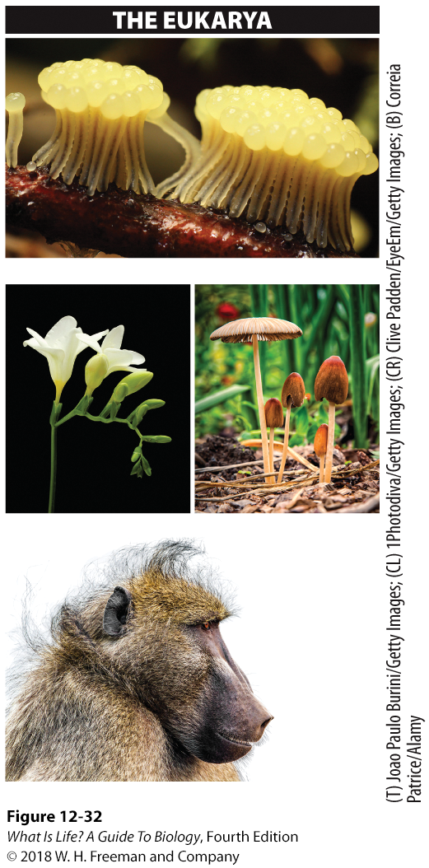
12.18 The eukarya domain consists of four kingdoms: plants, animals, fungi, and protists.
Slime mold
Most named species are eukaryotes.
Most eukaryotes are multicellular.
Most are visible with the naked eye.
Freesia
Mushrooms
Chacma baboon
Notes:
After exploring the archaea and bacteria domains, turning to the eukarya feels like coming home. We are most familiar with organisms in this domain: plants, mushrooms, insects, fish, birds, and, of course, mammals, including humans. Three kingdoms of eukarya can be seen with the naked eye: plants, animals, and fungi (Figure 12-32). All are made up of eukaryotic cells—they have a membrane-enclosed nucleus—and each kingdom is almost entirely multicellular.
A fourth kingdom contains the protists, which are often too small to be seen by the naked eye, and is a sort of grab bag that includes a wide range of mostly single-celled eukaryotic organisms, including amoebas, paramecia, and algae. Discovery of new species of protists, like that of the other microscopic organisms on earth (the bacteria and archaea), continues at a very high rate. As we noted earlier, biologists now know that the protists are not a monophyletic group, and they are increasingly splitting them into multiple kingdoms within the eukarya.
Because they are so much easier to see than bacteria and archaea, a disproportionate number of the named species on earth are in the domain eukarya. In fact, of the 1.5 million named species, the majority are eukarya, with about half being insects. This is more a result of the biases of biologists than a reflection of the relative numbers of actual species in the world.
28

