Slide 1
Cell Transport Notes

Slide 2
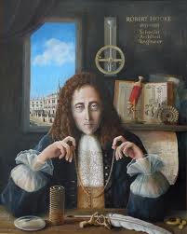
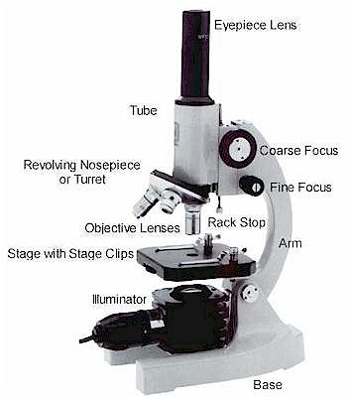
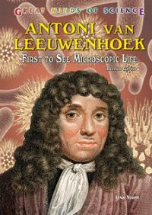
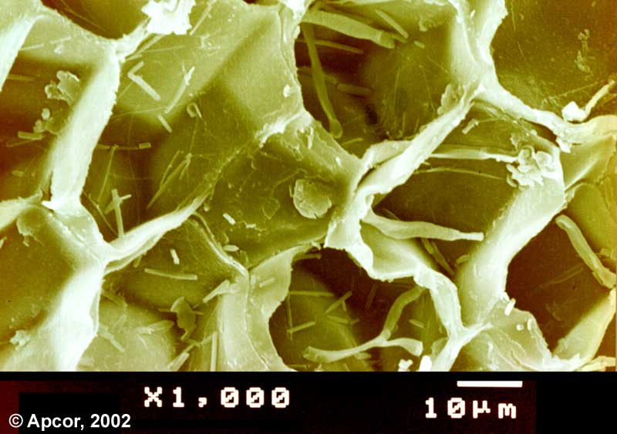
Robert Hooke discovered and named cells in 1665
He thought they looked like the cells that monks lived in

Slide 3
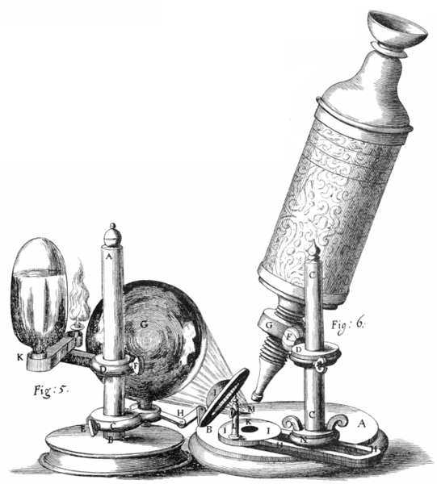
Anton van Leeuwenhoek
Observed microorganisms in 1670s using an early microscope
First to see unicellular organisms
Father of Microbiology

Slide 4
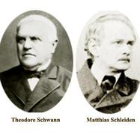
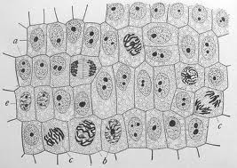
Schleiden and Schwann
-Schleiden discovered that all
plants are made up of cells
-Schwann discovered that all
animals are made up of cells

Slide 5
The Cell Theory
All living organisms are composed of cells. They may be unicellular or multicellular.
Cells are the basic unit of living things.
New cells only arise from existing cells.

Slide 6
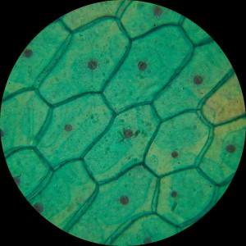
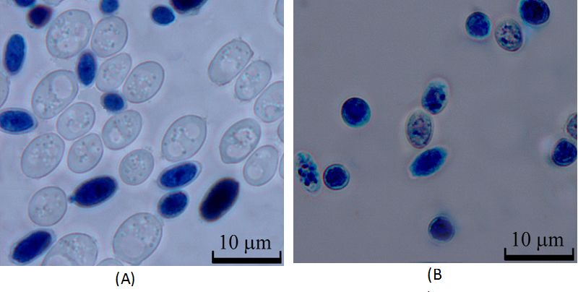
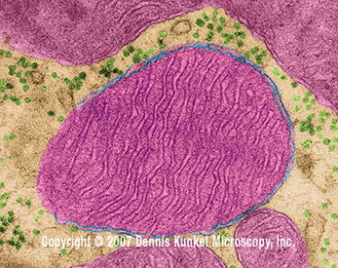
Compound light microscope- uses lens to magnify objects

Slide 7
How do we know what cells look like?
Types of modern (new) microscopes:
Confocal microscope
Electron microscope

Slide 8
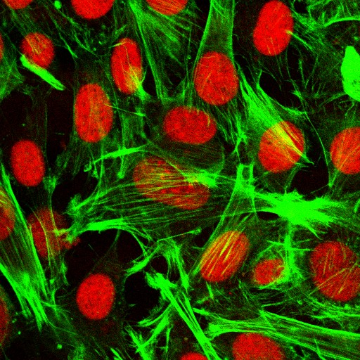
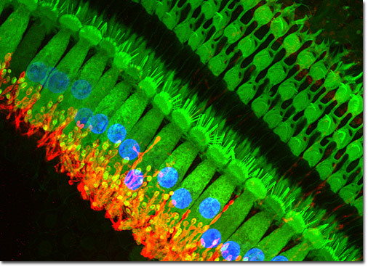
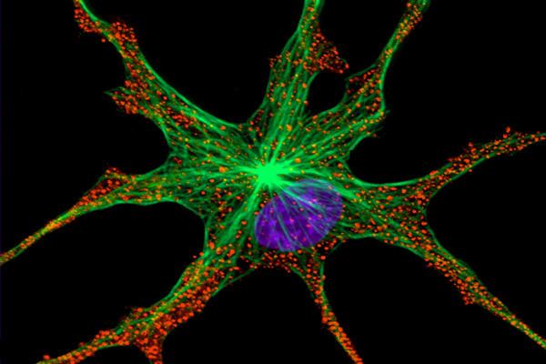
Confocal microscope- uses fluorescent dye and lasers to form full colorful images
https://www.youtube.com/watch?v=c-NMfp13Uug&list=PL7A321788730C25D1

Slide 9
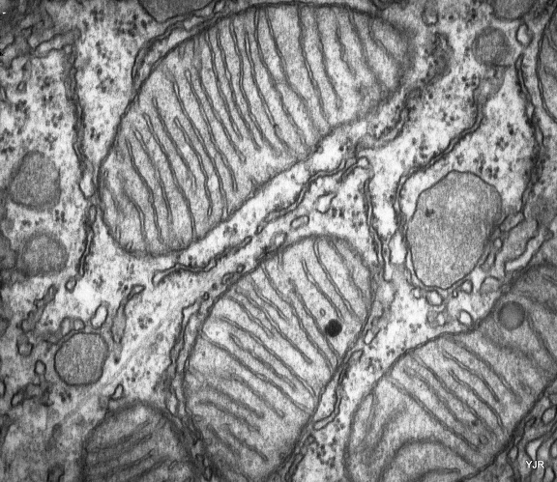
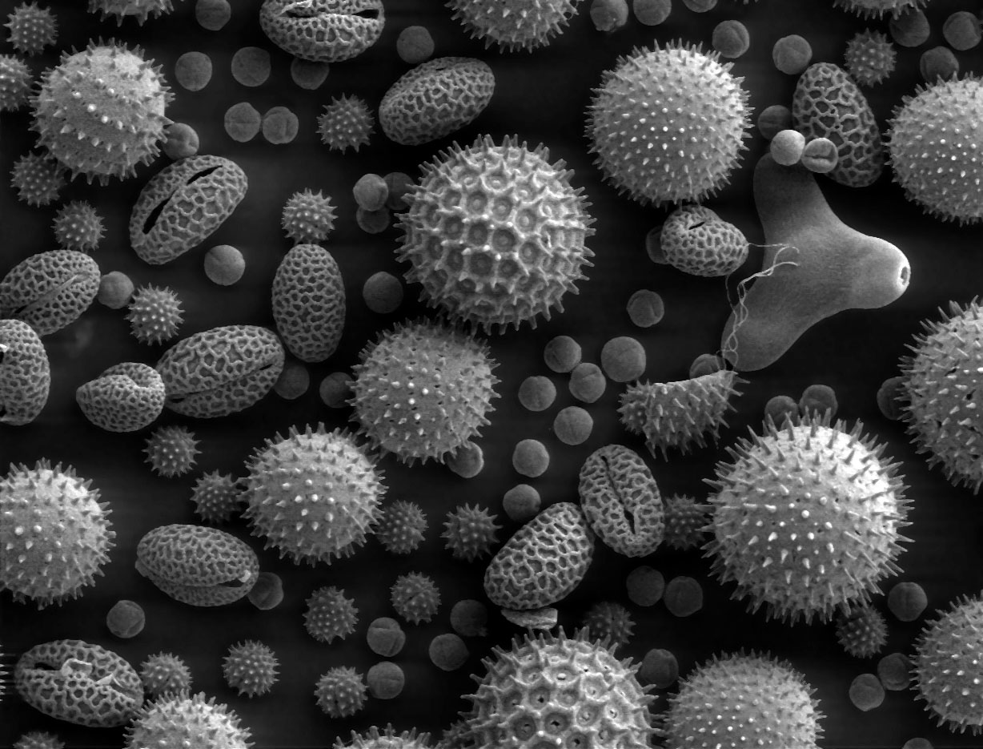
Electron microscope- uses beam of electrons to form a highly magnified image

Slide 10
Transmission vs Scanning Electron Microscope
TEM-
SEM

Slide 11
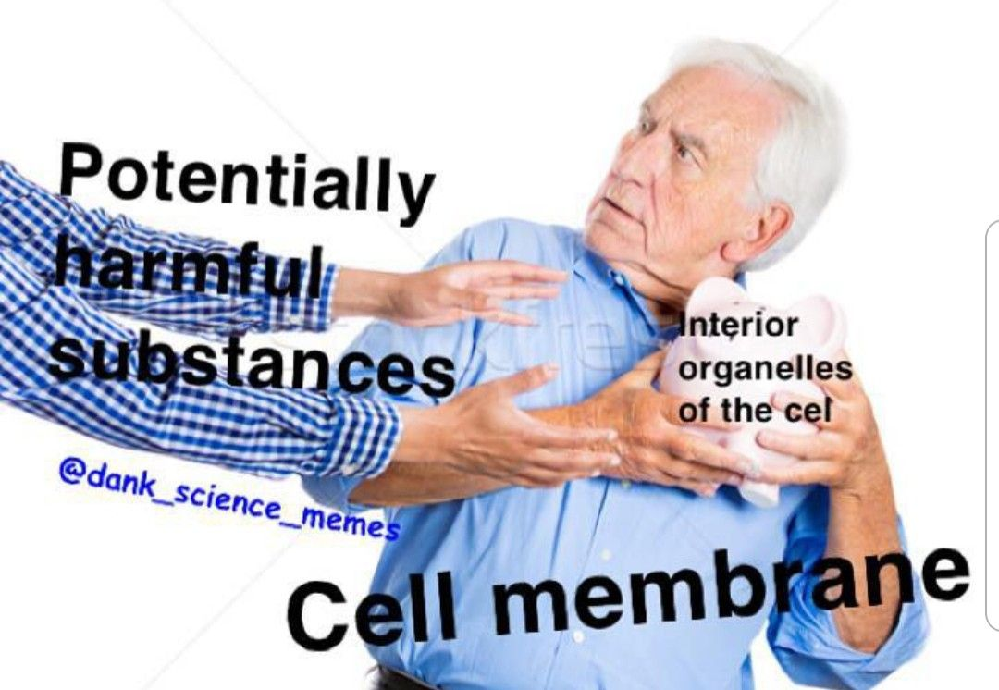
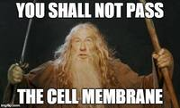
Cell Membrane-
-also known as the lipid bilayer
-regulates what enters and leaves the cell
-Mostly molecules called LIPIDS

Slide 12
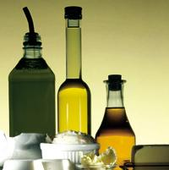
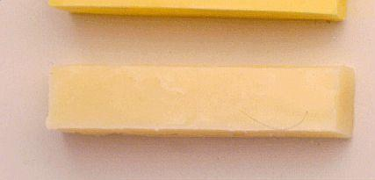
LIPIDS
Fats, Oils, and Waxes!!

Slide 13
Elements found in lipids….
Carbon, Hydrogen, and Oxygen
THINK: “CHO”

Slide 14
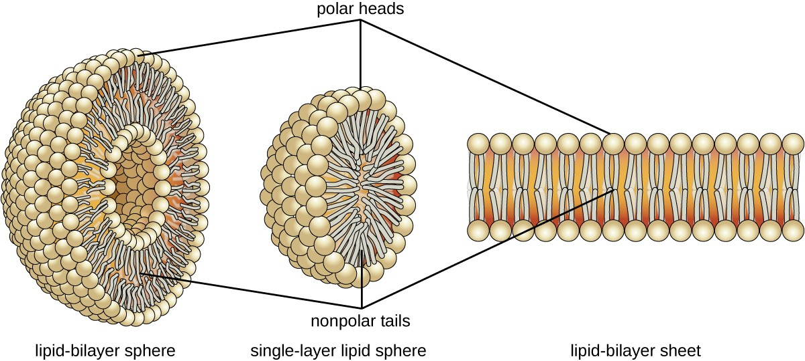
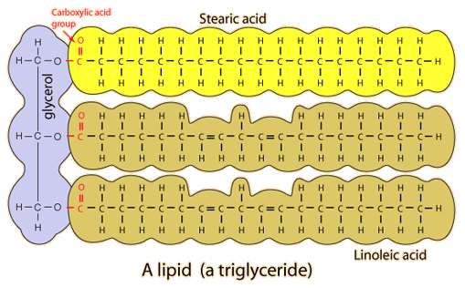
Lipids are NOT Polymers so they do NOT have monomers!

Slide 15
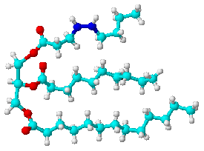
The Shape of a triglyceride is like the letter
E
This is a triglyceride molecule

Slide 16
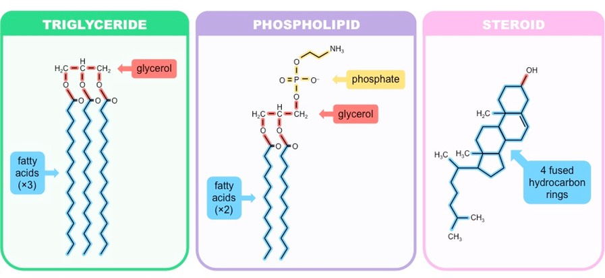
Main Functions of Lipids
Energy Storage- triglycerides
Waterproofing
Hormones- steroids
Form cell membranes- phospholipids

Slide 17
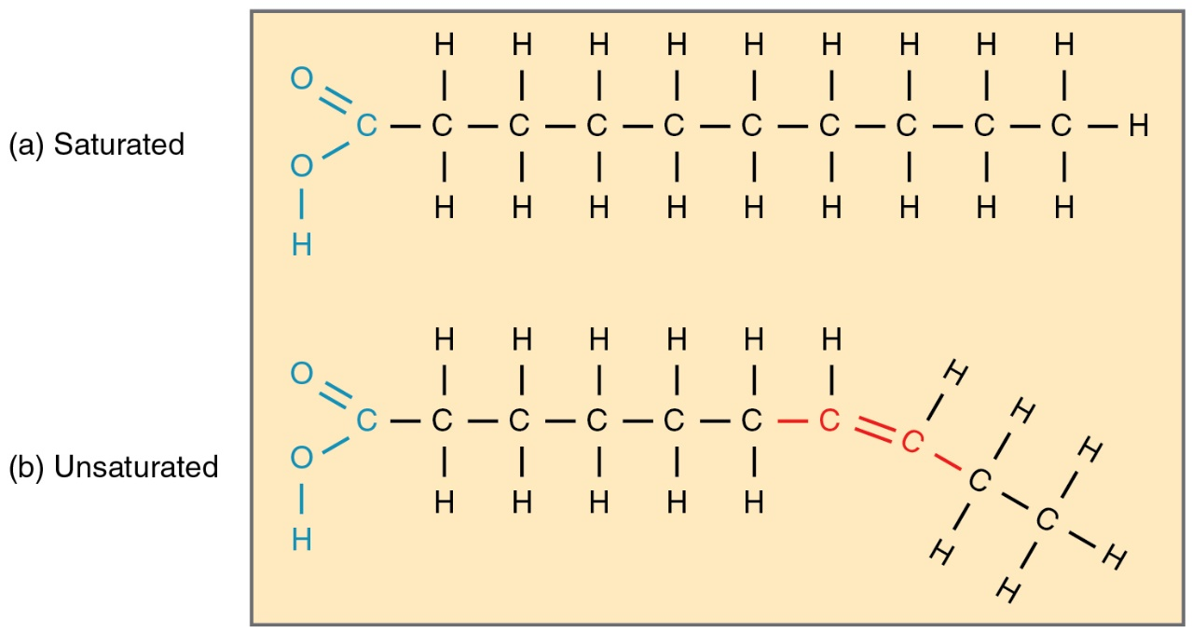
Types of Lipids
Saturated- has only single bonds
Unsaturated- has double or triple bonds

Slide 18
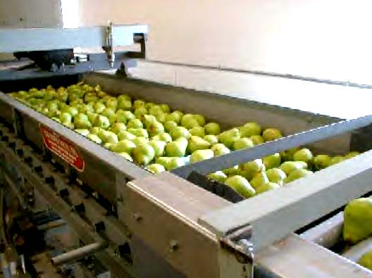
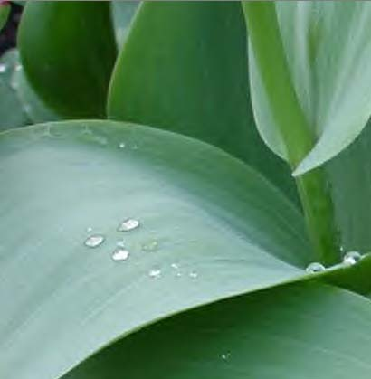
LIPIDS…Some interesting info
Waterproofing...
Fruits produce a waxy coating to keep from drying out.
The cells in a tulip make a wax which helps coat the leaves.
Ear wax traps dust, sand, and other foreign particles from going deeper into the ear and causing damage.
Beeswax- a structural material to hold honey in the hive

Slide 19
LIPIDS…Some interesting info
Steriods...
There are many different types of steroids. They are all lipids. Their functions vary. Some common steroids are:
SEX STEROIDS ANABOLIC STERIODS
CHOLESTEROL
They increase muscle
Like testosterone and estrogen

Slide 20
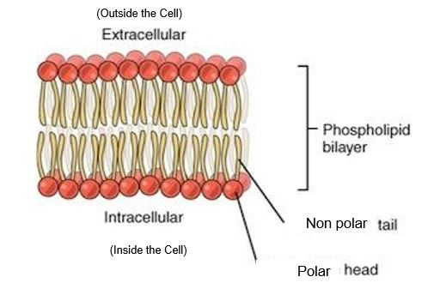
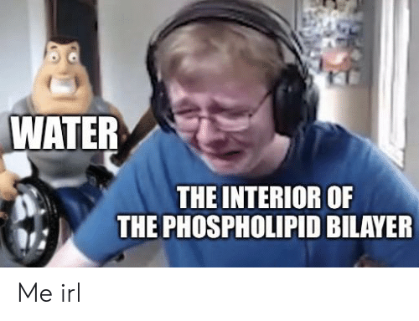
Membrane Lipid Structure

Slide 21
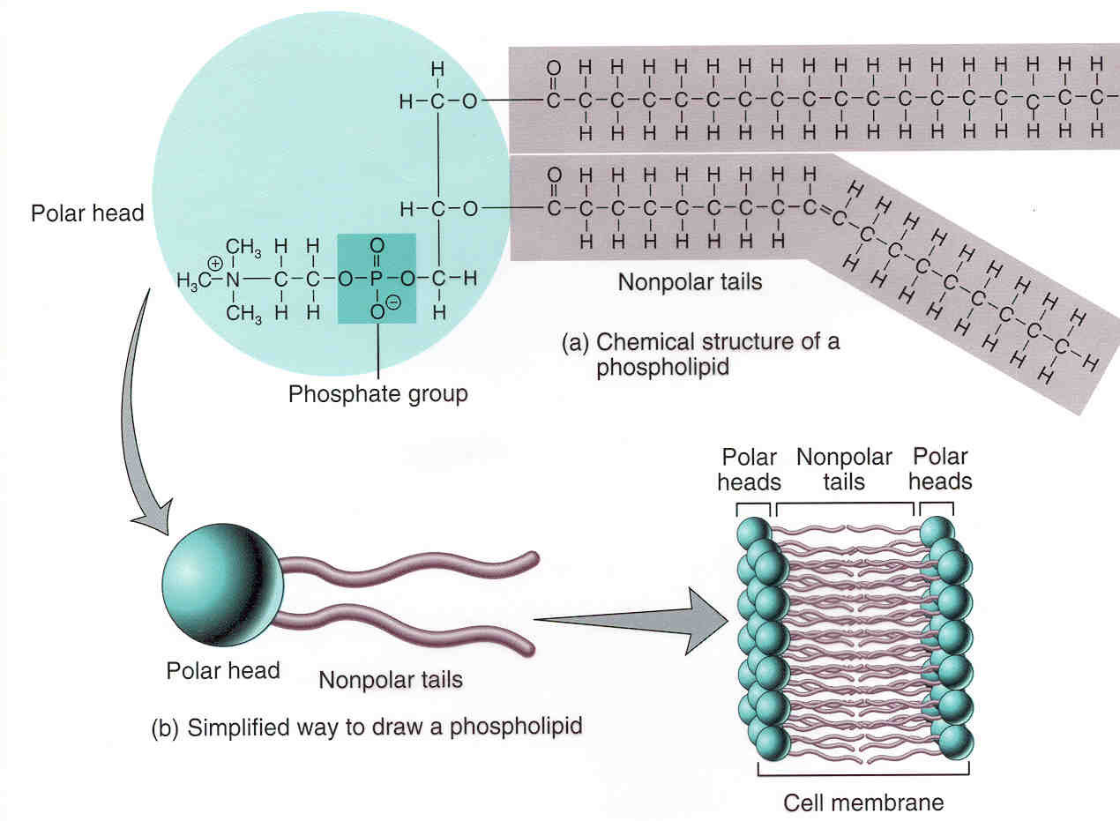
Single Membrane Phospholipid

Slide 22
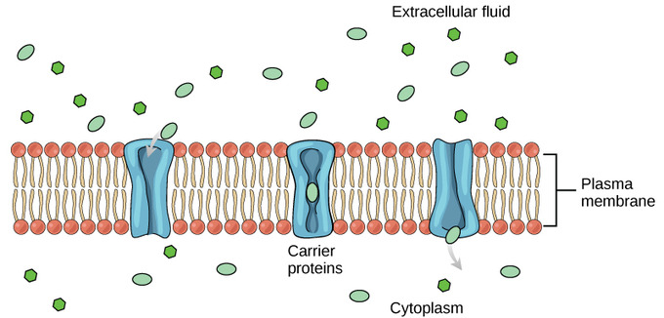
Macromolecules in Cell Membrane
Mostly Phospholipids- 2 layers with tails in between
OTHER MOLECULES IN THE CELL MEMBRANE:
1) Carbohydrates
2) Proteins

Slide 23
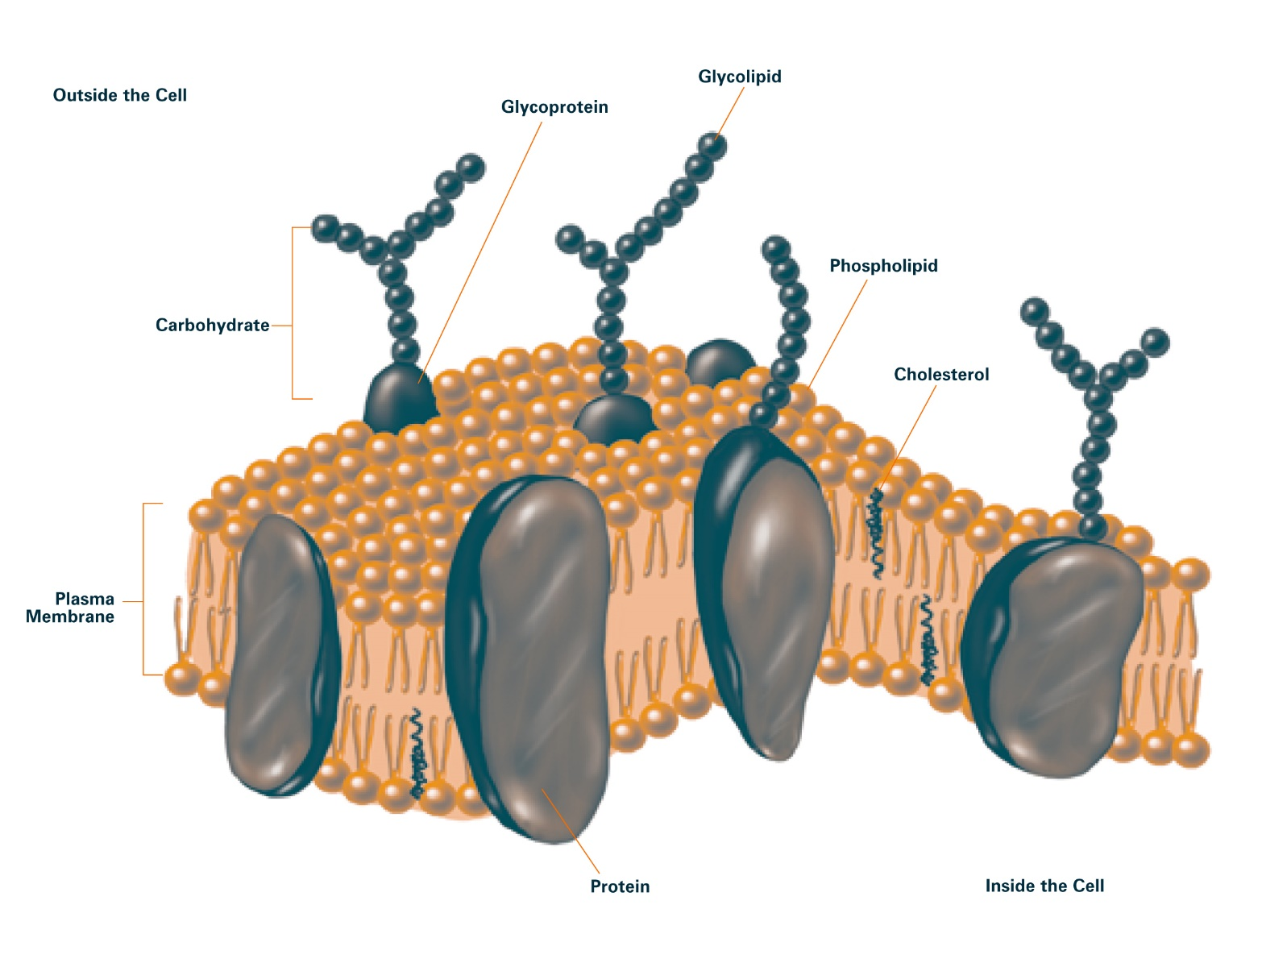
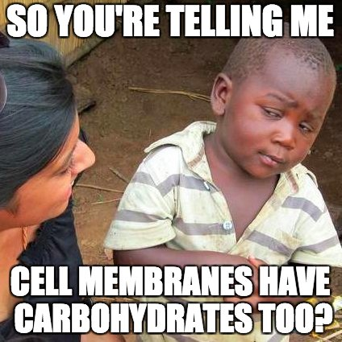
Carbohydrates in the Membrane
Act as markers to identify the cell

Slide 24
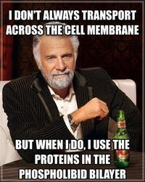
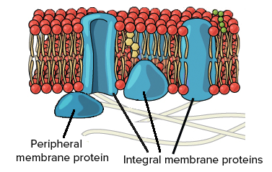
Proteins
Channels to let molecules into and out of the cell
Receptors that bind to signal molecules and cause a chemical reaction in the cell.

Slide 25
Why do we need protein channels?
The membrane is selectively-permeable (It lets some molecules pass through but others cannot)
Things that can pass: small, non polar molecules
Things that can’t pass: large or charged molecules
https://www.youtube.com/watch?v=Pfu1DE9PK2w

Slide 26
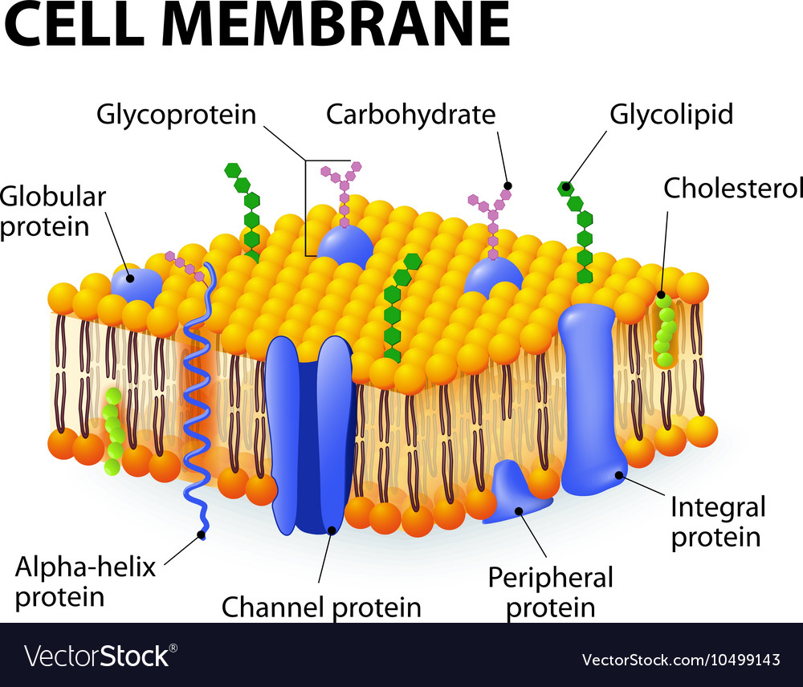

Slide 27
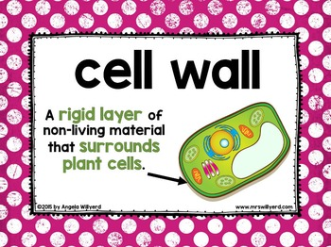
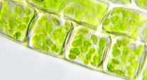
Cell Wall
Surrounds the cell membrane and provides structural support
Made up of cellulose, rigid
Not found in animals

Slide 28
Cell Transport- movement of particles into and out of the cell

Slide 29
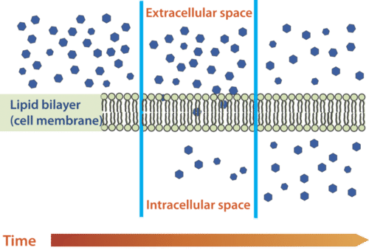
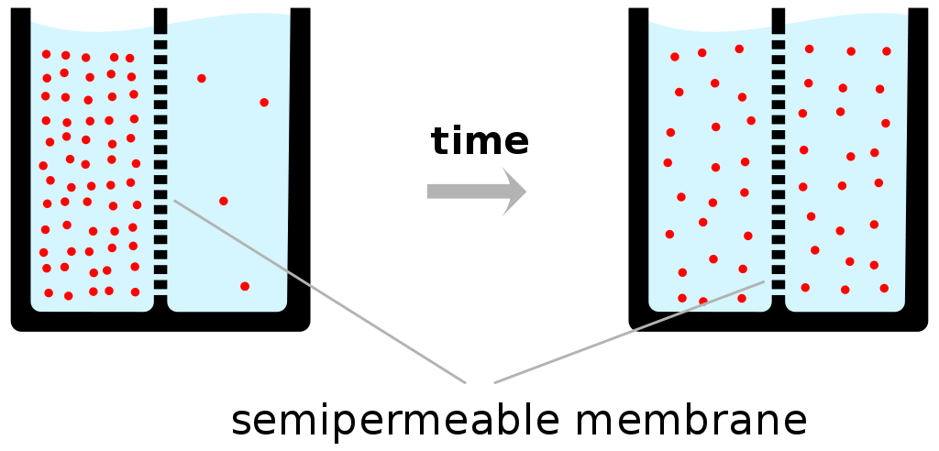
Important Vocabulary
Concentration- amount of a substance per unit volume
Equilibrium- same concentration on both the inside and the outside of the cell

Slide 30
2 Different Types of Cell Transport
Passive- doesn’t require any energy
DIFFUSION!!!
2) Active- requires energy

Slide 31
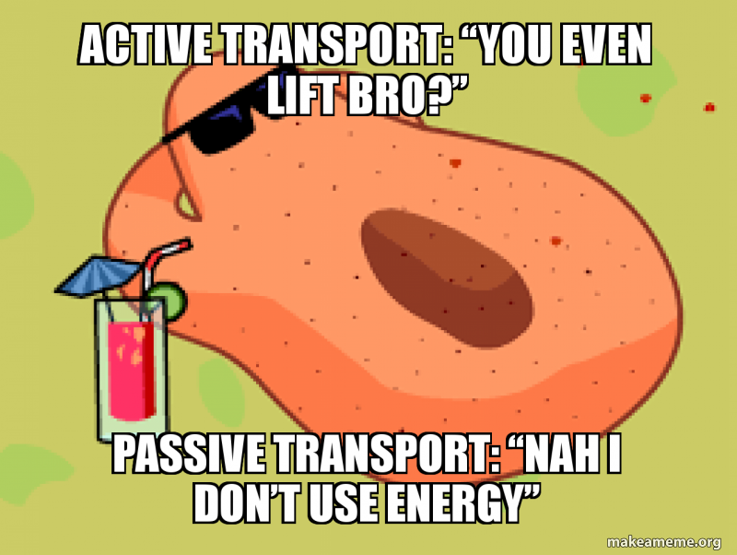

Slide 32
Passive Transport (also known as diffusion)
No energy required!!

Slide 33
Diffusion- movement of particles from high concentration to low concentration, spreading out Requires NO energy!!!!

Slide 34
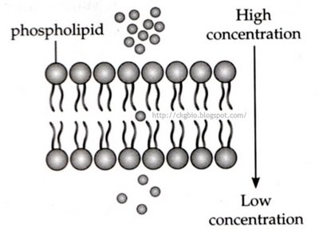
Types of Passive Transport
1) Simple Diffusion
2) Osmosis-
3) Facilitated Diffusion

Slide 35
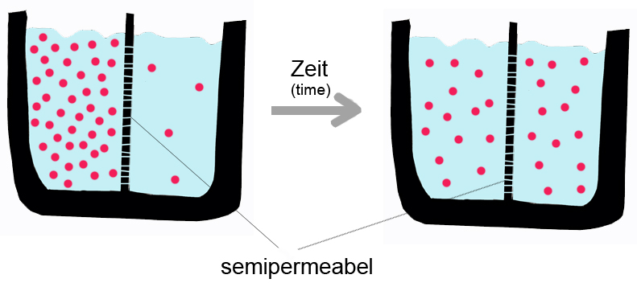
Simple Diffusion
Occurs when molecules move from high concentration to low concentration right through membrane (don’t need a carrier protein)
Equilibrium

Slide 36
Osmosis
The diffusion of water through a semi-permeable membrane
Water always moves to the side of the membrane with higher solute concentration.
https://www.youtube.com/watch?v=HqKlLm2MjkI

Slide 37
Comparing Solutions in Osmosis
Hypertonic- the solution (or side of the membrane) with HIGHER solute concentration
Hypotonic- the solution (or side of the membrane) with LOWER solute concentration
Isotonic- both solutions (or sides of the membrane) have the same concentration.

Slide 38
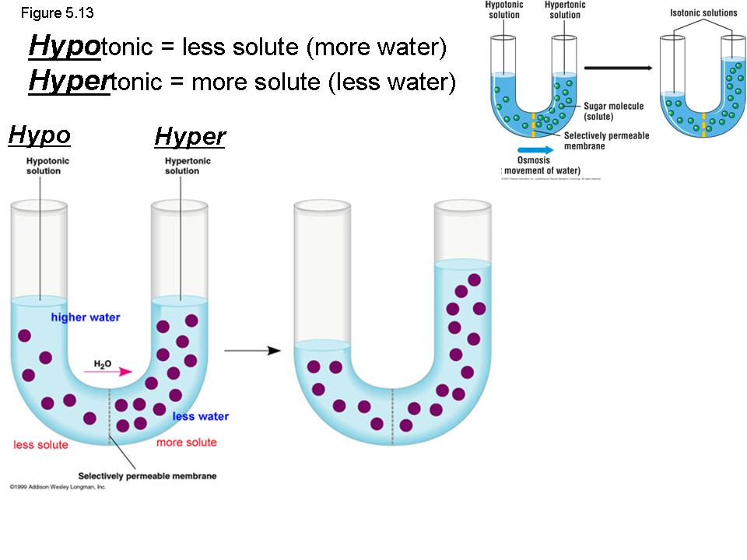
Isotonic- 2 solutions have the
same concentration of solute
SALT SUCKS

Slide 39
In osmosis, water always goes to the hypertonic side of the membrane!!!
The pink arrows are showing the movement of water.
Hypotonic inside
Hypertonic inside

Slide 40
The black arrows are showing the movement of water!
Cell in isotonic solution
Cell in hypertonic solution
Cell in hypotonic solution

Slide 41
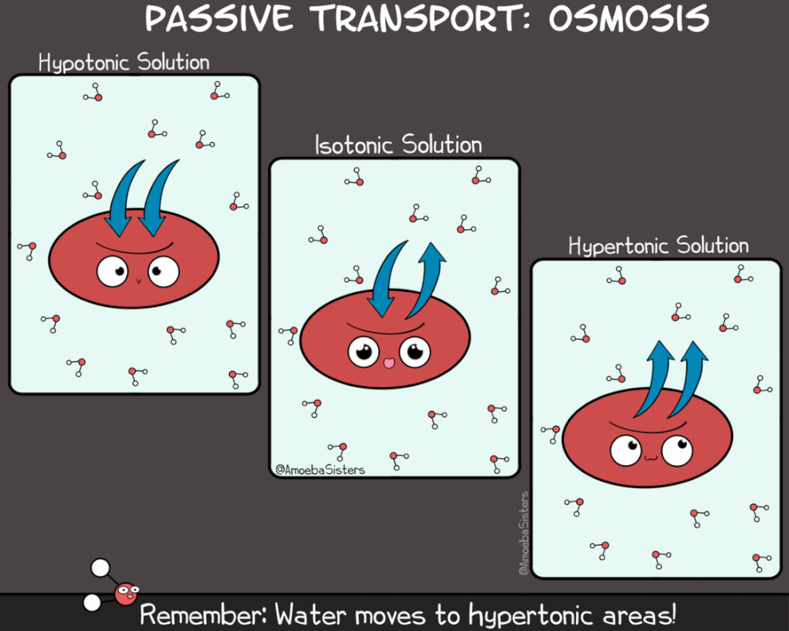

Slide 42
Facilitated Diffusion
Diffusion that requires carrier protein
Transport materials that can’t pass through membranes on their own (large or charged molecules)
Does not need energy!!!!
Example- glucose molecules have to go
through a carrier protein.

Slide 43
Active Transport
Goes against the gradient and requires energy!!!

Slide 44
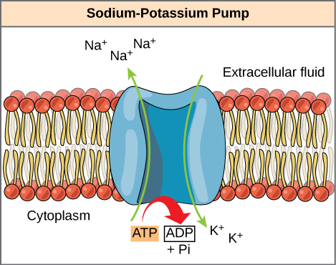
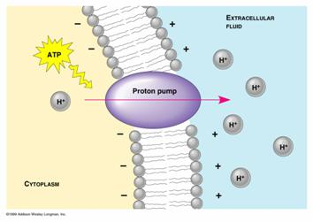
Protein Pumps
Pumps materials AGAINST the gradient
UP THE SLIDE!!!!

Slide 45
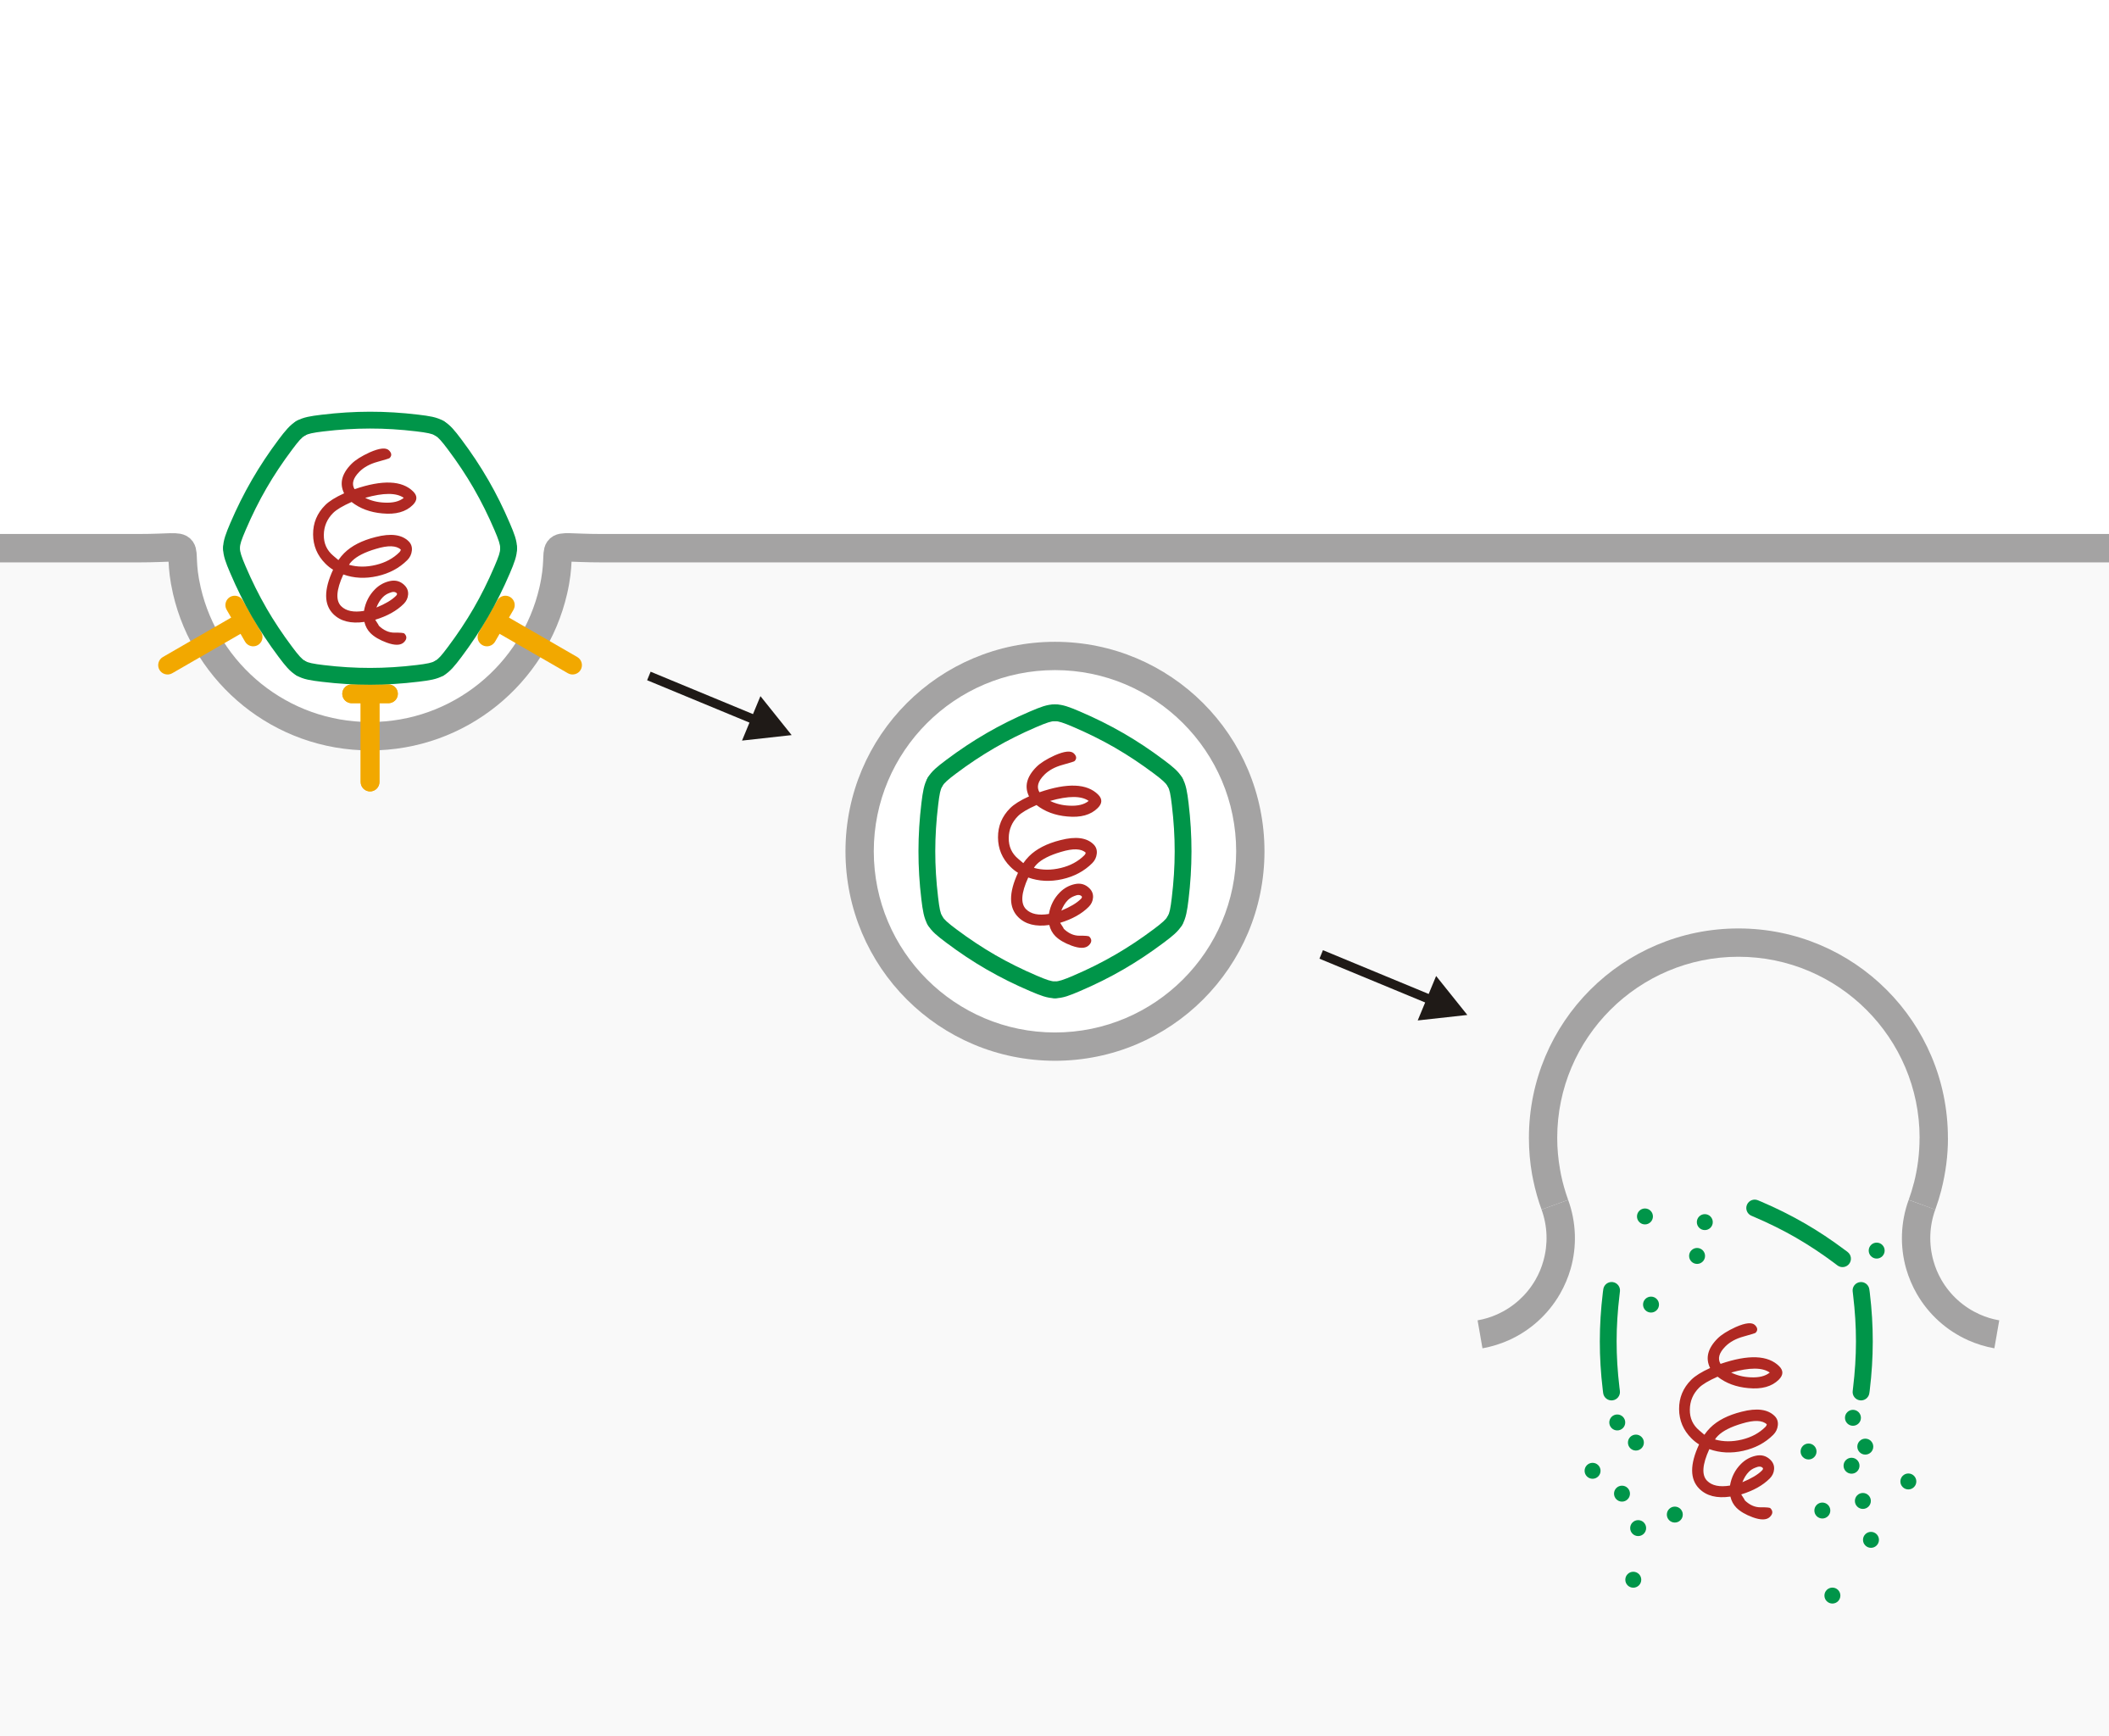
Endocytosis
- transport of very large materials into the cell

Slide 46
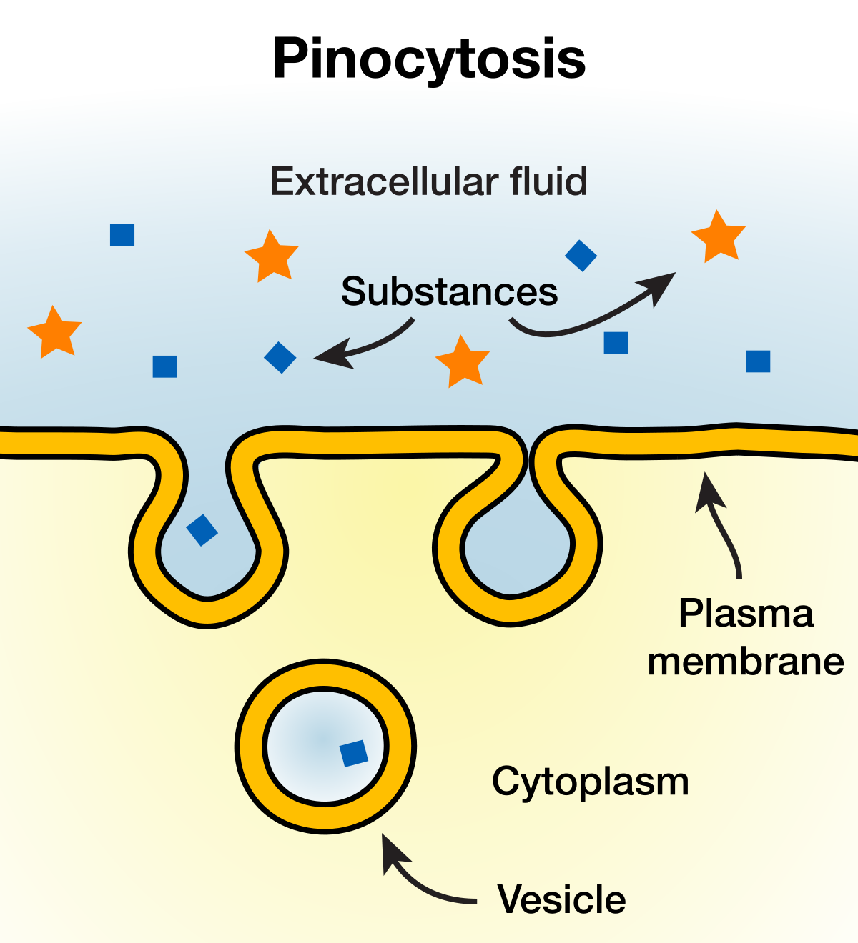
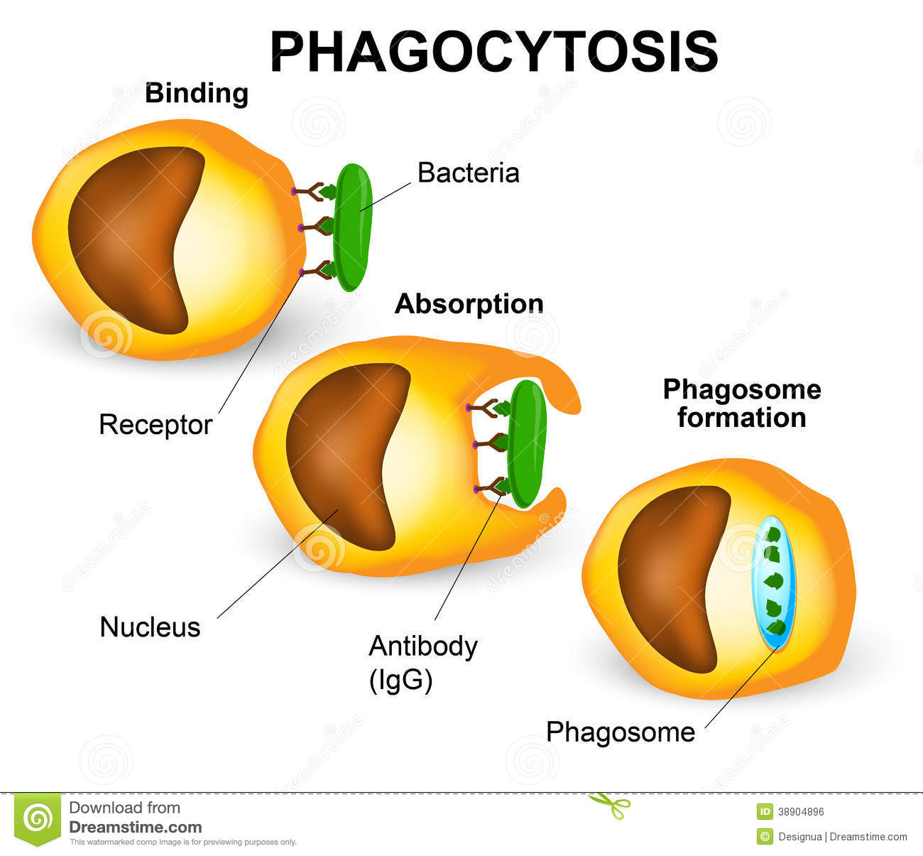
Types of Endocytosis
Pinocytosis- “cell drinking”, absorbing liquids into
the cell
2) Phagocytosis- “cell eating”, absorbing food into
the cell

Slide 47
Exocytosis
- transport of very large materials out of the cell

