Slide 1
Cells
https://www.youtube.com/watch?v=NkC9AiJf7gI

Slide 2
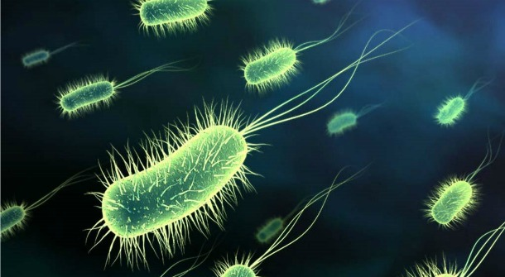
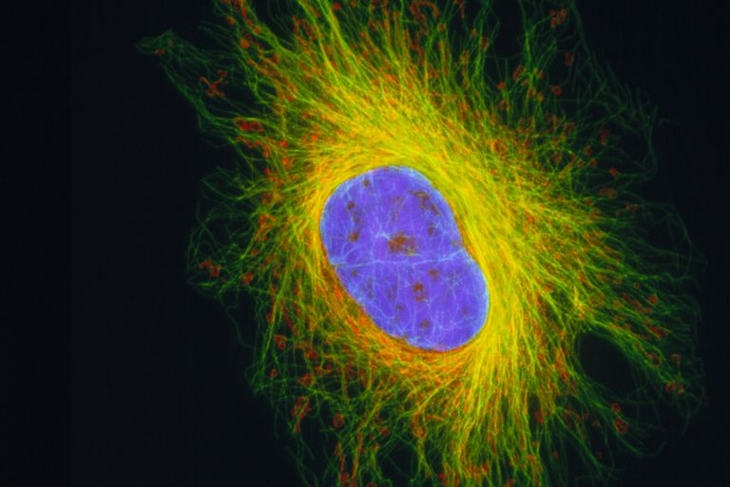
2 Main Types of Cells
Prokaryotic
2) Eukaryotic-

Slide 3
Prokaryotic cells- NO nucleus!!! (bacteria)
Characteristics:
A) Do not have a nucleus
B) First organisms on earth
C) Small
D) No organelles
E) Example: Bacteria

Slide 4
Eukaryotic cells- have a nucleus and organelles (make up everything except bacteria)
Characteristics:
A) Have a nucleus
B) Came after prokaryotic cells
C) Larger, have organelles (tiny “organs” inside of cell)
D) Example: cells of animals, plants, fungi, and protists

Slide 5
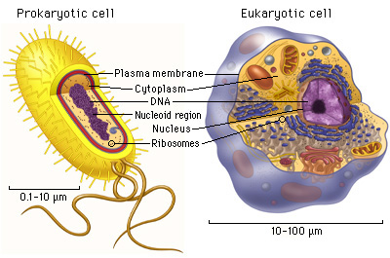

Slide 6
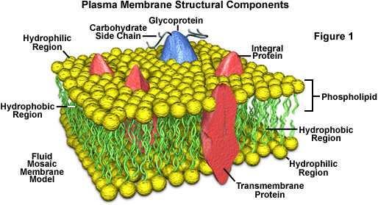
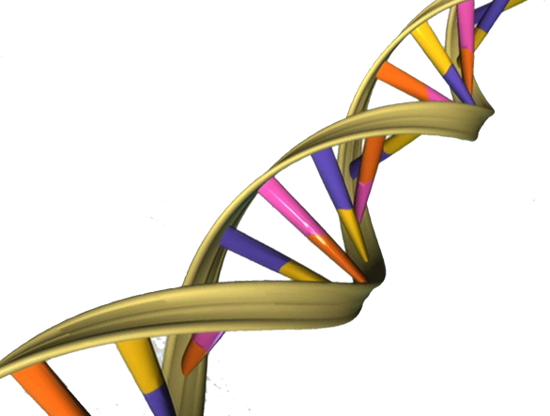
Both Have a Membrane and DNA
And ribosomes!

Slide 7
Eukaryotic Cell Structure

Slide 8
Main (major) Parts of a Eukaryotic Cell
1) Nucleus- central part of a cell where DNA is contained
2) Cytoplasm- contains organelles
3) Cell Membrane- surrounds cell

Slide 9
Central part of cell that contains genetic information (DNA) in the form of chromatin
Special Parts:
1) nucleolus – makes ribosomes (we will define that later)
2) nuclear membrane- double, has tiny pores
(holes)

Slide 10
Cytoplasm
Cytoplasm- Jelly like substance that contains organelles
Organelles- little “organs” within the cell that perform specific functions

Slide 11
ORGANELLES
Image: http://www.chemistrypictures.org

Slide 12
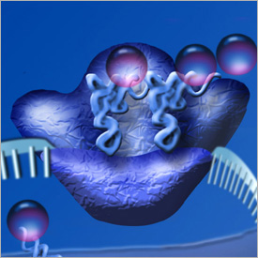
Ribosomes
Structure: Ball of RNA
Function: Produce protein
Location: Rough ER and free in the
Cytoplasm
https://www.youtube.com/watch?v=WjnUJusSYAo

Slide 13
Rough Endoplasmic Reticulum
Structure: Canals and Channels
Function: Contain ribosomes (make proteins)
Location: near nucleus

Slide 14
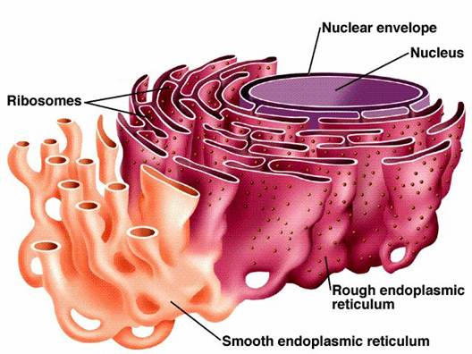
Smooth Endoplasmic Reticulum
Structure: Canals and Channels
Function: Make Lipids
Location: near rough ER

Slide 16
Structure: Flattened membranes
Function: packages and delivers proteins produced by the ribosomes
Location: Near rough ER

Slide 17
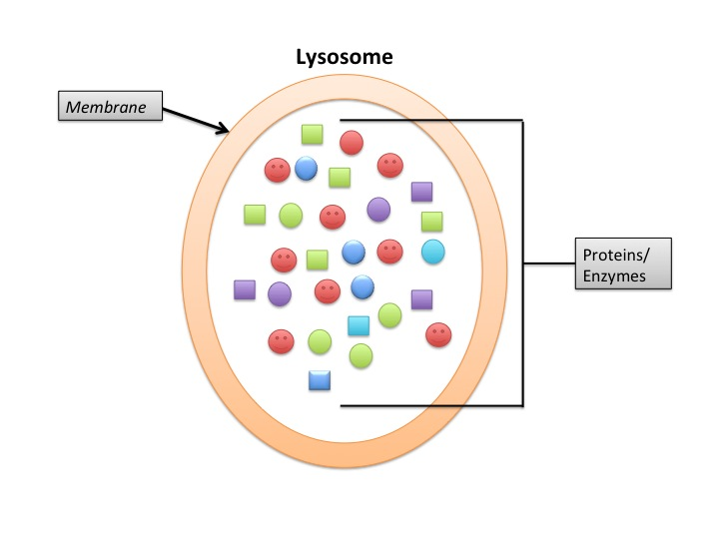
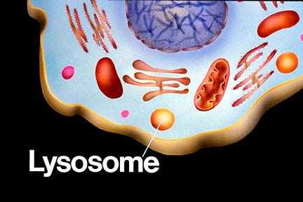
Lysosomes
Structure: Balls of enzymes
Function: Digest waste in cell
Location: Throughout cytoplasm

Slide 18
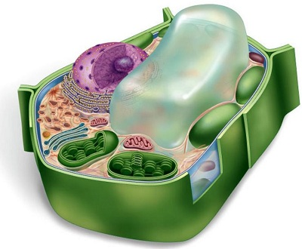
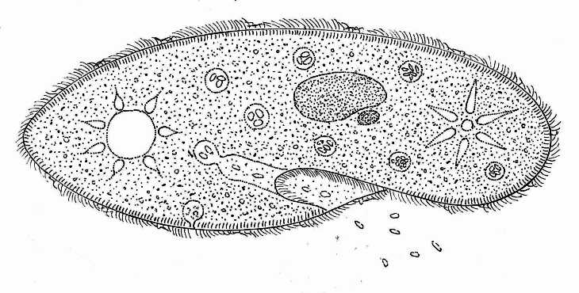
Vacuoles
Structure: empty sac
Function: Stores materials
Location: throughout the cell, large and in the center of plant cells

Slide 19
Structure: kidney shaped, 2 membranes, has its own DNA
Function: Converts energy in food into the high energy molecule ATP (Cellular Respiration)
Location: Throughout cell
CRISTAE

Slide 20
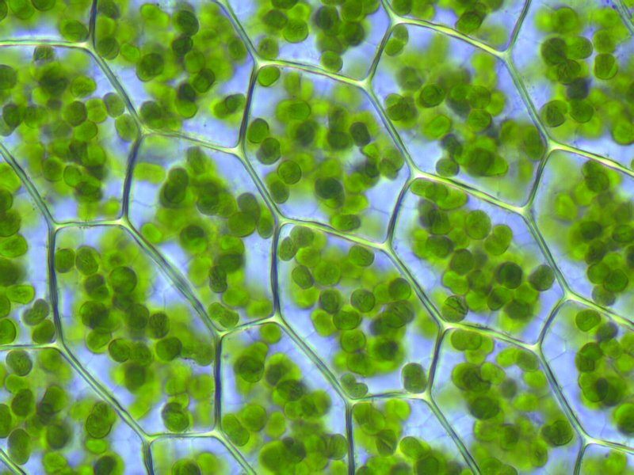
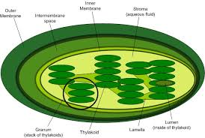
Chloroplasts
Structure: green, 2 membranes, has its own DNA
Function: harvests energy from the sun to make sugar (photosynthesis)
Location: Throughout cell in plants

Slide 21
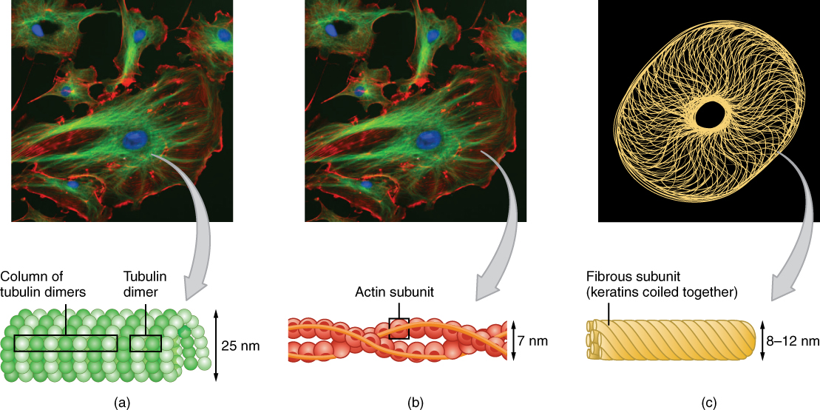
Cytoskeleton
Structure: protein fibers
Function: support the cells shape, help the cell move
Location: varies

Slide 22
Parts of Cytoskeleton
Microtubules – hollow and help the cell maintain shape, also used during cell division
-Microfilaments- made up of the protein actin and help the cell move

Slide 23
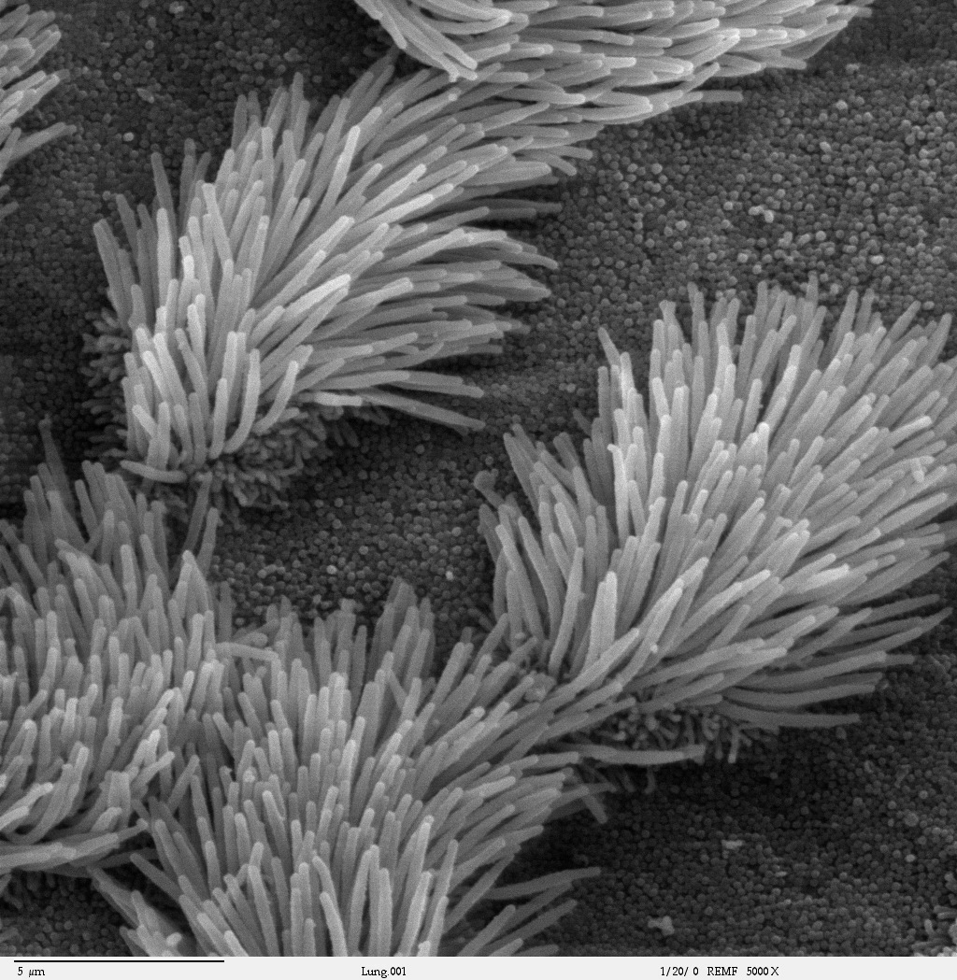
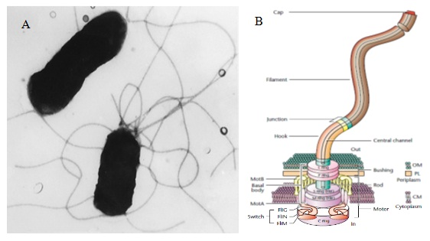
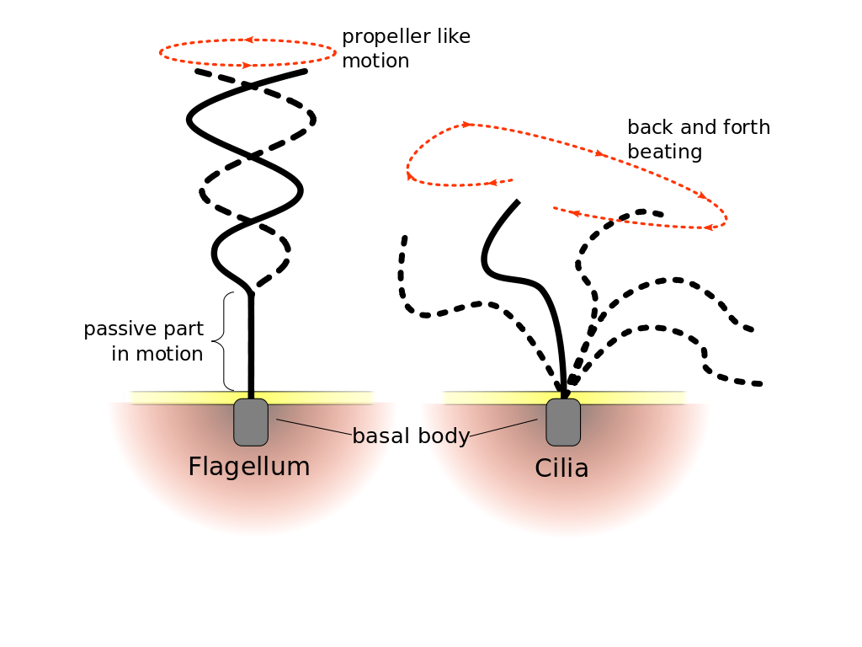
Cilia- small, hair-like structures made up
of microtubules, help cell move
Flagella- 1 or 2 tail-like
structures used for movement

Slide 24
https://www.youtube.com/watch?v=URUJD5NEXC8

Slide 25
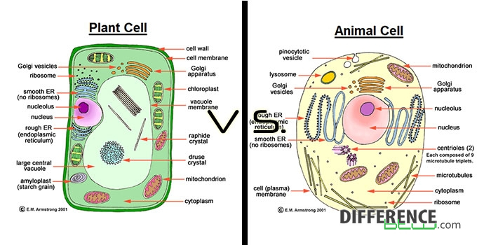
Cell Wall
Chloroplasts
Large Central Vacuole

Slide 26
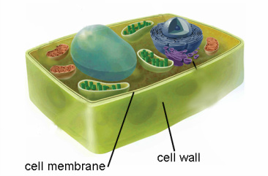
Cell Wall
Provides support
Found in plants, algae, fungi, and some bacteria

Slide 27
