Slide 1
Exam 4 Clicker Questions

Slide 2
Glycolysis occurs in ___
Mitochondria
The cytoplasm
Chloroplasts
Cell membrane
Notes:
Ans: B

Slide 3
Which process is similar between cellular respiration and photosynthesis?
Both break down sugar to form ATP and electron carriers
Both use light to produce ATP and electron carriers
Both produce a proton gradient for ATP production
Both use oxygen as a final electron acceptor
Notes:
Answer: 3

Slide 4
What makes your muscles sore and stiff the following day after intense exercise?
Alcoholic fermentation
Lactic acid fermentation
Both A and B
None of the above
Notes:
Ans: D

Slide 5
Which describes the second line of defense?
The second line of defense includes acid secretions and skin bacteria.
The skin is the major organ of the second line of defense.
C. The second line of defense keeps most pathogens out of the body.
D. The pathogens that enter the body encounter the second line of defense
Notes:
Ans: D

Slide 6
“Complement protein” is part of a non-specific defense. What does it do?
A. prevents virus reproduction
B. forms holes in bacteria
C. attracts white blood cells to an injury
D. coats pathogens so they can’t infect cells
Notes:
Ans: b

Slide 7
An antigen is ___
Any immune system protein
Any substance that elicits an immune response
Any cell that functions in the immune system
The ultimate product of vaccination
A particular kind of lymphocyte
Notes:
Ans: B

Slide 8
What do B cells do?
A. produce antibodies
B. signal other immune cells
C. eat pathogens
D. kill infected cells
Notes:
Ans: A

Slide 9
The cowpox virus is an effective vaccine for smallpox because the ____ it elicits also recognizes smallpox virus
Antigens
Antibodies
Lysozymes
enzymes
Notes:
Talk to them about how antibodies are the anitgen receptors
Ans: B

Slide 10
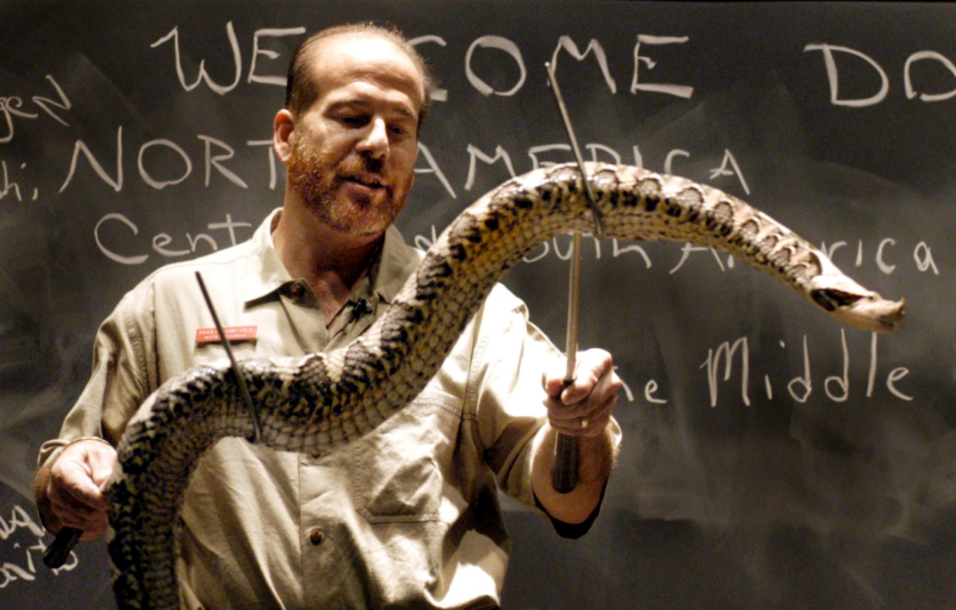
Antivenom given to patients of snake bites is a passive type of immunity
True
False
Notes:
Ans: A

Slide 11
This cell alerts the specific immune system by presenting pieces of the pathogen on its cell membrane.
Neutrophil
Macrophage
mast cells
natural killer (NK) cells
Basophil
Notes:
Answer: B

Slide 12
You take a sip of coffee, and it’s too hot. The ___ of your __ receive this stimulus
A. axons; motor neurons
B. dendrites; motor neurons
C. axons; sensory neurons
D. dendrites; sensory neurons
E. axons; interneurons
Notes:
Answer: 4

Slide 13
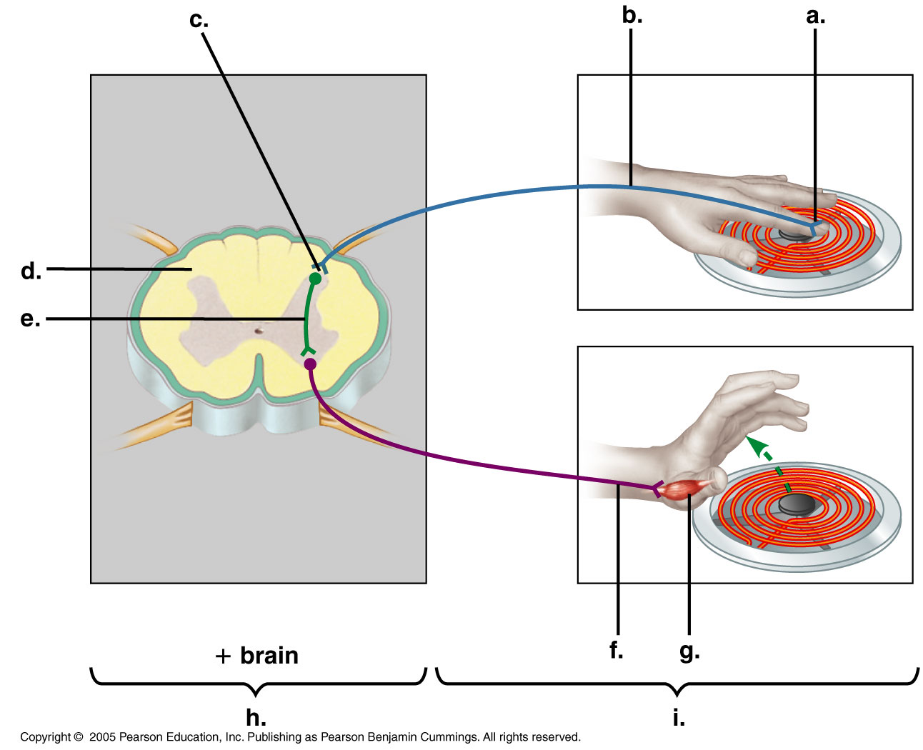
What is letter G?
A. Effector cells
B. Interneuron
C. Motor neuron
D. Sensory receptors
E. Synapse
Ouch!!
Notes:
Ans: A

Slide 14
The presence of myelin allows an axon to ___
Produce more frequent action potentials
Conduct impulses more rapidly
Produce action potentials of larger amplitude
Produce action potentials of longer duration
Notes:
Ans: B

Slide 15
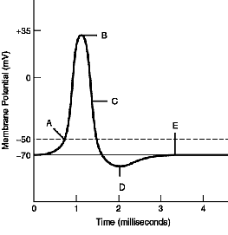
Pick the term that describes the membrane potential changes from -80mV to -70mV
Hyperpolarize
Depolarize
Repolarize
Notes:
Ans: B

Slide 16
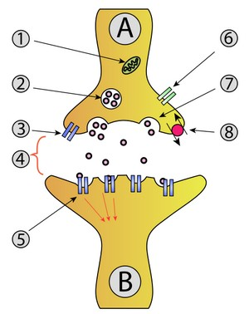
5
1
What is labeled as #4 ?
Transporter
Neurotransmitter
Vesicles
Receptor
2
3
4
6
Notes:
Ans: D
Synaptic vesicle full of neurotransmitter
Synaptic cleft
Neurotransmitter receptor
Calcium Channel
Fused vesicle releasing neurotransmitter
Neurotransmitter re-uptake pump

Slide 17
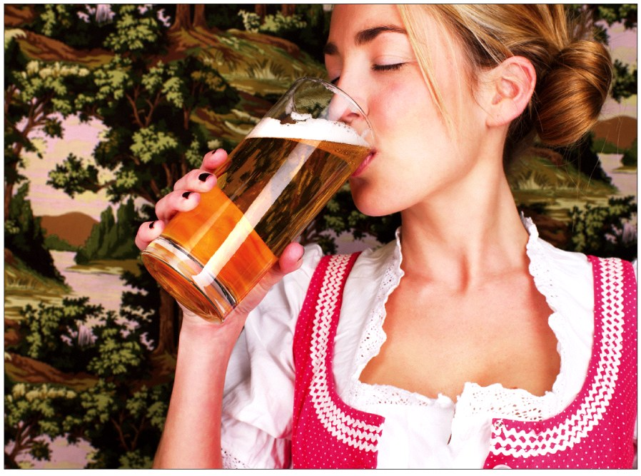
Alcohol interferes with many different neurotransmitters.
Dopamine, serotonin, gaba, glutamate
Alcohol ___ GABA activity and ___ Glutamate activity.
Increases ; Increases
Increases; Decreases
Decreases; Increases
Decreases; Decreases
Notes:
Figure 23-56 Alcohol impersonates several neurotransmitters, with several consequences. Alcohol is a great NT impersonator fooling at least four different receptor molecules
Ans:B

