Slide 1
MACROMOLECULES

Slide 2
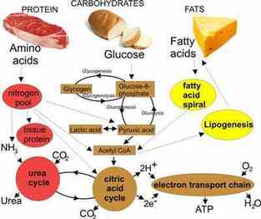
Types of Macromolecules
Carbohydrates (Polysaccharides)
Lipids
Nucleic Acids
Proteins

Slide 3
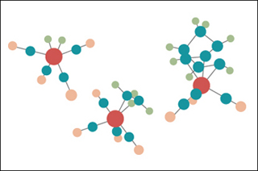
Carbon
-Most important building block of the macromolecules
Can form 4 covalent bonds
Can form bonds with other carbon atoms
Can form single, double, or triple bonds

Slide 4
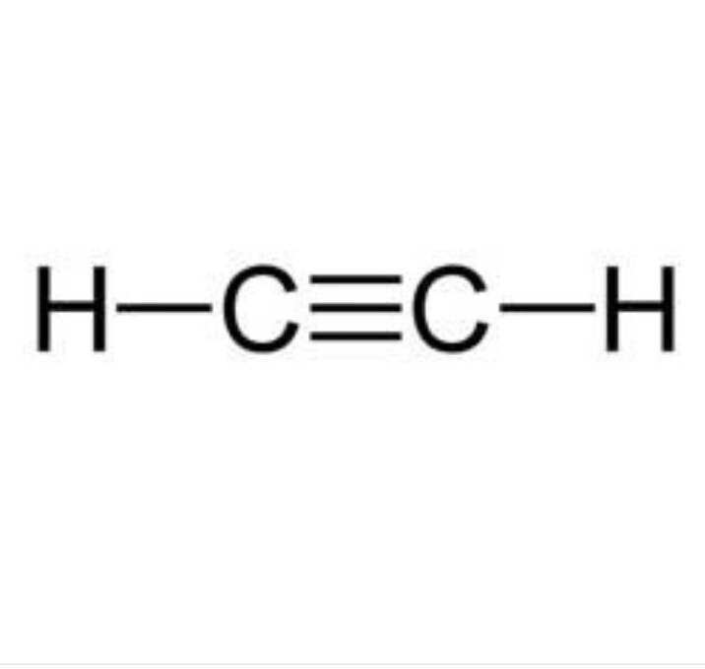
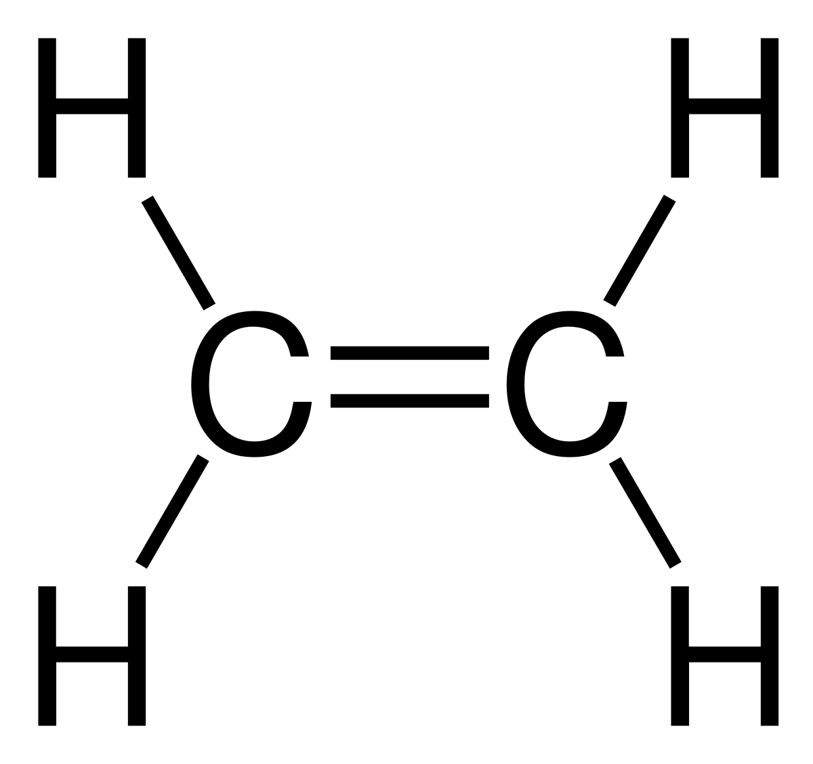
Double and Triple Bonds
Double Bond- where 2 pairs of electrons are shared
Triple Bond- where 3 pairs of electrons are shared

Slide 5
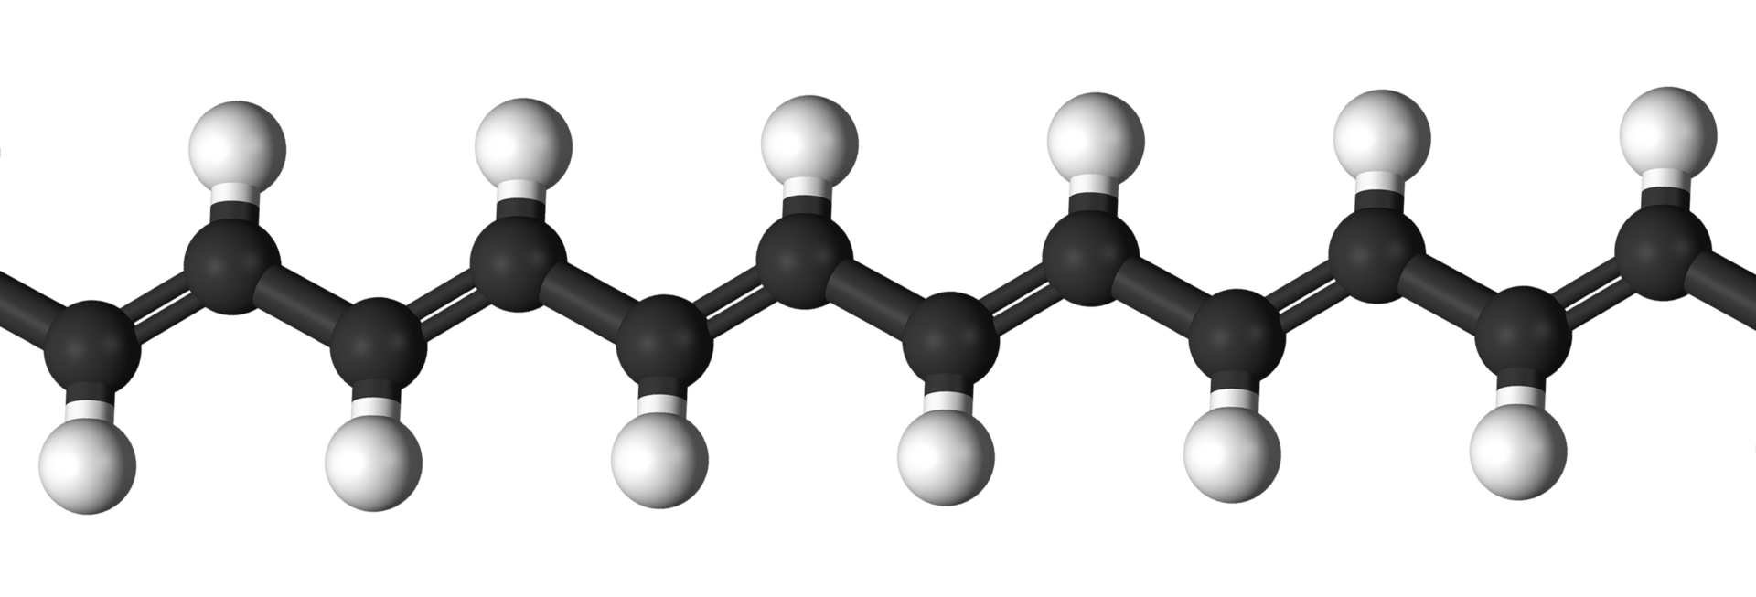
Most macromolecules are polymers
Poly means many!
Polymer- long chain of smaller
molecules

Slide 6
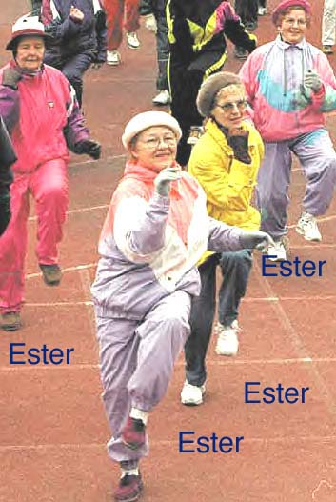
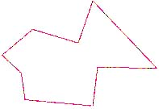
"Poly"
Polygons
Polyester
Polygamy
Means...

Slide 7
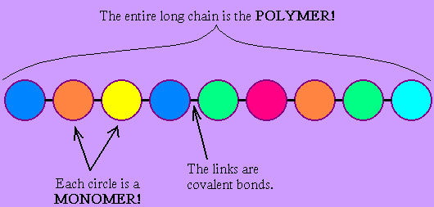
Monomer
Mono means 1!!
Monomer- part that makes up a polymer

Slide 8
What does “Mono” mean?
1

Slide 9
A Polymer
Here are some analogies to better understand what polymers and monomers are….
EXAMPLE of POLYMER | MONOMER
A TRAIN | ?
A NECKLACE | ?
If the train is the whole polymer, what would be the small groups that make up the train? If the necklace is the polymer, what are the monomers that make up the necklace?

Slide 10
A Polymer
Here are some analogies to better understand what polymers and monomers are….
EXAMPLE of POLYMER | MONOMER
A TRAIN | THE CARS
A NECKLACE | EACH PEARL
If the train is the whole polymer, what would be the small groups that make up the train? If the necklace is the polymer, what are the monomers that make up the necklace?

Slide 11
Three out of the 4 types of biochemical macromolecules can be found on food nutrition labels…

Slide 12
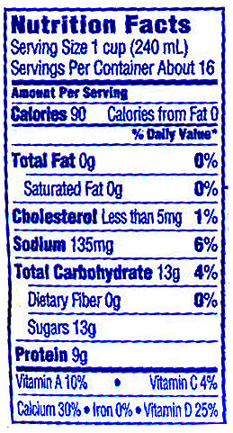
Look at the label to the left. 3 of the 4 macromolecules can be found in foods.
The 3 biochemical molecules
found on a nutrition label are:
FAT
1____________________
2____________________
3____________________
(0 grams in this product)
Carbohydrates
(13 grams in this product)
Protein
(9 grams in this product)

Slide 13
When studying these biochemical molecules, we are interested in finding out…..
What types of atoms they have
what their monomers are.
what they do for living things.
and how they may help the body gain energy to sustain life.

Slide 14
1) Polysaccharides (Complex Carbohydrates)

Slide 15
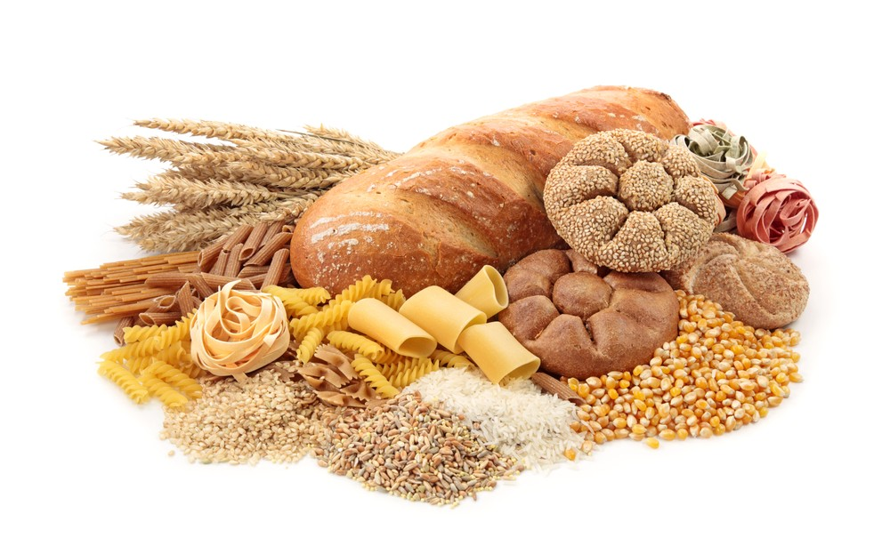
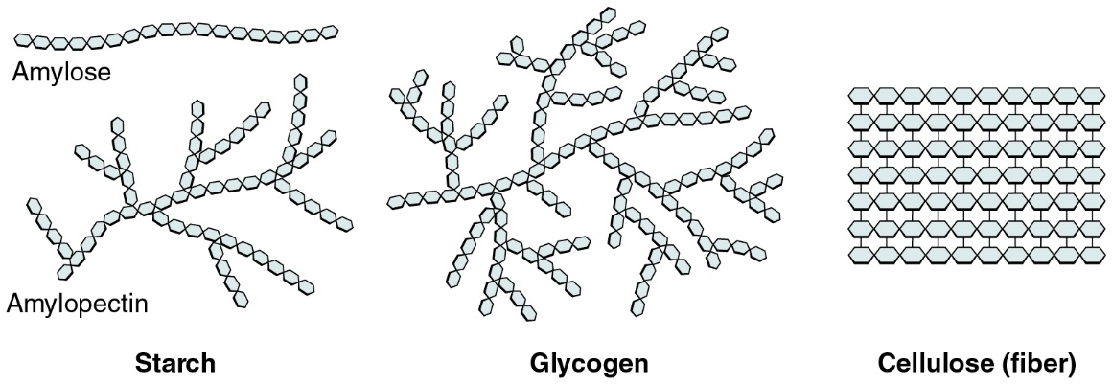
Polysaccharides
Yummy Carbs!!!

Slide 16
Elements in Polysaccharides….
Carbon, Hydrogen, and Oxygen
THINK: “CHO”

Slide 17
The monomers that make up Polysaccharides are called Monosaccharides. -made up of 1 or 2 rings -taste sweet. Examples: glucose and fructose,

Slide 18
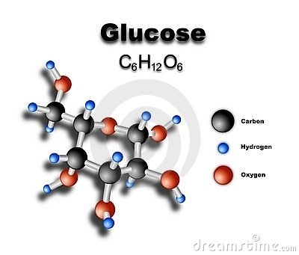
The function of monosaccharides is to give the cell quick energy

Slide 19
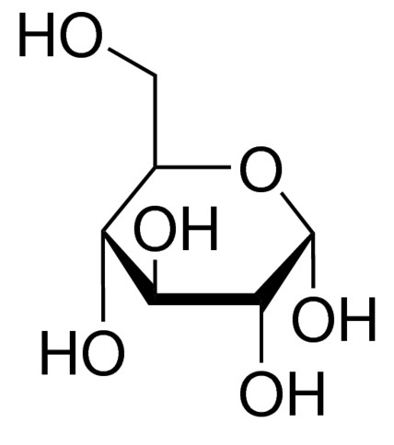
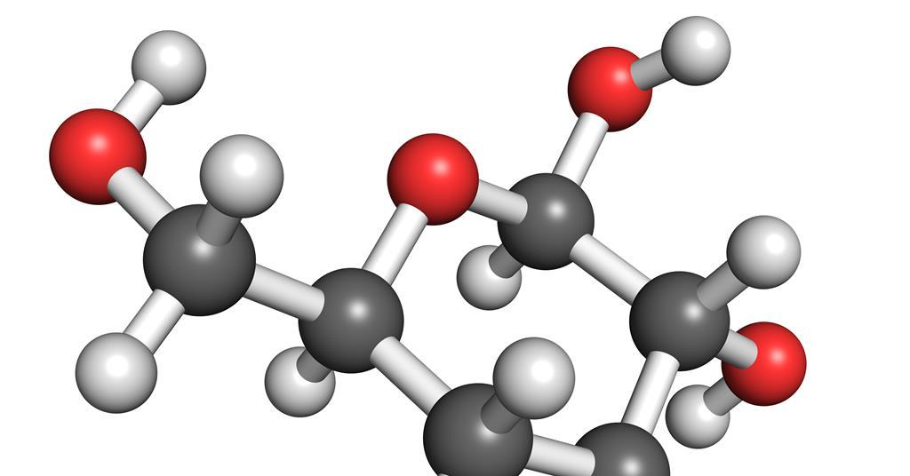
More about Glucose
-Makes up polysaccharides in living things
- Quick energy

Slide 20
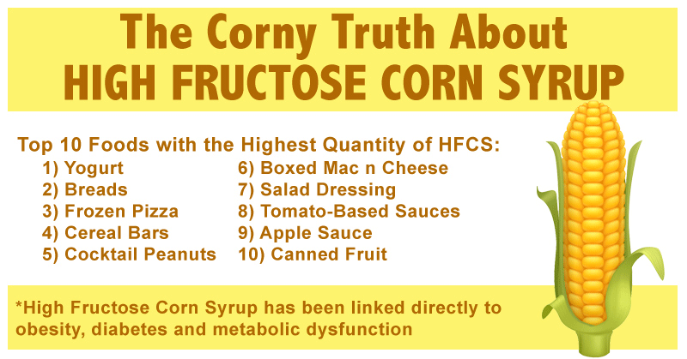
High Fructose Corn Syrup

Slide 21
Polysaccharide Structure…
Strings of glucose!!!!
Glucose monomer

Slide 22
Polysaccharide Function
WHAT DO THEY DO?
Polysaccharides
Starch- glucose storage in plants
Cellulose- forms plant structure
Glycogen- glucose storage in animals

Slide 23
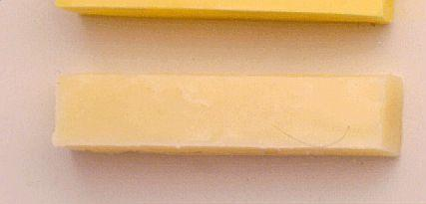
2) LIPIDS
Fats, Oils, and Waxes!!

Slide 24
Elements found in lipids….
Carbon, Hydrogen, and Oxygen
THINK: “CHO”

Slide 25
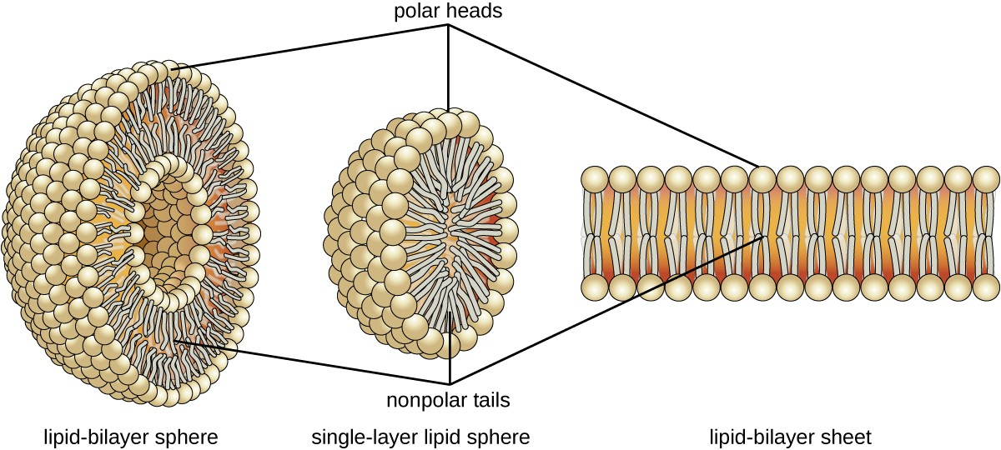
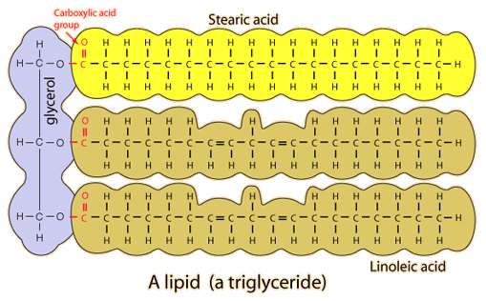
Lipids are NOT Polymers so they do NOT have monomers!

Slide 26
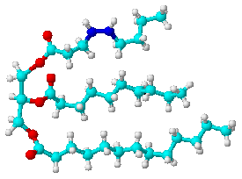
The Shape of a triglyceride is like the letter
E
This is a triglyceride molecule

Slide 27
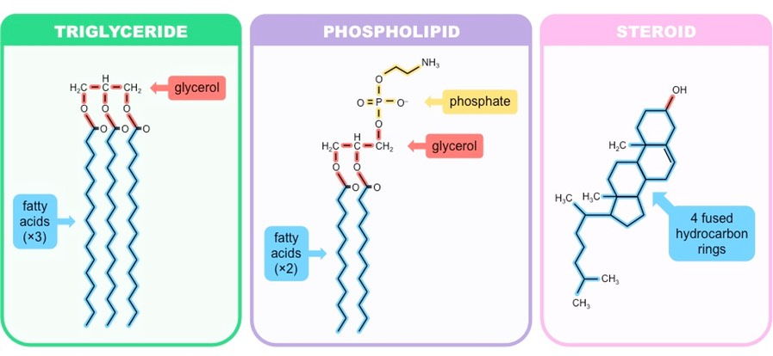
Main Functions of Lipids
Energy Storage- triglycerides
Waterproofing
Hormones- steroids
Form cell membranes- phospholipids

Slide 28
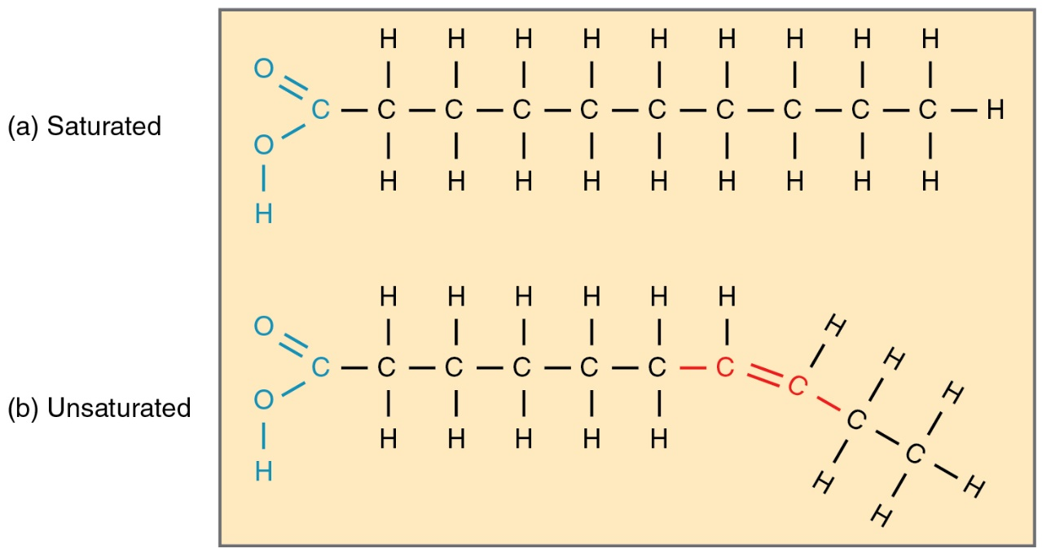
Types of Lipids
Saturated- has only single bonds
Unsaturated- has double or triple bonds

Slide 29
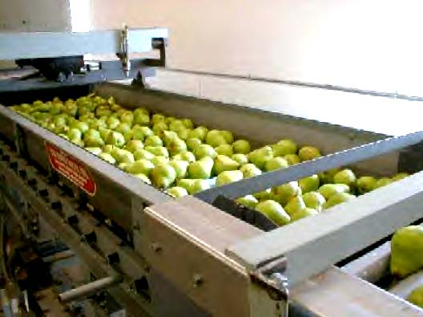
LIPIDS…Some interesting info
Waterproofing...
Fruits produce a waxy coating to keep from drying out.
The cells in a tulip make a wax which helps coat the leaves.
Ear wax traps dust, sand, and other foreign particles from going deeper into the ear and causing damage.
Beeswax- a structural material to hold honey in the hive

Slide 30
LIPIDS…Some interesting info
Steriods...
There are many different types of steroids. They are all lipids. Their functions vary. Some common steroids are:
SEX STEROIDS ANABOLIC STERIODS
CHOLESTEROL
They increase muscle
Like testosterone and estrogen

Slide 31
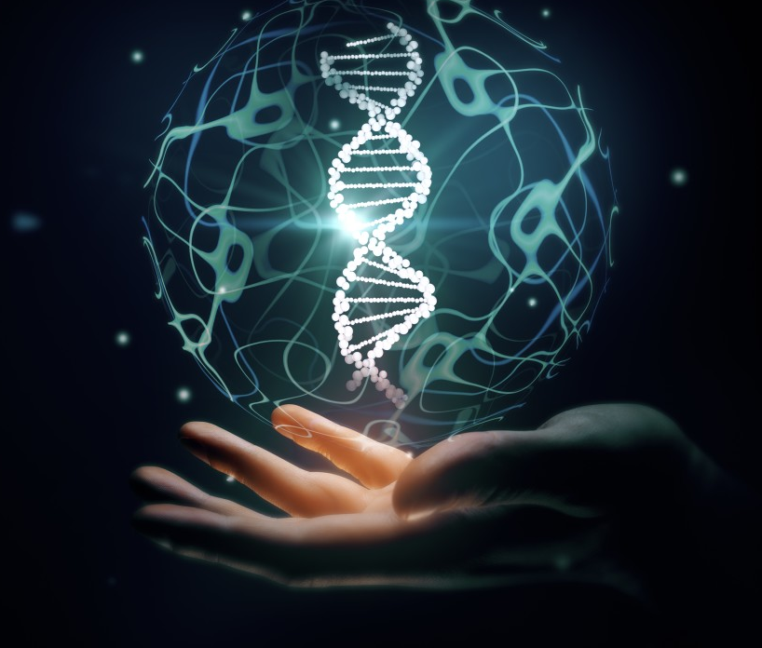
3) NUCLEIC ACIDS

Slide 32
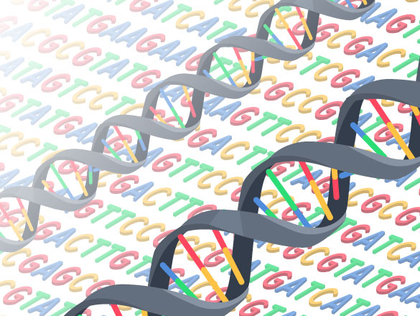
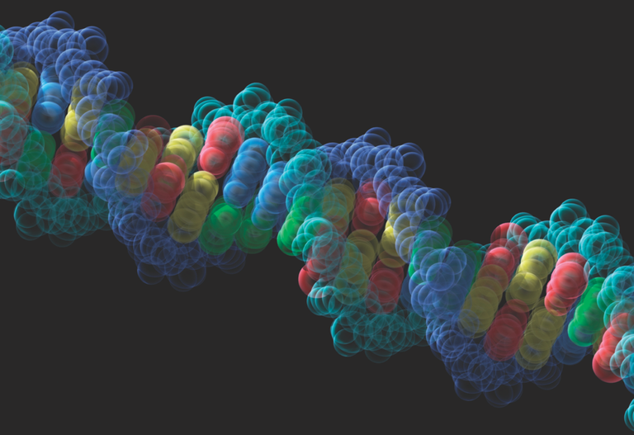
Most Famous Nucleic Acid: DNA!

Slide 33
Elements in Nucleic Acids
Phosphorus, Nitrogen, Carbon,
Hydrogen, and Oxygen
THINK: “PONCH”

Slide 34
NUCLEIC ACID
The monomers that make up nucleic acids are called…
Nucleotides!

Slide 35
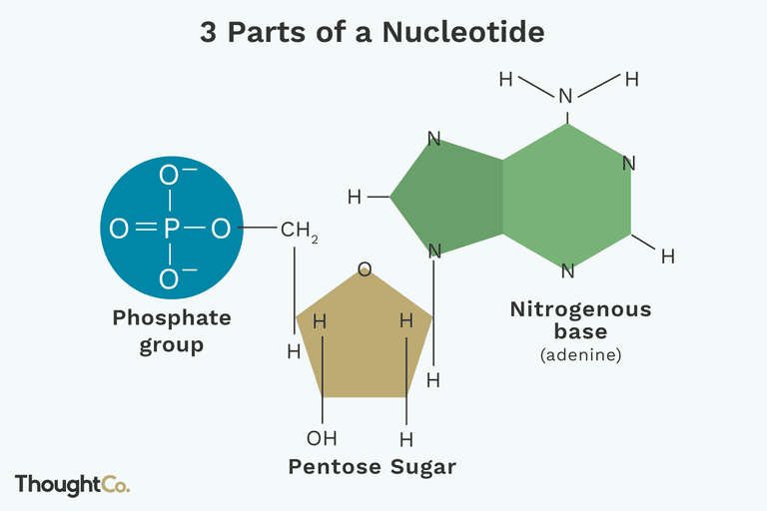
Parts of a Nucleotide
Nucleotide Structure
Sugar
Phosphate
Base

Slide 36
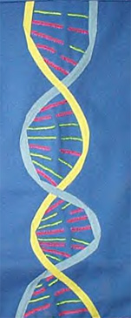
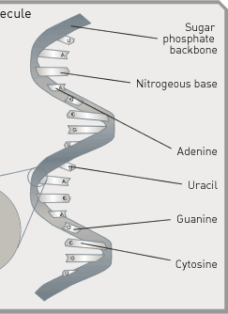
The structure of nucleic acids:
DNA is a double helix
RNA is a single strand

Slide 37
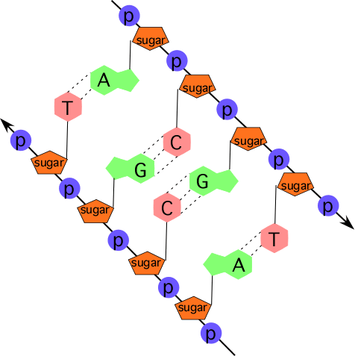
NUCLEIC ACIDS

Slide 38
Nucleic Acids
WHAT DO THEY DO
DNA and RNA contain instructions for making protein

Slide 39
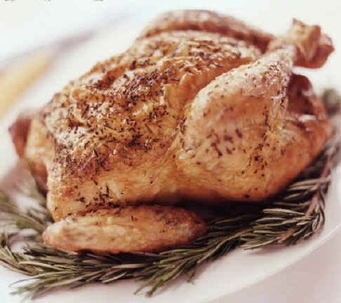
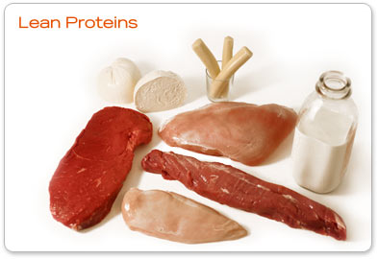
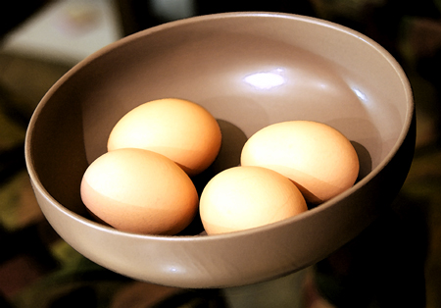
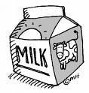
4) Proteins

Slide 40
Elements that make up Proteins are …..
Carbon, Hydrogen, and Oxygen, Nitrogen and sometimes Sulfur
THINK: “CHONS”

Slide 41
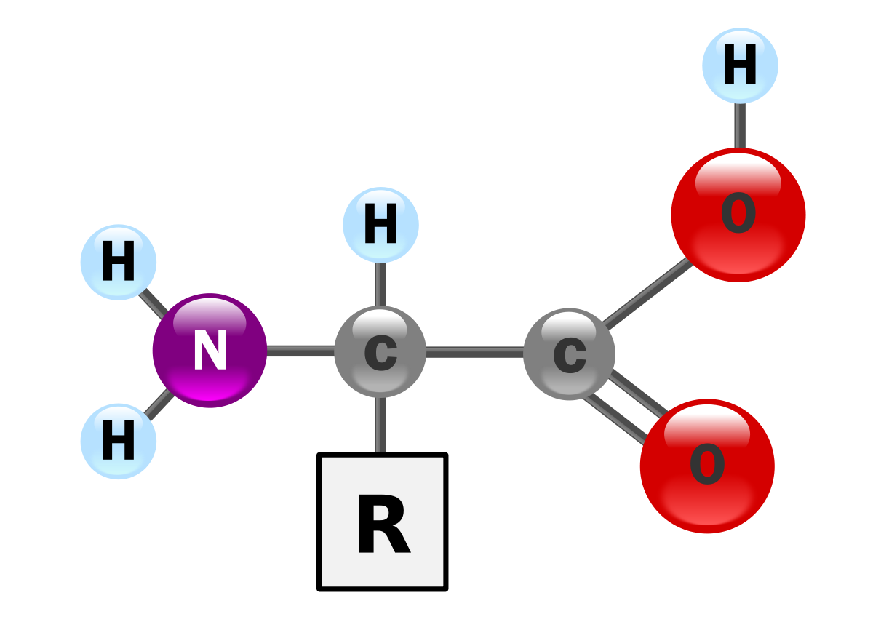
The monomers that make up proteins are called…
AMINO ACID
There are 20 different types of amino acids!

Slide 42
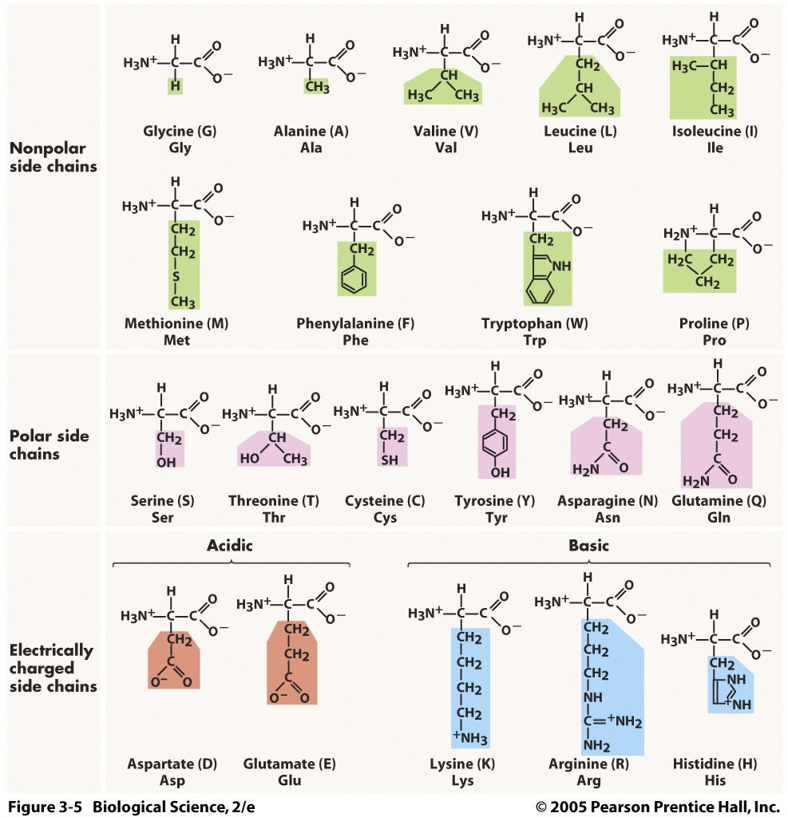

Slide 43
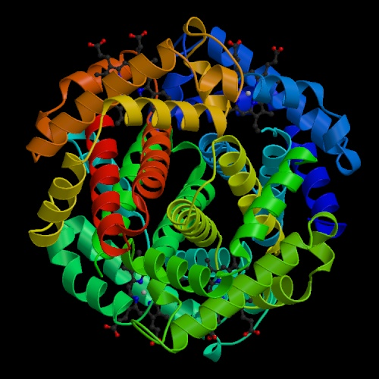
The shapes of proteins are like a balled up piece of string

Slide 44
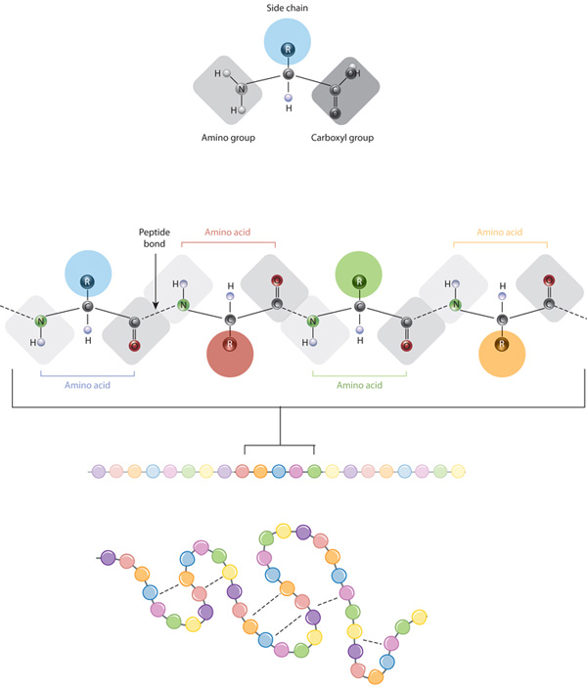

Slide 45
PROTEINS
Types and Functions
They are the major structural molecules in living things for growth and repair : muscles, ligaments, tendons, bones, hair, skin, nails…IN FACT ALL CELL MEMBRANES have protein in them
They make up antibodies in the immune system
They make up enzymes for helping chemical reactions
They makeup non-steriod hormones which
THINK: Proteins= membranes, enzymes, antibodies, non-steriod hormones, structural molecules, “MEANS”

Slide 46
EXAMPLE PROTEIN
hemoglobin
Carries oxygen in blood

Slide 47
REVIEW QUESTIONS
What elements are found in all of the Big 4 molecules? Which of the Big 4 has different elements and what are they?
Since Polysaccharides and Lipids have the same elements in them, how can you tell the difference?
Which molecule is in the shape of a hexagon?
Which molecule is in the shape of an E?
A polymer of amino acids makes what molecule?

Slide 48
Enzymes

Slide 49
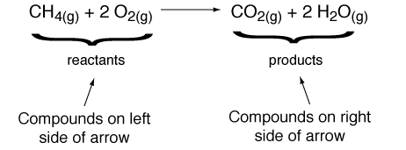
Reactions
Reactants- elements or compounds entering into a chemical reaction
Products- elements or compounds that are produced by a chemical reaction

Slide 50
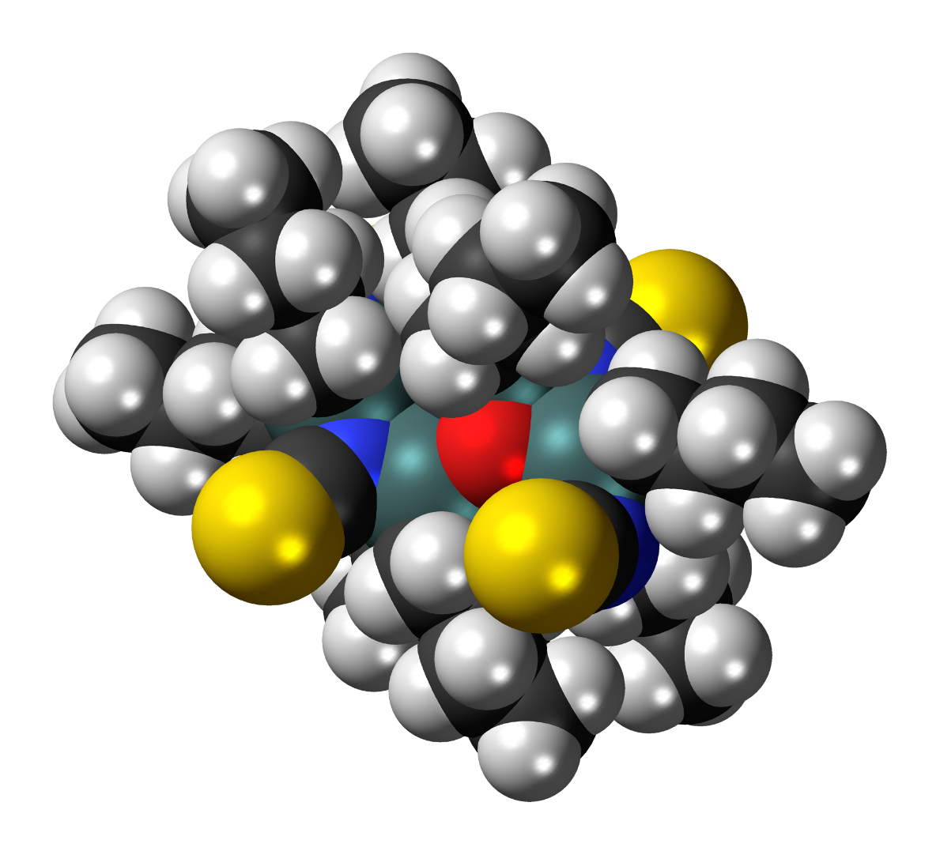
Catalyst
Speeds up a chemical reaction

Slide 51
Enzymes are Catalysts in living things
Animation Menu
Enzymes are catalyst to over 4000 biochemical reactions!
Most enzymes are proteins
http://en.wikipedia.org/wiki/File:GLO1_Homo_sapiens_small_fast.gif
Life Sciences-HHMI Outreach. Copyright 2009 President and Fellows of Harvard College

Slide 52
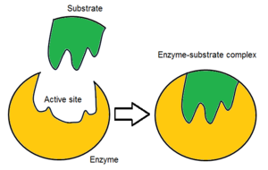
Substrate
Molecule that an enzyme binds to

Slide 53
Active site
Part of the enzyme where the substrate binds

Slide 54
Enzymes fit their substrates like a lock and key

Slide 55
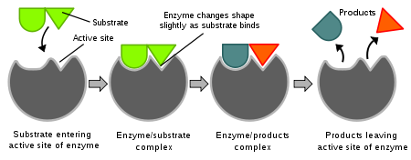
Induced Fit Model
Enzymes can form to the shape of its substrate.
http://en.wikipedia.org/wiki/File:Induced_fit_diagram.svg
Life Sciences-HHMI Outreach. Copyright 2009 President and Fellows of Harvard College

Slide 56
Enzyme-Substrate Complex
Enzyme and its substrate bound together

Slide 57
Factors that Affect Enzymes
pH
Temperature
Enzyme Concentration

Slide 58
Denaturing Enzymes
When an enzyme is denatured it is damaged.
Denaturing changes the shape.
Without the correct shape enzymes won’t function properly.
Some things that can denature enzymes are temperature and pH
Life Sciences-HHMI Outreach. Copyright 2009 President and Fellows of Harvard College

Slide 59
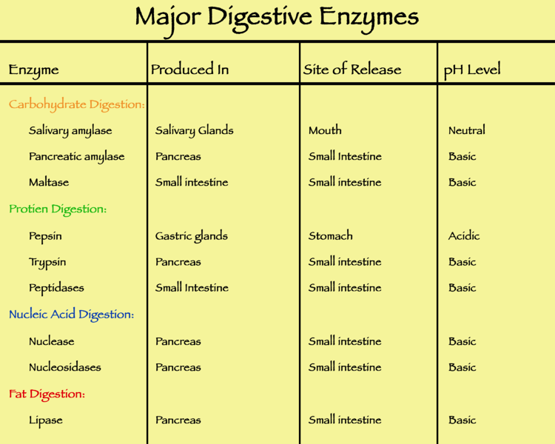
http://upload.wikimedia.org/wikipedia/commons/thumb/6/6f/Major_digestive_enzymes.png/750px-Major_digestive_enzymes.png
Life Sciences-HHMI Outreach. Copyright 2009 President and Fellows of Harvard College

