Slide 1
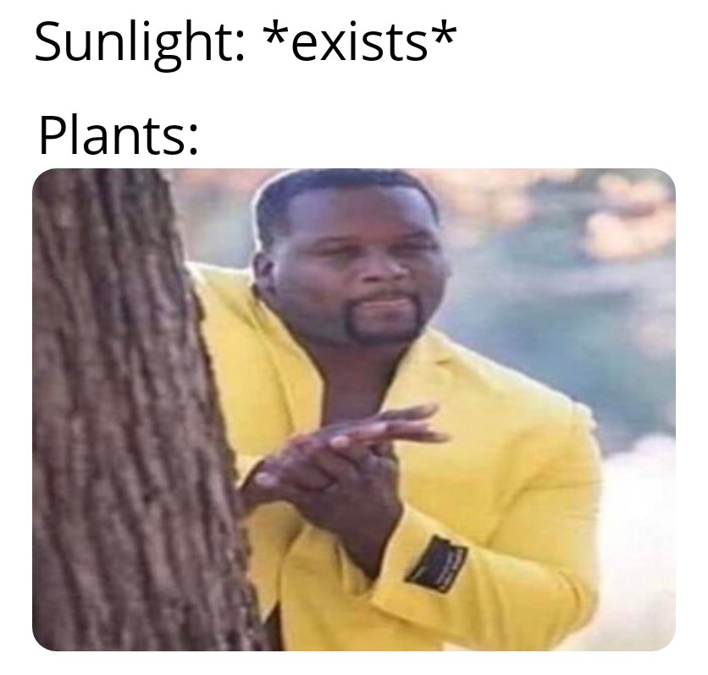

Slide 2
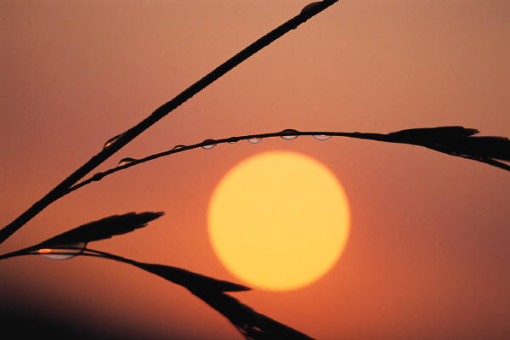
PHOTOSYNTHESIS
The process by which plants and plant-like organisms make glucose from sunlight.
https://www.youtube.com/watch?v=xMSNBlCX8LA

Slide 3
Why is Photosynthesis important?
Makes organic molecules (glucose) out of inorganic materials (carbon dioxide and water).
It begins all food chains/webs. Thus all life is supported by this process.
It also makes oxygen gas!!
Notes:
3

Slide 4
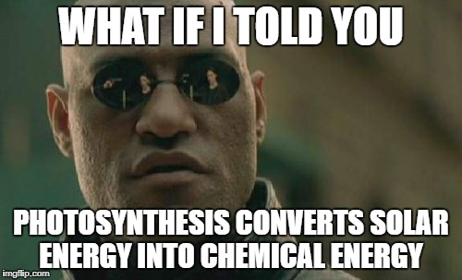

Slide 5
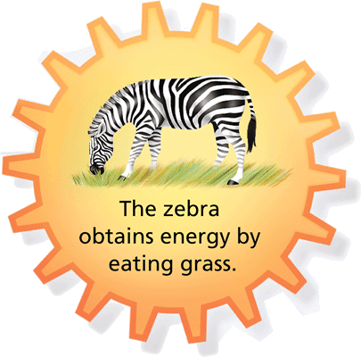
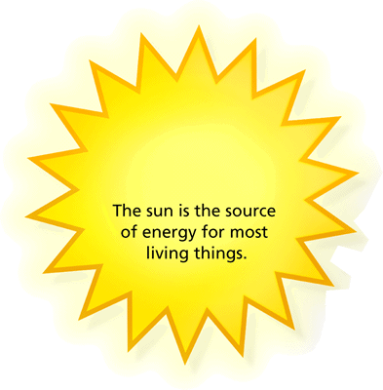
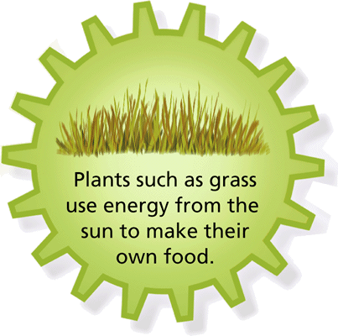
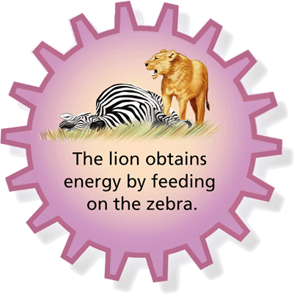
Photosynthesis-starts to ecological food webs!
Notes:
5

Slide 6
How do we know that plants make carbohydrates from just carbon dioxide water and light energy?
Experiments!
For example:
Jan Baptisa van Helmont (1648) planted a willow branch weighing 5 pounds into 200 pounds of soil and then after 4 years the tree weighed 169 lbs. and the soil was still nearly 200 lbs.

Slide 7
Photosynthesis
Carbon dioxide + water glucose + oxygen
sunlight
absorbed by chlorophyll
6CO₂ + 6H₂O + energy → C₆H₁₂O₆ + 6O₂
As can be seen from the equation for photosynthesis, the wood, bark, and root came from water and carbon dioxide.
Notes:
7

Slide 8
Plants in Action
Check it!
What is the process that uses the sun’s energy to make simple sugars?
Notes:
8

Slide 9
Photosynthesis happens in the Chloroplasts
Notes:
9

Slide 10
Chloroplasts contain Chlorophyll
Pigment- molecule that absorbs light
Chlorophyll is a pigment that absorbs light for photosynthesis
Notes:
10

Slide 11
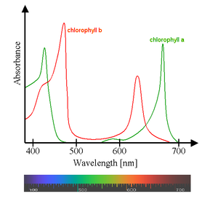
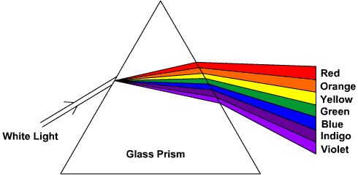
Absorption Spectrum of Chlorophyll
The main types of chlorophyll absorb mainly blue and red light and reflects green

Slide 12
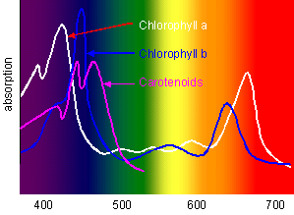
Notes:
12

Slide 13
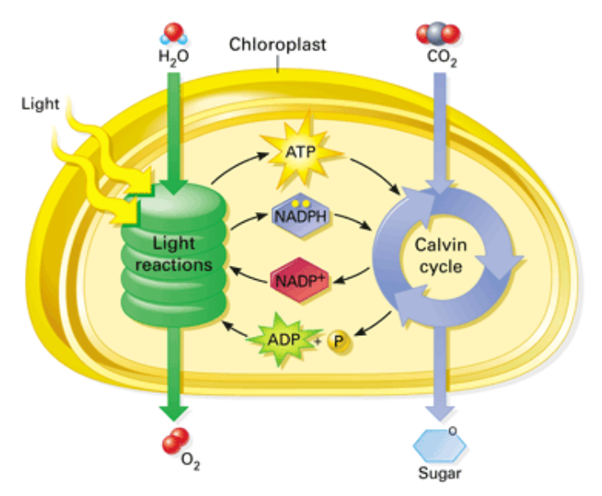
2 Main parts of Photosynthesis: Light Reactions and The Calvin Cycle

Slide 14
Photosynthesis has 2 steps:
1) Light-dependent Reactions: Harvest sun’s energy
2) Calvin Cycle: Uses that energy to build glucose

Slide 15
Main Objective of Light Reactions
To excite electrons and use the energy to make high energy molecules ATP and NADPH
https://www.youtube.com/watch?v=IT6TIv1UKgQ

Slide 16
Light Reaction Players
Photosystem- cluster of proteins and chlorophyll where the electrons are excited by sunlight
Electron Transport Chain- series of proteins that use the energy in an excited electron to make NADPH
ATP Synthase- uses energy from excited electrons to make ATP

Slide 17
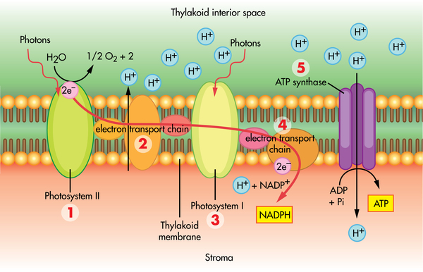
Light Reactions of Photosynthesis
Light is absorbed by chlorophyll and electrons get excited. The excited electrons are then passed onto a series of proteins called an electron transport chain.
Water is split and the oxygen is released into the air.
The energy from the electrons is used to make ATP (from ADP).
The excited electrons then produce NADPH (from NADP).

Slide 18
Summary of Light Reactions
Reactants:
light, ADP, water, NADP
Products:
ATP, NADPH, Oxygen
Location: thylakoid membrane

Slide 19
Oxygen and Sugar!
Notes:
19

Slide 20
PHOTOSYNTHESIS
Light-dependent reaction (LIGHT Reaction)
Requires light
Occurs in chloroplast (in thylakoids)
Light excites electron (e-)
Kicks excited electrons out of chlorophyll to an electron transport chain
Excited Electrons replaced by splitting water

Slide 21
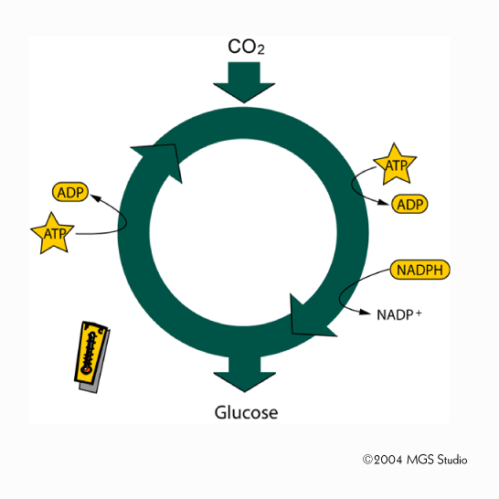
Calvin Cycle (aka Light-Independent or Dark Reactions)
https://www.youtube.com/watch?v=OYSD1jOD1dQ

Slide 22
Main Objective of Calvin Cycle
To use the high energy molecules produced in the light reactions to make glucose

Slide 23
PHOTOSYNTHESIS
Light-independent reaction (Dark Reaction)
Does not require light
Occurs in stroma of chloroplast
Reactants: ATP and NADPH (from light reaction) and CO²
Products: Glucose, ADP, and NADP

Slide 24
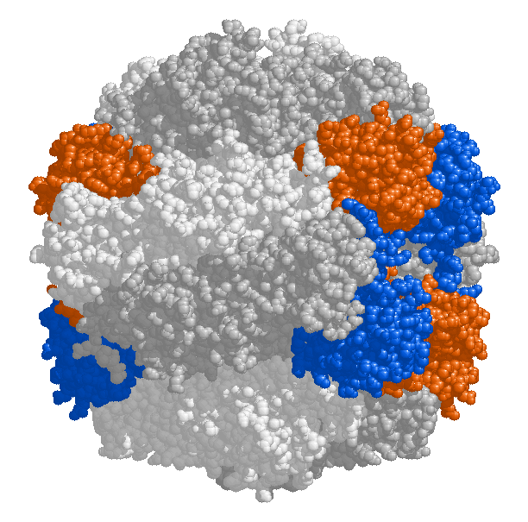
Most important player in Dark Reaction
RuBisCO enzyme
Most abundant enzyme on earth

Slide 25
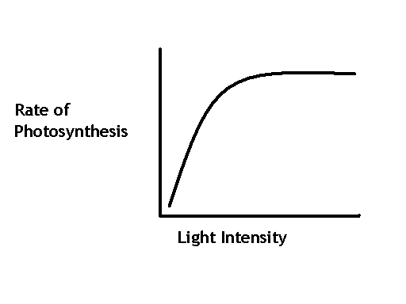
PHOTOSYNTHESIS
What affects photosynthesis?
Light intensity: as light increases, rate of photosynthesis increases

Slide 26
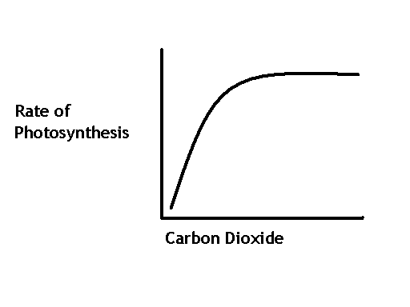
PHOTOSYNTHESIS
What affects photosynthesis?
Carbon Dioxide: As CO₂ increases, rate of photosynthesis increases

Slide 27
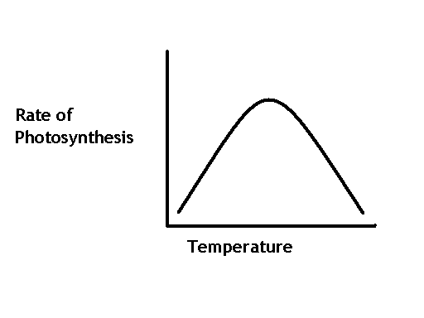
PHOTOSYNTHESIS
What affects photosynthesis?
Temperature:
Temperature Low = Rate of photosynthesis low
Temperature Increases = Rate of photosynthesis increases
If temperature too hot, rate drops

