Slide 1
Protein Synthesis

Slide 2
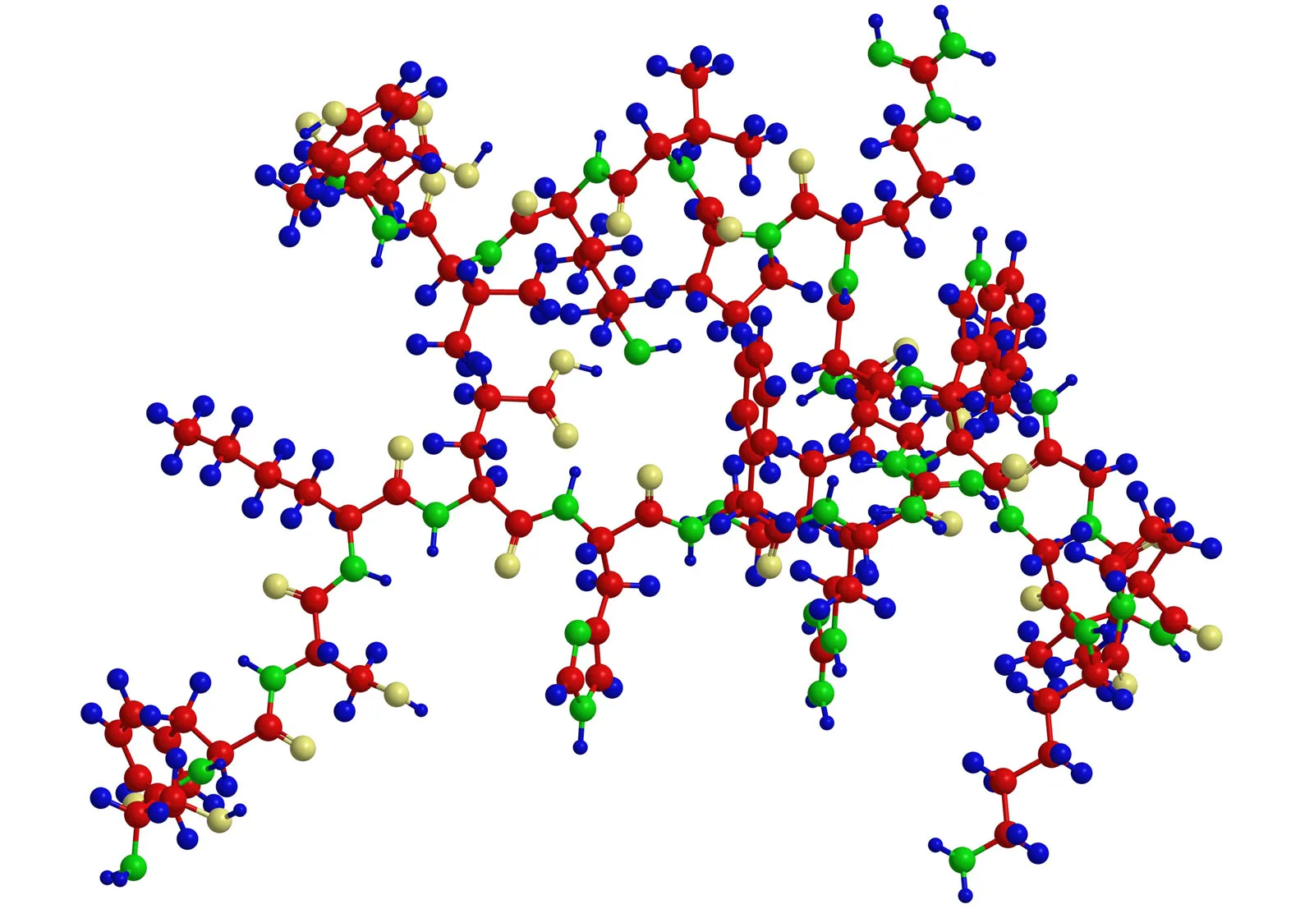
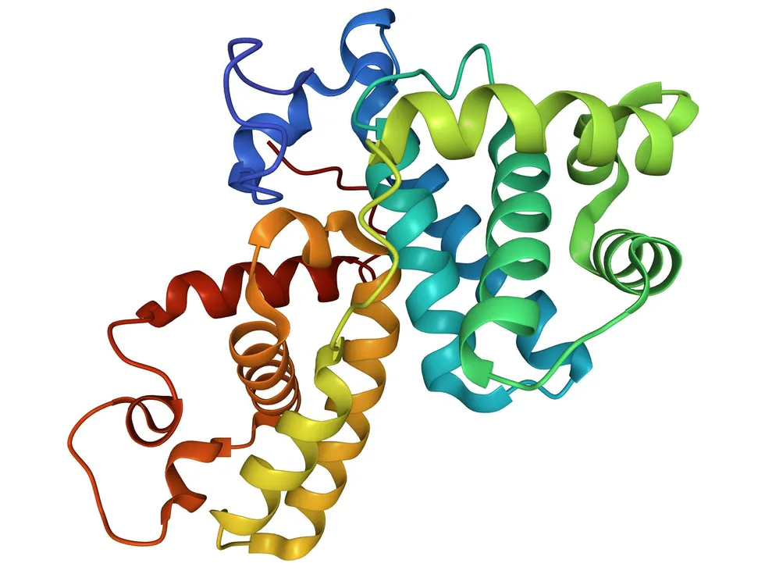
Proteins
Large molecules with complex 3D shapes that perform many functions in the cell

Slide 3
Elements that make up Proteins are …..
Carbon, Hydrogen, Oxygen, Nitrogen, and Sulfur
THINK: “CHONS”

Slide 4
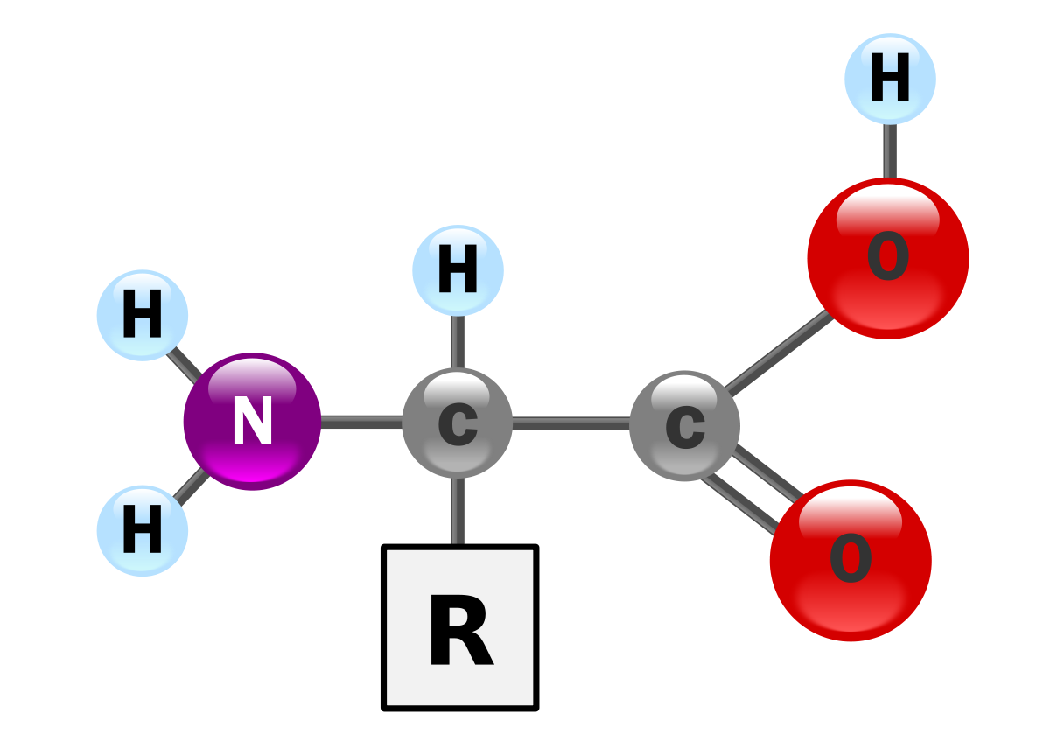
The monomers that make up proteins are called…
AMINO ACID
There are 20 different types of amino acids!

Slide 5
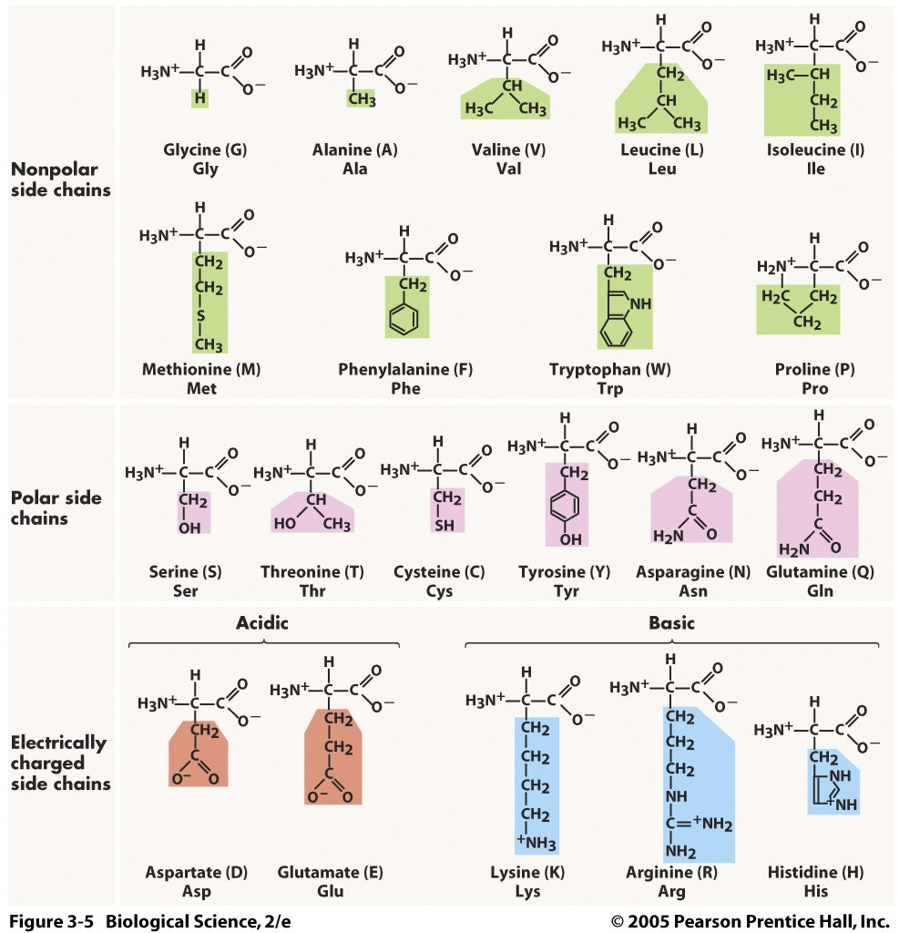

Slide 6
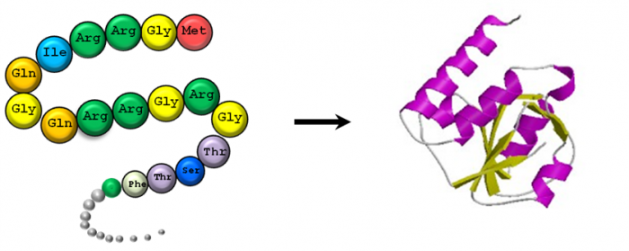
Protein Structure
-

Slide 7
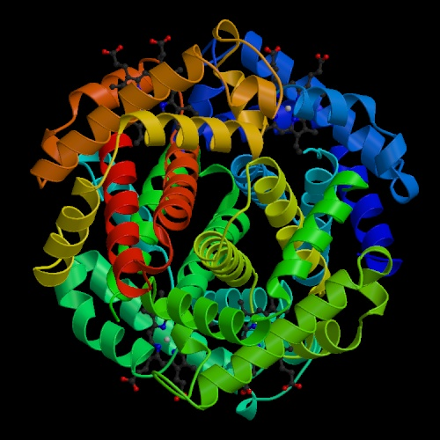
The shapes of proteins are like a balled up piece of string

Slide 8
EXAMPLE PROTEIN
hemoglobin
Carries oxygen in blood

Slide 9
Protein Types and Function
Structure of bones and muscles
2) Antibodies that fight infection
3) Enzymes that speed up chemical reactions
4) Receptors in the membrane that let molecules in and out of the cell or bind signal molecules
5) Non steroid ormones

Slide 10
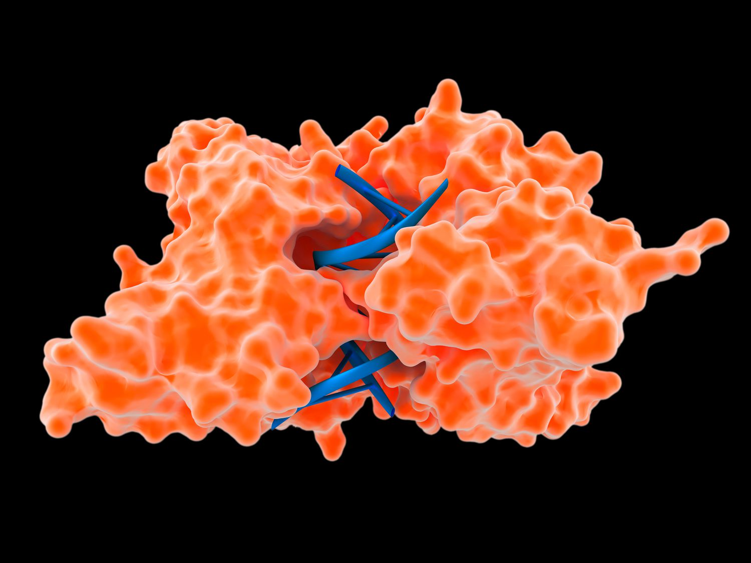
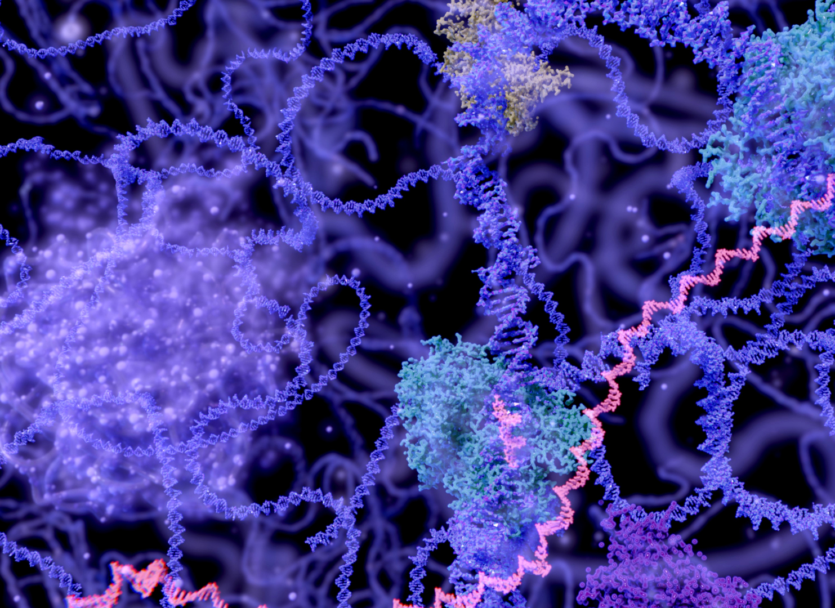
Enzymes
Biological catalysts that speed up chemical reactions.

Slide 11
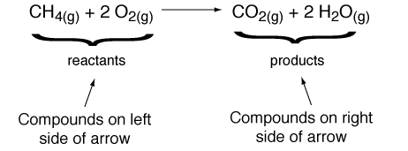
Reactions
Reactants- elements or compounds entering into a chemical reaction
Products- elements or compounds that are produced by a chemical reaction

Slide 12
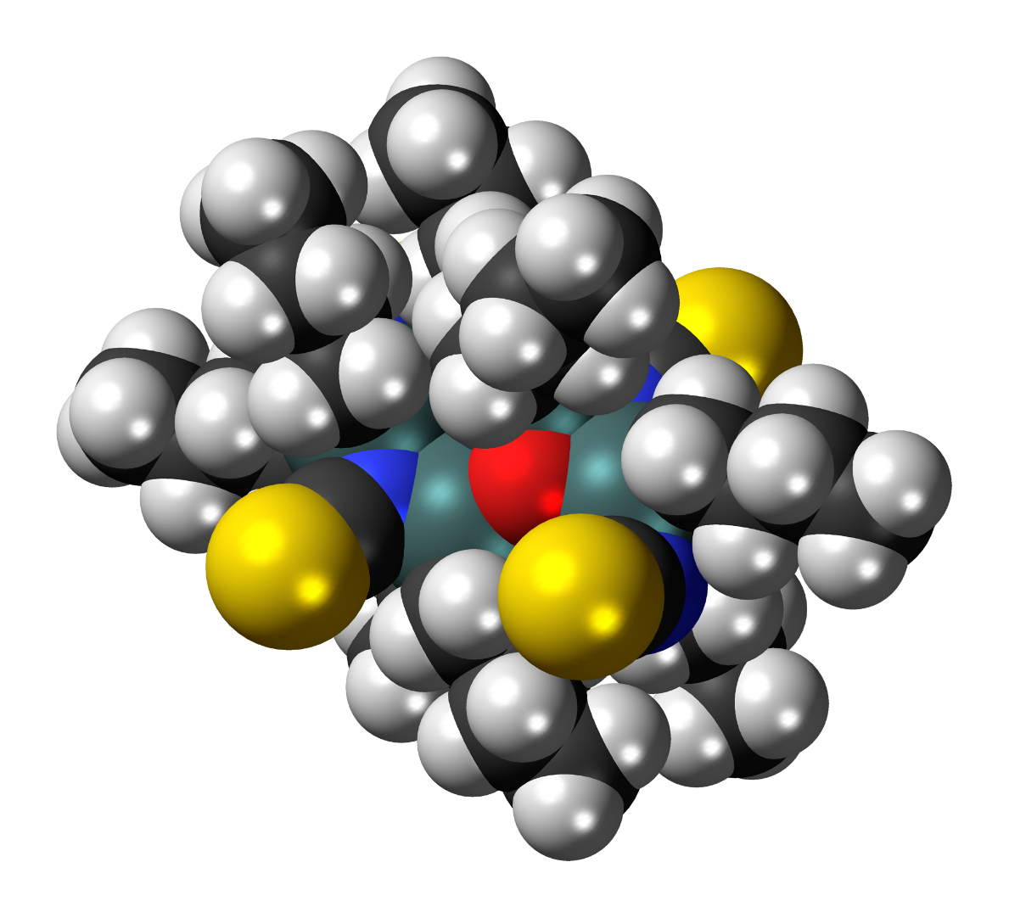
Catalyst
Speeds up a chemical reaction

Slide 13
Enzymes are Catalysts in living things
Animation Menu
Enzymes are catalyst to over 4000 biochemical reactions!
Most enzymes are proteins
http://en.wikipedia.org/wiki/File:GLO1_Homo_sapiens_small_fast.gif
Life Sciences-HHMI Outreach. Copyright 2009 President and Fellows of Harvard College

Slide 14
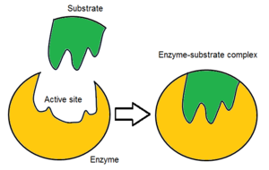
Substrate
Molecule that an enzyme binds to

Slide 15
Active site
Part of the enzyme where the substrate binds

Slide 16
Enzymes fit their substrates like a lock and key

Slide 17
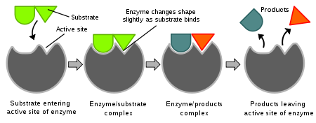
Induced Fit Model
Enzymes can form to the shape of its substrate.
http://en.wikipedia.org/wiki/File:Induced_fit_diagram.svg
Life Sciences-HHMI Outreach. Copyright 2009 President and Fellows of Harvard College

Slide 18
Enzyme-Substrate Complex
Enzyme and its substrate bound together

Slide 19
Factors that Affect Enzymes
pH
Temperature
Enzyme Concentration

Slide 20
Denaturing Enzymes
When an enzyme is denatured it is damaged.
Denaturing changes the shape.
Without the correct shape enzymes won’t function properly.
Some things that can denature enzymes are temperature and pH
Life Sciences-HHMI Outreach. Copyright 2009 President and Fellows of Harvard College

Slide 21
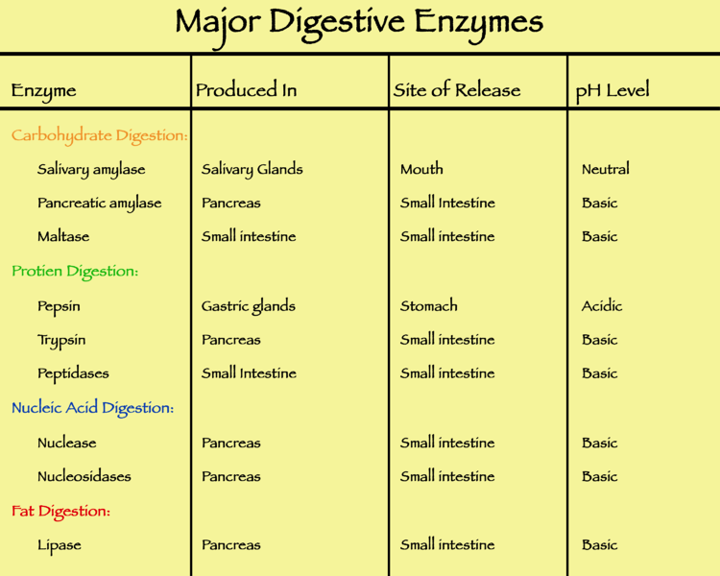
http://upload.wikimedia.org/wikipedia/commons/thumb/6/6f/Major_digestive_enzymes.png/750px-Major_digestive_enzymes.png
Life Sciences-HHMI Outreach. Copyright 2009 President and Fellows of Harvard College

Slide 22
Protein Synthesis- the process by which proteins are made

Slide 23
Gene
A piece of DNA that has instructions for making one protein

Slide 24
Protein Synthesis Song
https://www.youtube.com/watch?v=JTc18Yh7bSU

Slide 25
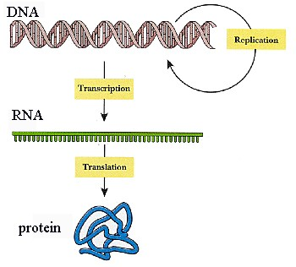
Protein Synthesis has 2 steps

Slide 26
Introducing……Ribonucleic Acid (RNA)!
Type of Nucleic acid
Single stranded
Has ribose instead of deoxyribose
Contains 4 bases:
1) uracil
2) cytosine
3) adenine
4) Guanine
3 types we will be talking about:
(messenger, ribosomal, transfer)

Slide 27
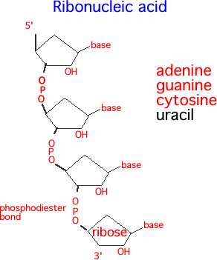
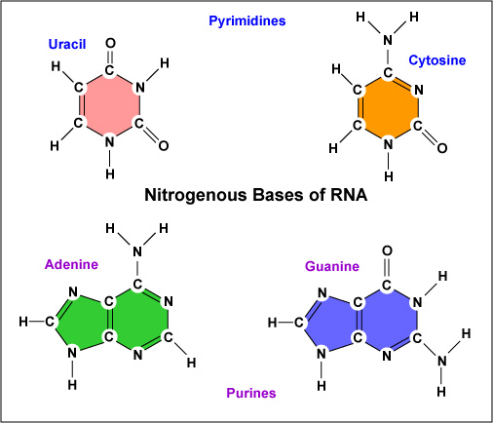
RNA structure

Slide 28
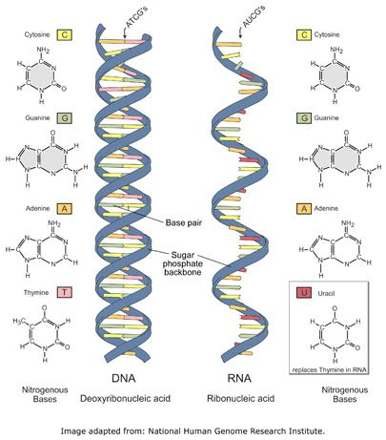

Slide 29
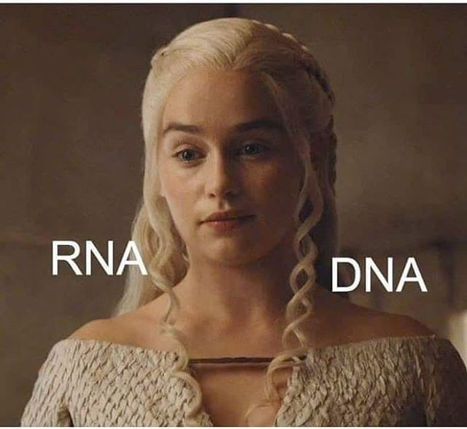

Slide 30
2 Main Parts of Protein Synthesis
Transcription
Translation

Slide 31
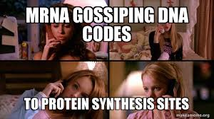
Transcription
Location- nucleus
Objective- Uses DNA to make messenger RNA (disposable copy of the DNA)

Slide 32
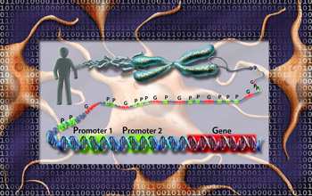
Transcription Steps
RNA polymerase binds to the DNA promotor region to separate strands
2) It then uses the DNA as template to construct messenger RNA, using base pairing rules
3) RNA polymerase proofreads to
make sure the RNA is correct

Slide 33
Transcription follows base pairing rules
If there’s a C in the
DNA, there will be a G
in the mRNA.
If there’s an A in the DNA,
there will be a U in the mRNA
DNA: CTTTAGAAA
mRNA:GAAAUCUUU

Slide 34
Example of Transcription

Slide 35
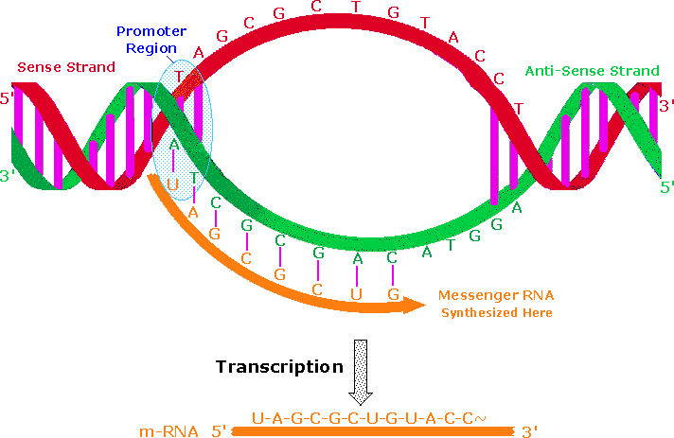
Transcription Song!
https://www.youtube.com/watch?v=JTc18Yh7bSU

Slide 36
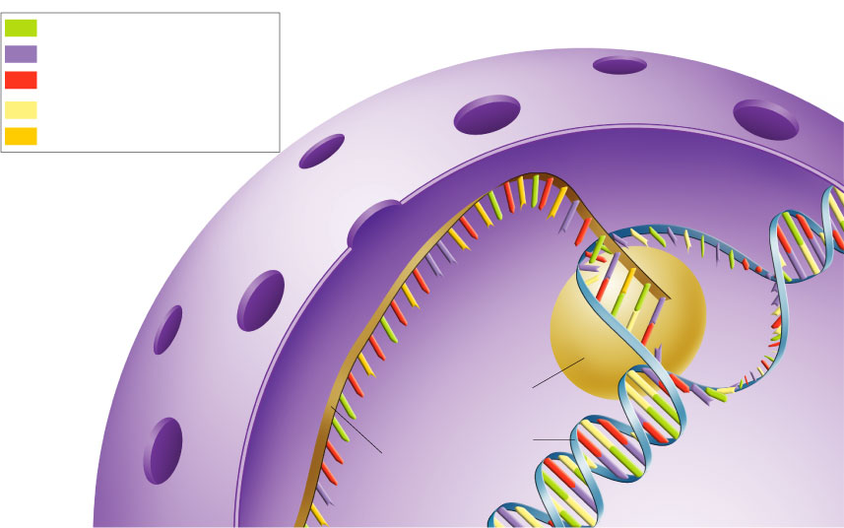
Section 12-3
Adenine (DNA and RNA)
Cystosine (DNA and RNA)
Guanine(DNA and RNA)
Thymine (DNA only)
Uracil (RNA only)
RNA polymerase
DNA
RNA

Slide 37
mRNA editing
Introns- RNA sequences that don’t make proteins
“in the way”
Exons- RNA sequences that make proteins
Introns are removed before going to next
step in protein production!

Slide 39
Remember that a protein is a string of amino acids Translation uses the code from the mRNA to build the amino acid chain
Translation

Slide 40
The Code
1) Genetic Code- the sequence of bases in mRNA that determines the amino acids in the protein
2) Codon- 3 bases in messenger RNA (mRNA) that code for 1 amino acid
mRNA: UCGCACGGU
codons: UCG - CAC - GGU

Slide 41
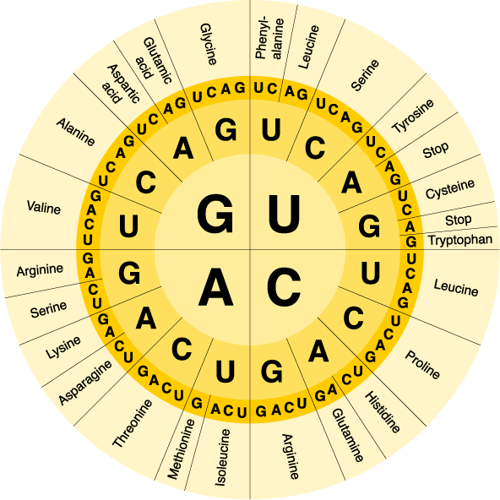
Use a diagram to see which amino acid each codon represents:
Section 12-3

Slide 42
Example:

Slide 43
But how is the amino acid chain actually built?

Slide 44
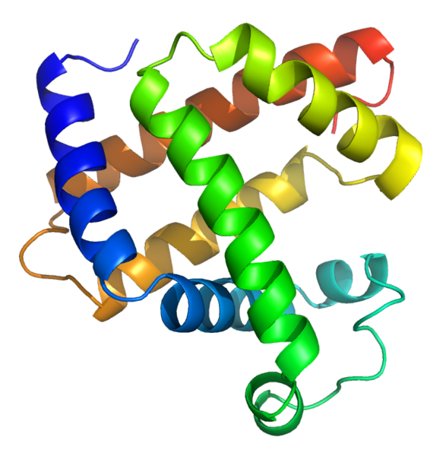
Translation
Location: Ribosomes
Objective: to use mRNA to build an amino acid chain
(protein)

Slide 46
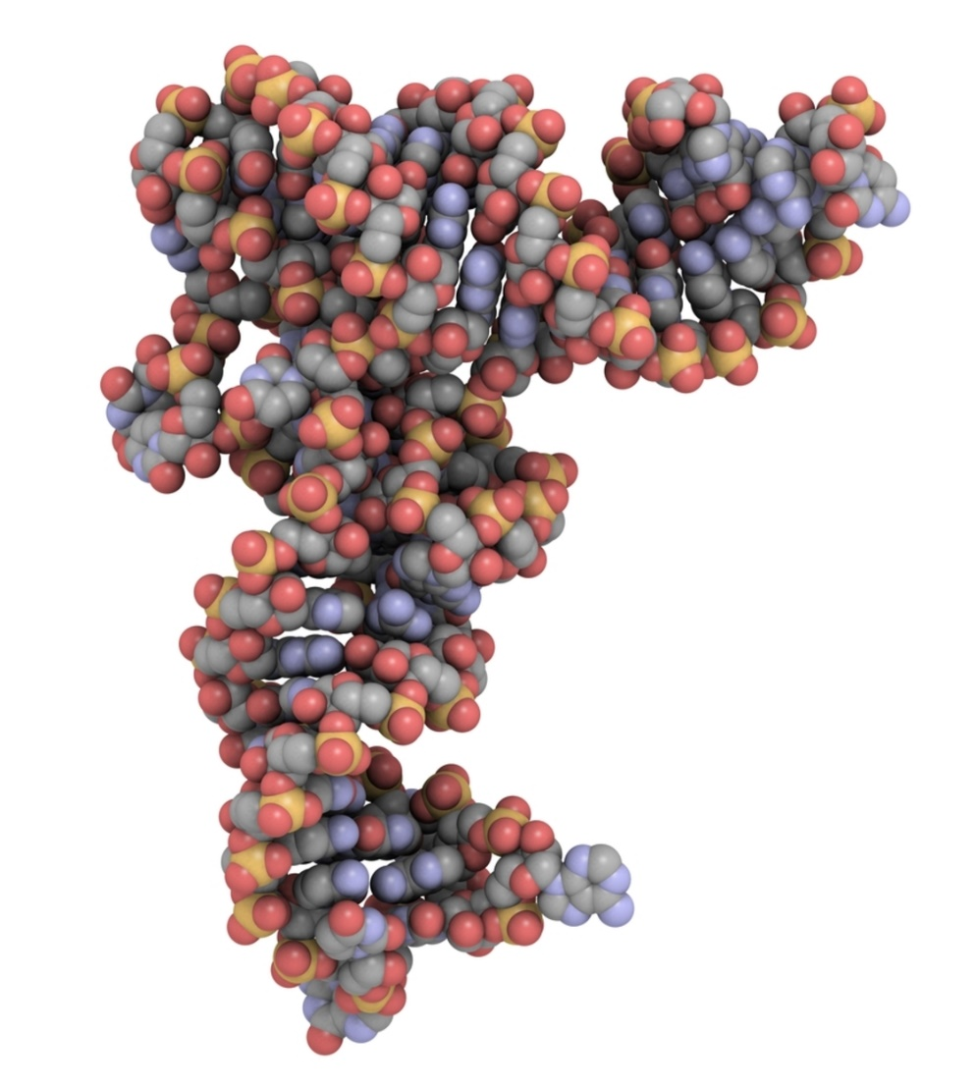
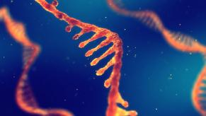
Important Molecules for Translation
Transfer RNA
Ribosomal RNA

Slide 47
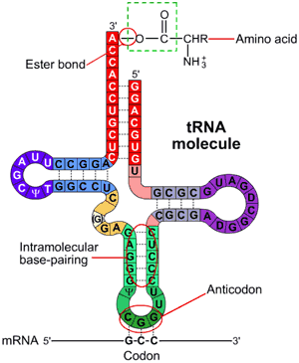
Transfer RNA
A type of RNA that binds to the
messenger RNA and adds an
amino acid to the protein
Parts of a tRNA molecule:
1) amino acid end
2) Anticodon- 3 bases on the other
end that bind to a codon on mRNA

Slide 48
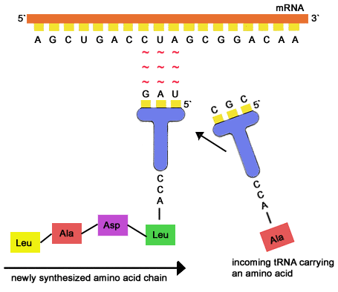
Transfer RNA
Binds to mRNA and
adds appropriate
amino acid to growing
protein
Each type transports
only 1 type of amino
acid

Slide 49
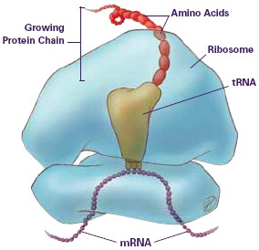
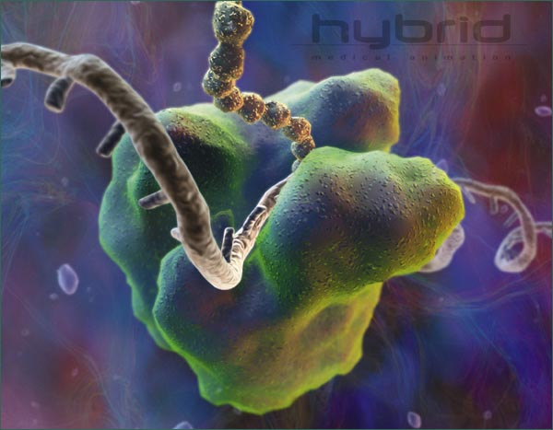
Ribosomal RNA

Slide 50
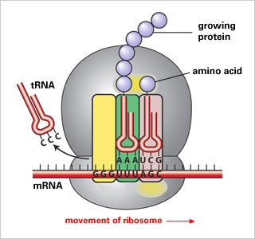
Translation
mRNA leaves the nucleus
and goes to ribosome
2)tRNA molecules bind to the
codons in mRNA, and add their
amino acids to thegrowing protein.
1st amino acid is always methionine
1st codon is always AUG
3) The tRNA molecules bind ONE AT A TIME
4) When a “stop” codon is reached, the process ends

Slide 51
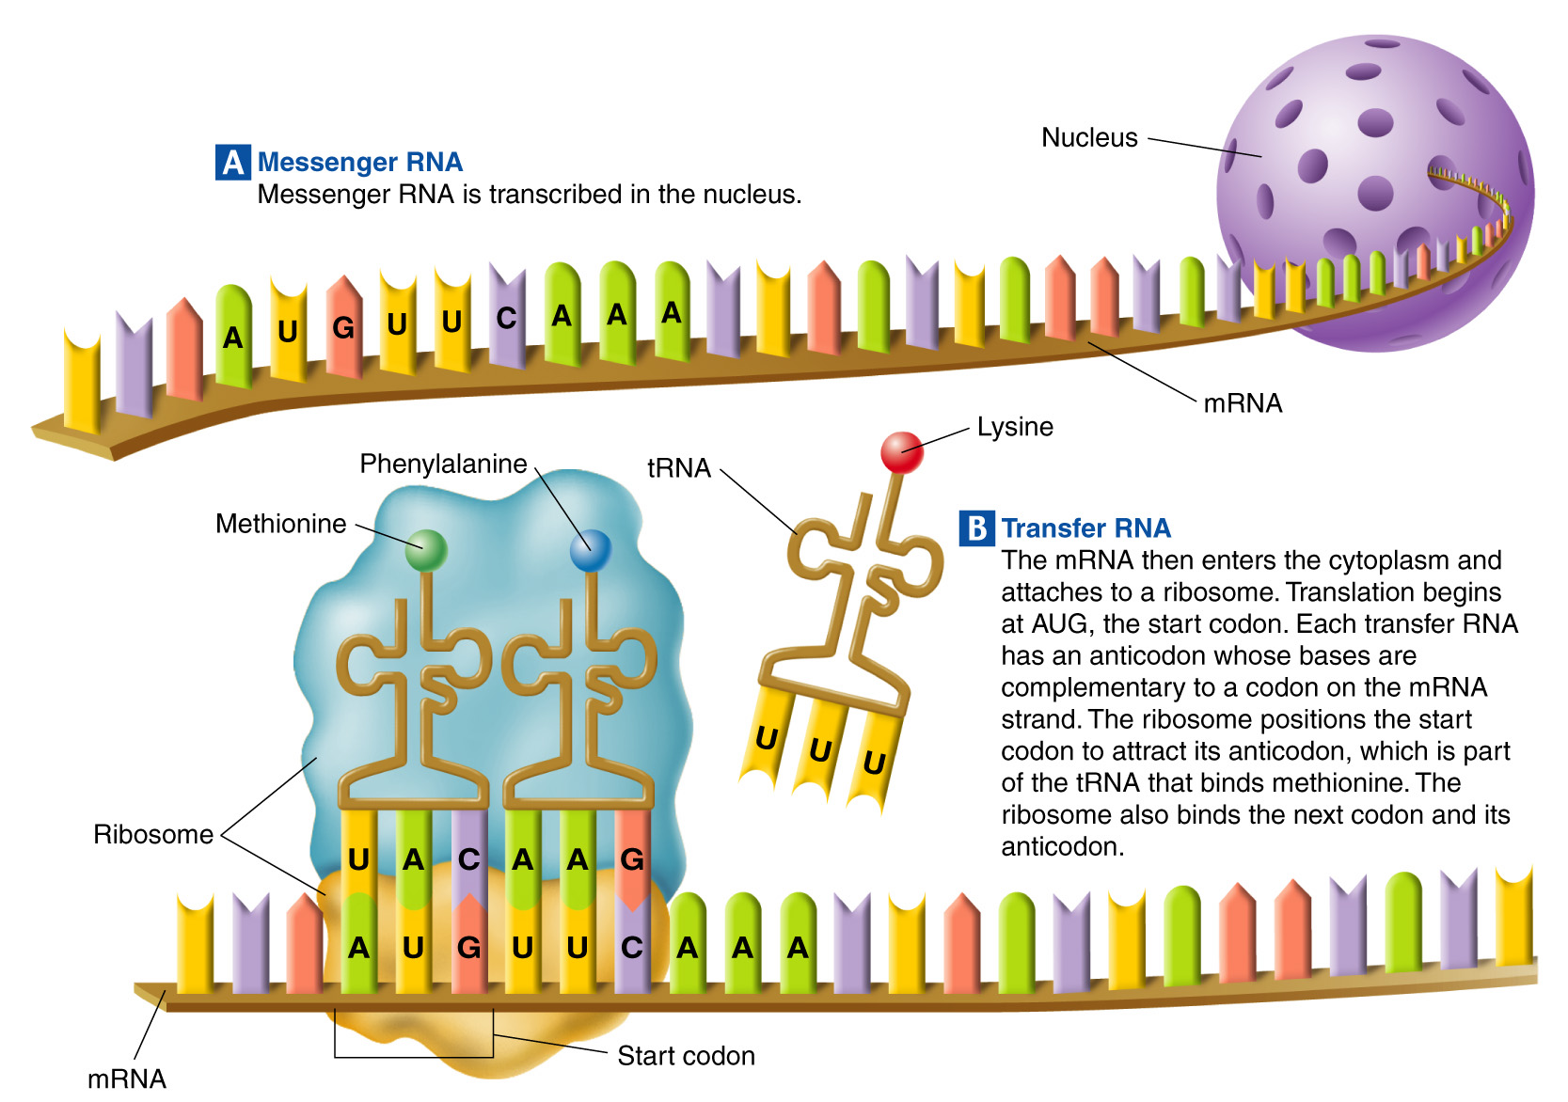
Section 12-3

Slide 52
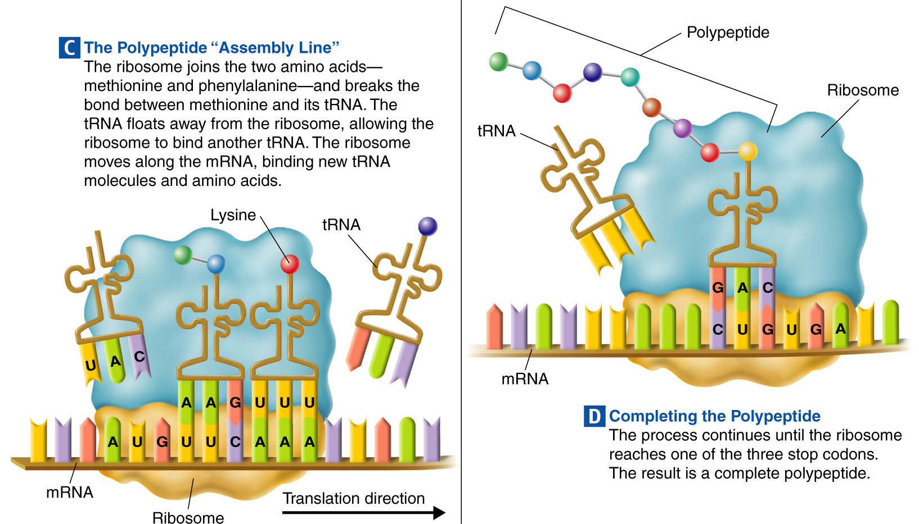
Section 12-3

Slide 53
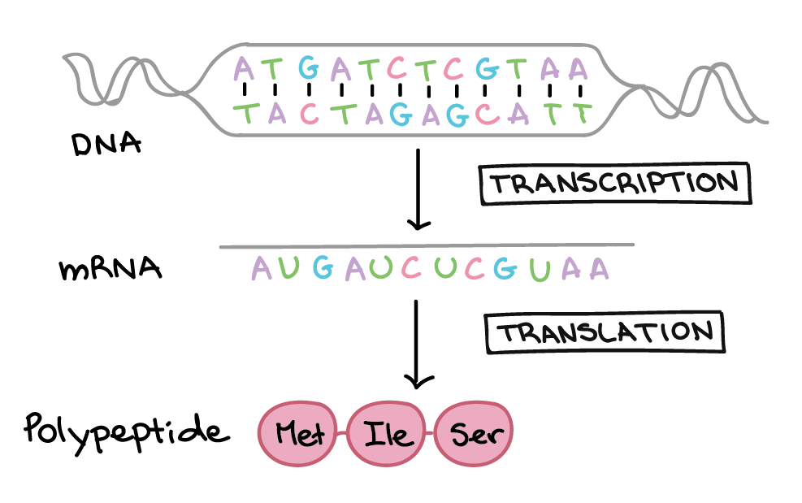

Slide 54
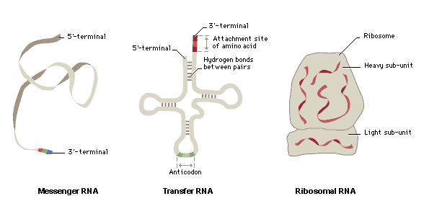
Types of RNA (Summary)

Slide 55
Amoeba Sisters Video Summary
https://www.youtube.com/watch?v=oefAI2x2CQM

Slide 56
Gene Regulation

Slide 57
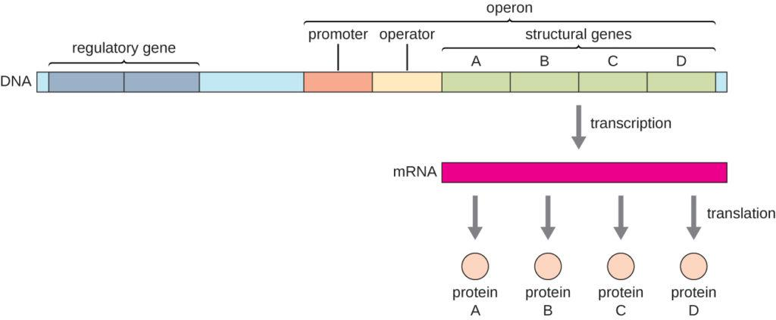
Prokaryotic Regulation
Operon- group of genes under the control of a single promoter

Slide 58
Lac Operon
Has genes that make enzymes to break down lactose

Slide 59
Lac Operon Parts
Promoter- part of DNA before the gene where RNA Polymerase binds.
Operator- where repressor can bind
Repressor- binds to operator to stop transcription when no lactose is there.

Slide 60
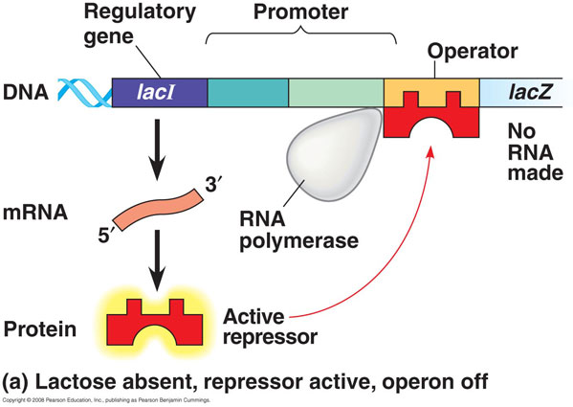
Inactive Lac Operon
Operator- binds repressor

Slide 61
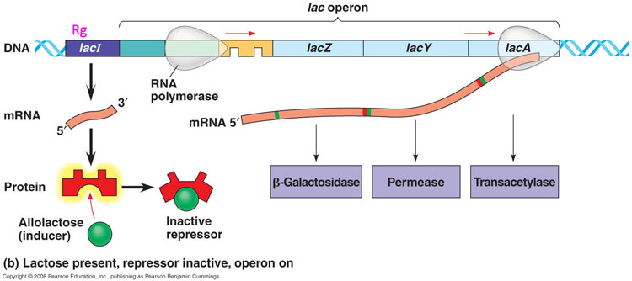
Active lac operon
Lactose can be broken down

Slide 62
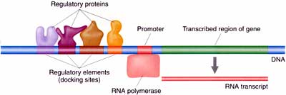
Eukaryotic Gene Regulation
Genes controlled individually
NO OPERONS!!!!
Have more complex regulatory sequences

Slide 65
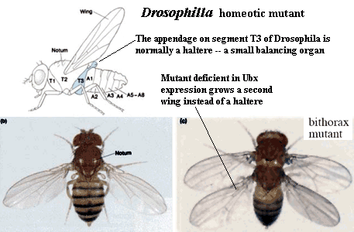
Differentiation
Process by which cells become specialized
Hox genes- control differentiation of cells in the embryo

Slide 66
Mutations

Slide 67
Objectives
To learn the 2 main types of mutations
Given a mutation, identify its type
Predict how a mutation will affect a protein.

Slide 68
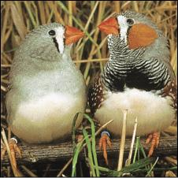
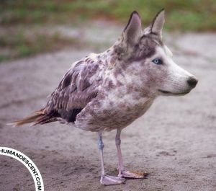
Mutations
Changes in genetic material (DNA)

Slide 69
2 main types of mutations
Point mutation- change in one or a few nucleotides (letters)
Chromosomal mutation- change in very large section of DNA

Slide 70
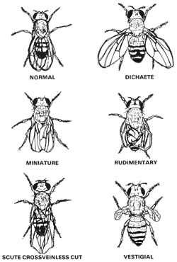
Types of Point Mutations
Substitution- one base is replaced with another
Normal: ATCG
Mutation: AGCG
2) Insertion- adds nucleotides
Normal: ATCG
Mutation: ATCCG
3) Deletion- takes them away
Normal: ATCG
Mutation: ATG

Slide 71
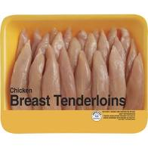

Slide 72
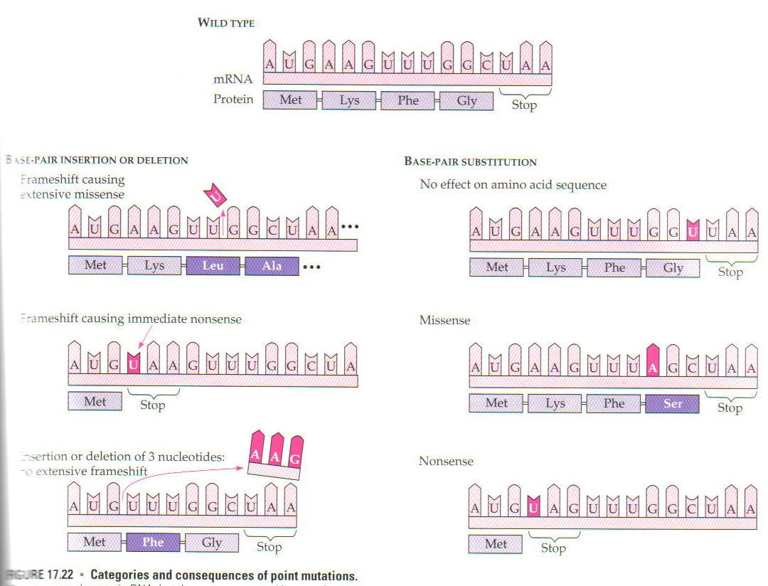

Slide 73
Frameshift mutation- causes change in grouping of codons

Slide 75
Sickle Cell Anemia

Slide 77
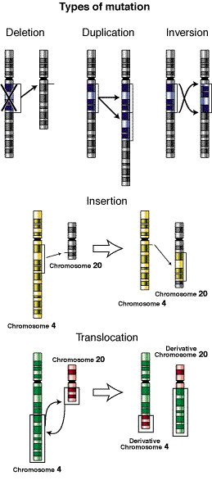
Chromosomal mutations
Changes in very large section of DNA
-more than one gene is
affected
Chromosome- very large piece of DNA
with many genes
Polyploidy- organism has
extra set of chromosomes

Slide 78
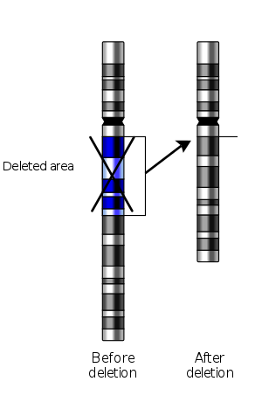
Deletion
Part of chromosome missing

Slide 79
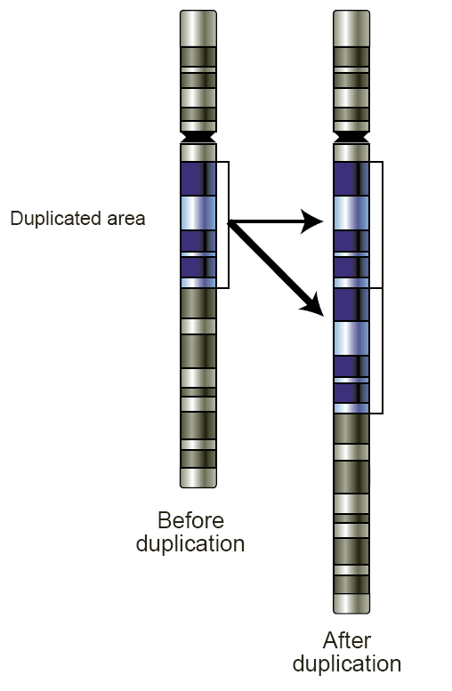
Duplication
Piece is duplicated

Slide 80
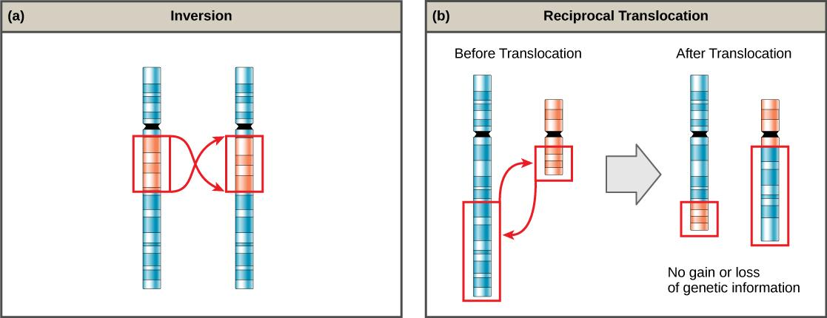
Inversion
Piece is added backwards

Slide 81
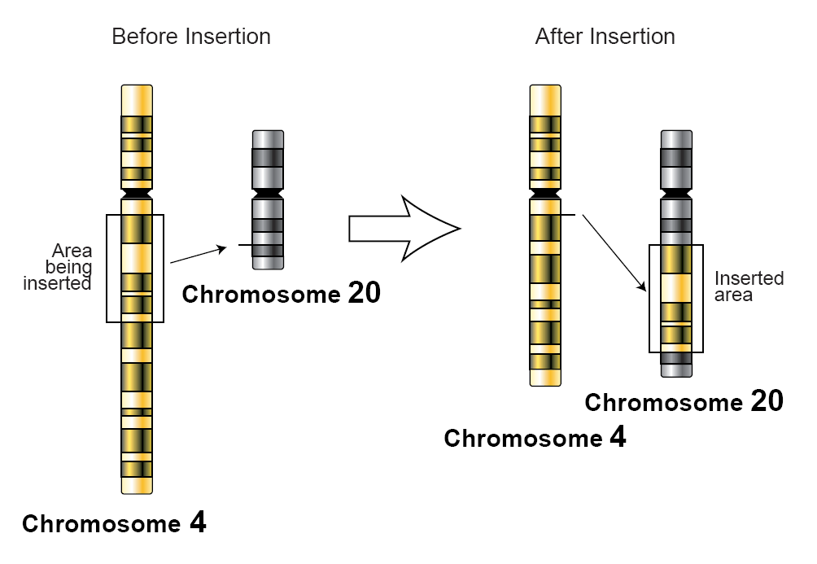
Insertion
Piece is added

Slide 82
Translocation
Piece inserted in the wrong spot

