Slide 1
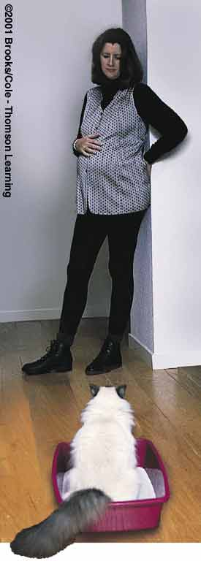
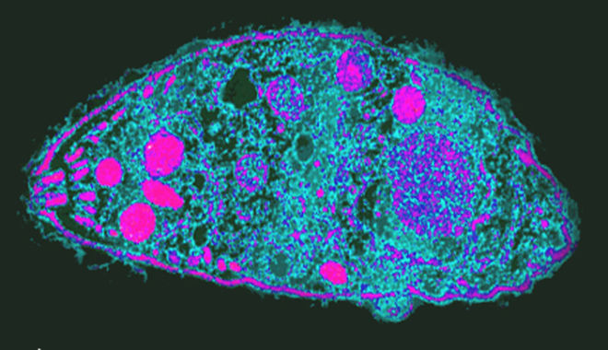
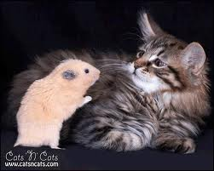
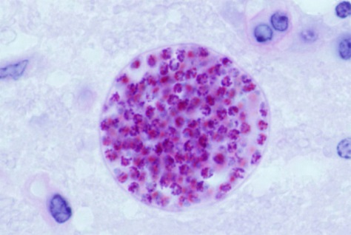
PROTISTS
Know the characteristics of protists and different types of protists
Parasite : Toxoplasma
Disease: toxoplasmosis
Notes:
Toxo influences the brain
The parasitic protist toxoplasma gondii causes its rat host to become more curious and less fearful. Such changes make infected rats easier prey of the cats, the other host of the parasite. The cat eats the infected rat and itself becomes infected with the parasite. Toxo as its informally called can infect birds and mammals. Most often contracted from raw meat, toxo caused more deaths and illness than any other food borne pathogen other than salmonella..mild flu like symptoms and enlarged lymph nodes. Pregnant women are at risk from acute toxo infections since the parasite can cause birth defect, slower reaction times, higher rates of accident, increased rates of anxiety and resistance to new situations.

Slide 2
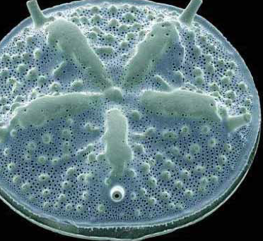
Protists are all alike in that all are _____
Bacterial
Photosynthetic
Prokaryotic
Archaean
Eukaryotic
Notes:
Ans: E

Slide 3
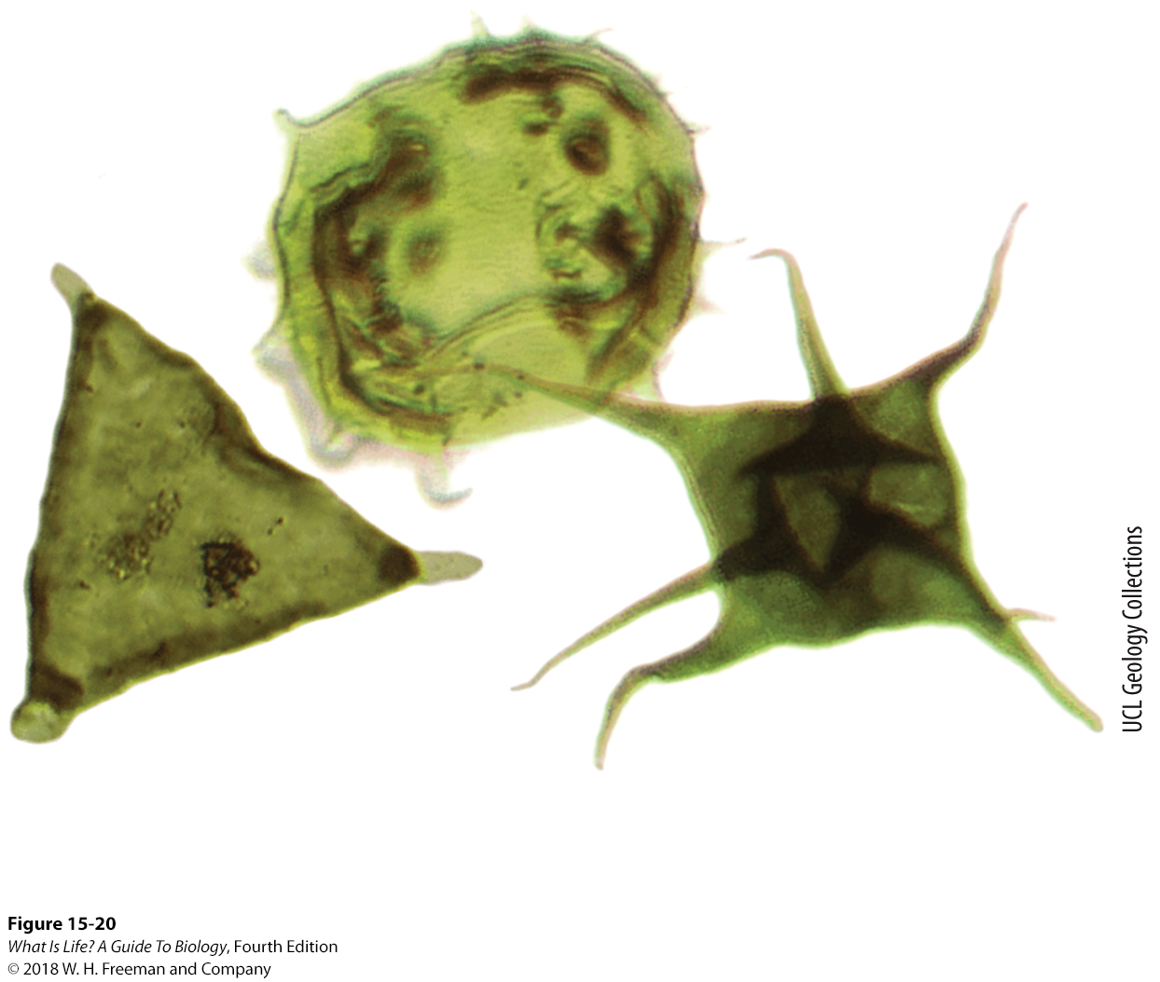

15.13 The first eukaryotes were protists.
Acritarchs
  Larger than prokaryotes
  Cellular organelles evolve
Nucleus
  Endoplasmic reticulum
  Golgi apparatus
  Lysosomes
Endosymbiosis – early protists take on a bacterial symbiont
  Mitochondria
In these ancient fossilized eukaryotes, organelles are visible.
Notes:
For the first 2 billion years of life on earth, organisms were extremely small—bacteria and archaea less than 10 micrometers across, one-eighth the diameter of a human hair. But in rocks about 1.9 billion years old, we find fossils of new kinds of organisms that are 10 times larger. These are a group of organisms called acritarchs (a name that can be translated as “confusing old things”). They were the first eukaryotes.
The larger size is the first thing you notice about these fossil cells, but the internal changes were the basis for the success of the entire eukaryote lineage, including humans. For the first time in the history of life, cells had internal structures that carried out specific functions. These structures, the cellular organelles, perform the specialized activities that make eukaryotic cells more complex than prokaryotes.
The nucleus is an evolutionary innovation that first appeared in protists. Infoldings of the plasma membrane that surrounded the cell probably fused around the DNA, creating a membrane-enclosed compartment containing the cell’s DNA. Thus, the cell nucleus was formed, separated by a double membrane from the cytoplasm of the cell.
Many modern prokaryotes have plasma membranes with complex infoldings that increase the total surface area of the cell and allow better exchange of material between the internal and external environments. Membrane infoldings of this type may also have played a role in endosymbiosis and formation of the first organelles.
Subsequently, the first nuclear membranes developed two specializations: they incorporated proteins that controlled the movement of molecules into and out of the nucleus, and they extended outward from the nucleus to form a folded membrane called the endoplasmic reticulum. The endoplasmic reticulum is the part of a eukaryotic cell where some proteins are assembled. Further development of internal membranes produced the Golgi apparatus, where newly synthesized proteins are given some final processing steps, and sac-like structures called lysosomes, which contain enzymes that break down damaged molecules. Finally, a lineage of protists took in a guest—a bacterial cell that subsequently became the mitochondrion, the organelle that produces most of the ATP synthesized by a eukaryotic cell.
3

Slide 4
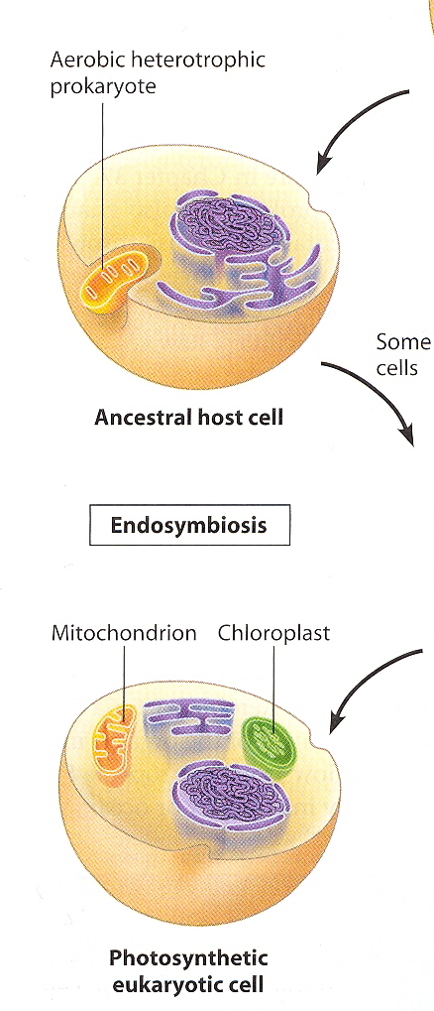
Endosymbiosis: Model of eukaryotic cell origin
Mitochondria came from aerobic bacteria
Chloroplast came from cyanobacteria
Endosymbiosis video
http://www.sumanasinc.com/webcontent/animations/content/organelles.html
Notes:
Mitochondria and chloroplast both have dna as they originated from bacteria
The DNA is circular , which is similar to the DNA of bacteria
Both these organelles are double membraned as well

Slide 5
Take Home Message 15.13
The nucleus is an evolutionary innovation that appeared for the first time in protists.
Early protists took in bacterial cells that subsequently became the mitochondrion, an organelle in eukaryotic cells that produces ATP.
Notes:
5

Slide 6
Which of the following does not contain DNA?
0
A. Ribosomes
B. Nucleus
C. Mitochondria
D. Chloroplasts
Notes:
Ans: A

Slide 7
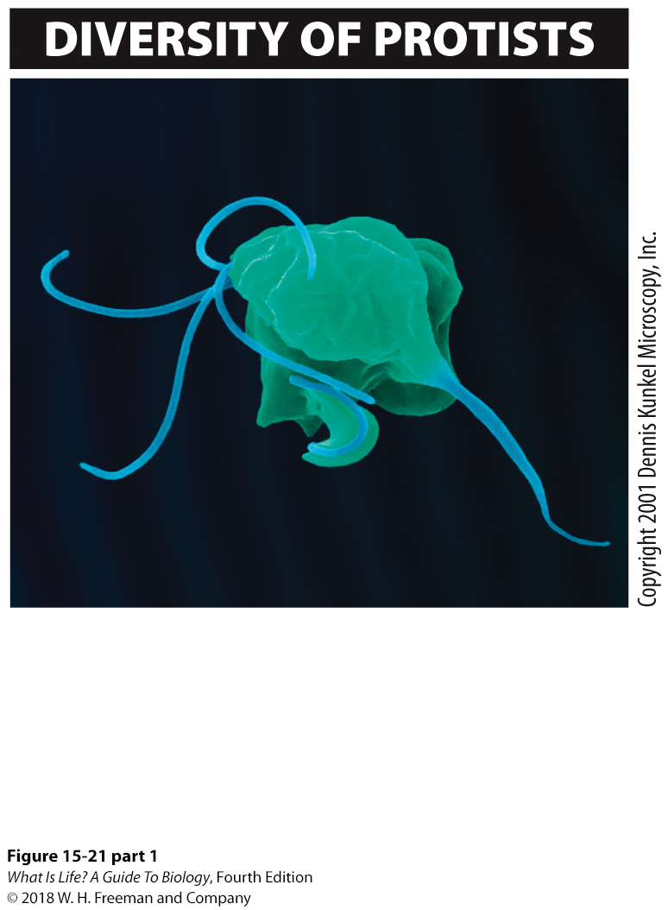
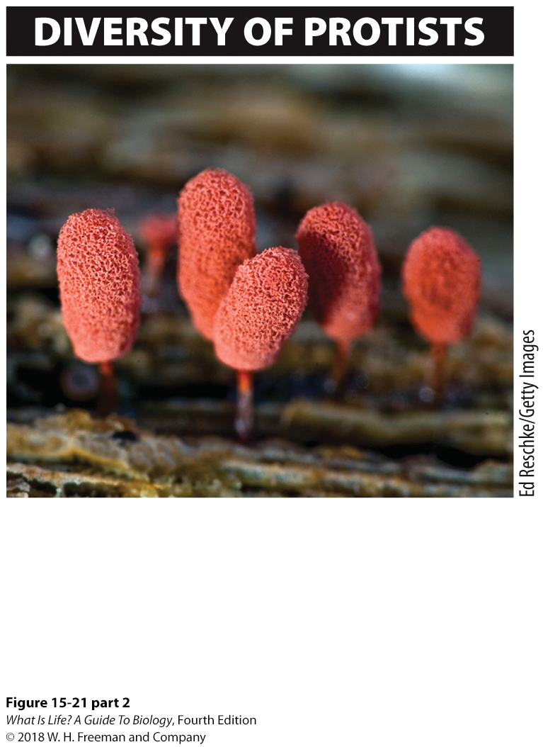
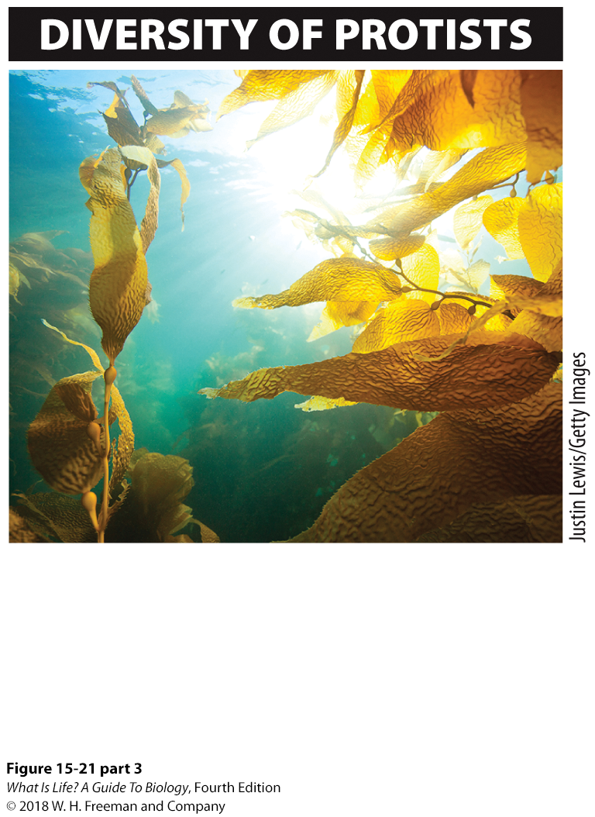
15.14 There are animal-like protists, fungus-like protists, and plant-like protists.
ANIMAL-LIKE PROTISTS
Some protists, such as Trichomonas vaginalis shown here, move around and hunt for prey like an animal.
FUNGI-LIKE PROTISTS
Some protists, such as the carnival candy slime mold shown here, live as heterotrophs and form sheet-like colonies of cells like a fungus.
PLANT-LIKE PROTISTS
Some protists, such as the kelp forest shown here, are multicellular and carry out photosynthesis like a plant.
Notes:
Six major lineages of protists have been named, but even that classification does not capture the huge diversity of the group, and some of the best-known protists do not fit into any of the six lineages.
Protists include forms that are very much like animals, others that seem a lot like fungi, and still others that look like plants.

Slide 8
Animal-Like Protists
They are mobile.
They appear to hunt for prey.
Ciliates
  Named for cilia covering their body surfaces that propel them through water
  Feed on other organisms by the process of phagocytosis
  Paramecium is an example.
Notes:
Animal-like Protists
Some protists propel themselves quickly around their environment and appear to hunt for prey.
These animal-like protists, which include Paramecium, are the ciliates. They get their name from the cilia (hair-like projections) that cover their body surfaces and propel the cells through water. Paramecium feeds by the process of phagocytosis: cilia in a funnel-shaped structure called the gullet create an inward flow of water that carries bacteria and other small particles of food with it.

Slide 9
Fungi-Like Protists
They are heterotrophic (extra cellular digestion followed by absorption)
They resemble fungi.
They form sheet-like colonies of cells that use spores to reproduce (e.g., slime molds).
Notes:
Fungus-like Protists
Some protists resemble fungi: living as heterotrophs, establishing sheet-like colonies of cells on surfaces (such as the grout in shower stalls), using spores to reproduce, and sometimes producing fruiting bodies.
These are the slime molds. They generally spread without any individual cells moving, but rather by adding new cells at the edges of the colony. Some slime molds, called plasmodial slime molds, are oozing masses that flow along a surface, engulfing bacteria, fungi, and small bits of organic material as they go.
The streaming of a slime mold in its feeding phase is easy to observe with a microscope, and such a slime mold can flow around, over, or through almost anything—it can even flow through a window screen and reassemble itself on the other side! You may have seen an irregularly shaped blob of yellow material in a moist, shaded garden—that was a plasmodial slime mold.
Remarkably, a plasmodial slime mold is a very large, single cell (but has multiple nuclei). Slime molds divide by binary fission, just like other cells, but in this case a single cell may cover an area of several square centimeters. All of the nuclei in the cell undergo mitosis simultaneously.

Slide 10
Plant-Like Protists
They grow in water.
They use photosynthesis.
They often resemble plants (e.g., algae and seaweeds).
Notes:
Plant-like Protists Other members of the protists grow in water and resemble plants. These include the protists referred to colloquially as algae and seaweeds.
The term “seaweed” generally refers to the macroscopic, multicellular marine algae, many of which are used as a source of food for humans. And although all are protists, seaweeds encompass several groups that do not share a common multicellular ancestor.
These include some red algae and some green algae (from which the land plants most likely evolved), as well as some of the brown algae—such as the giant kelp that grows in water 30 meters deep. (The seaweeds, of course, represent species of protists that obviously are not “microbial.”)
Brown algae cover large portions of the rocks in the intertidal zone. Giant kelp, growing in temperate regions of the North and South Pacific and off the Atlantic coast of South Africa, are among the fastest growing organisms on earth, with some growing as much as 60 meters in a single year.
Kelp forests are an enormously diverse habitat; more than 1,000 species of fishes, crustaceans, snails, and mammals make their homes in these marine “forests.” Sea otters wrap a kelp frond around their waist when they sleep, and gray whales hide in kelp forests to escape killer whales.
Although many protists are unicellular, there are many exceptions. As we’ve seen, many green and brown algae are multicellular, composed of many different cells and cell types that preform different functions. Some other protists, such as spirogyra, are colonial, living as collections of cells, each of which can carry out all of its life processes independent of the other cells.

Slide 11
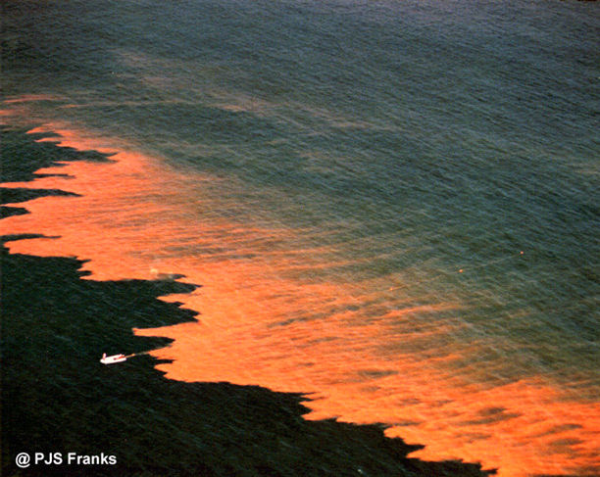
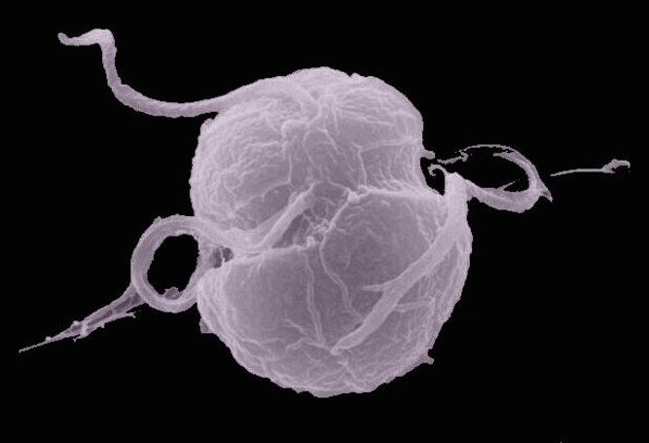
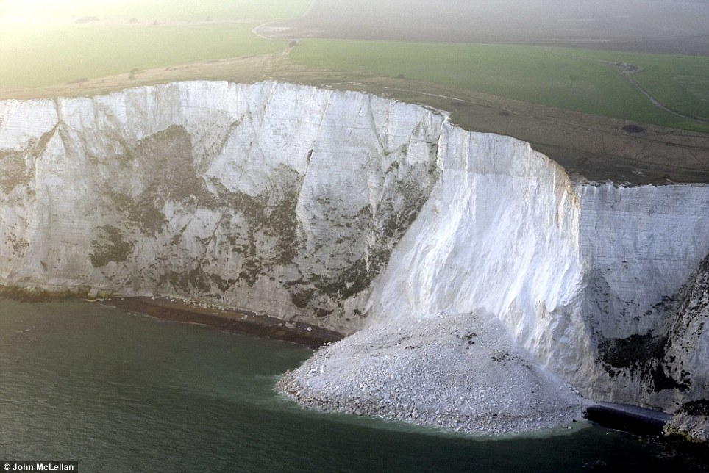
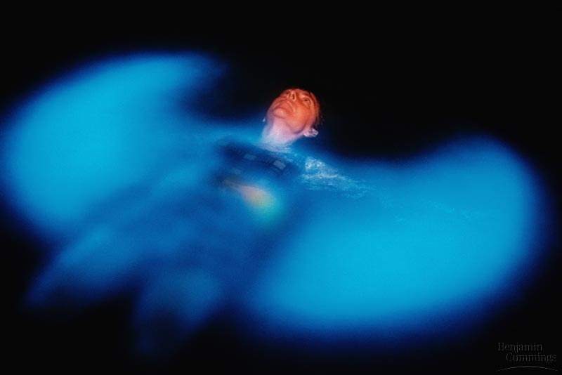
Dinoflagellates: Shells made of calcium carbonate
White cliffs of Dover
Red tide
http://www.bbc.co.uk/nature/life/Coccolithophore#p00bxk9c
Notes:
Remove carbon dioxide from oceans.
Helps lessen acidification
Dinoflagellates livve in ocean plant llike protists , huge population explosions, known as blooms, Occasional blooms of toxic dinoflagellates cause dangerous “red tides”. During red tides, shellfish that have eaten these toxic dinoflagellates, cause dangerous red tides. They are poison to huamns, nerve and muscle paralyssis.

Slide 12
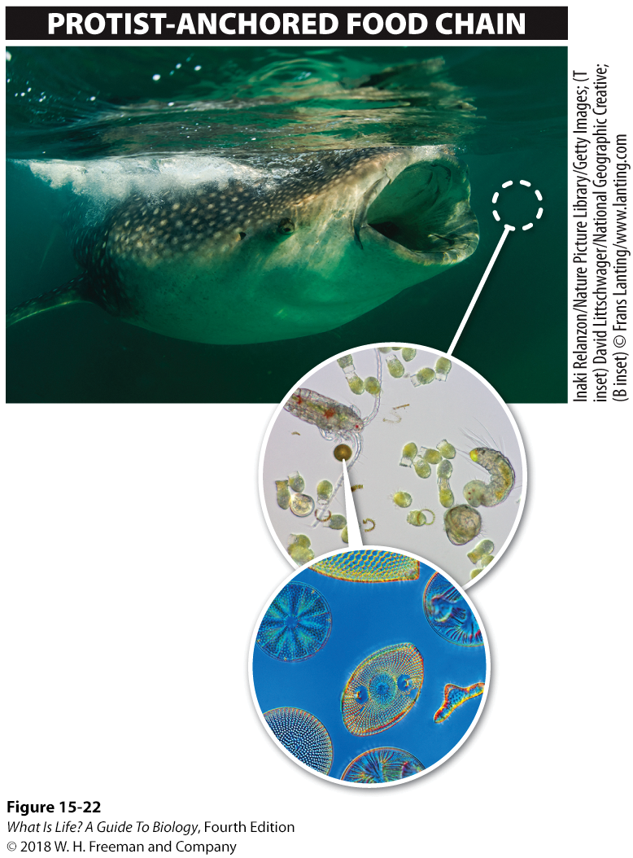
Aquatic Photosynthetic Protists: Diatoms
Diatoms:
  Microscopic
  Unicellular
  Aquatic
  Used as a source of biofuel
Phytoplankton are responsible for 25% of the photosynthetic production of oxygen on earth.
A whale shark feeding on krill and copepods (small crustaceans) in the Gulf of Mexico
A copepod feeding on phytoplankton (including diatoms)
Diatoms, having shells that are extremely diverse
Notes:
Also among the plant-like protists are the diatoms. Diatoms are unicellular organisms that live in ponds, lakes, and rivers as well as in the oceans. They are so small that, for some species, 30 individuals could be lined up across the width of a human hair.
A characteristic of the diatoms is that they are enclosed in a shell made of silica. Many species of diatoms float in the water, forming part of the phytoplankton—the collection of microscopic organisms that fix carbon dioxide and release oxygen. The phytoplankton can reach densities of hundreds of thousands of cells per liter, and it accounts for about one-quarter of the photosynthetic production of oxygen on earth, occupying a critical position in marine food chains.
Small fishes and shrimp-like organisms called copepods feed on phytoplankton, and these small predators are eaten by larger predators, which are eaten by still larger predators. Thus the diversity of life in the marine habitat relies on diatoms and the other microbes that make up the phytoplankton.

Slide 13
Take Home Message 15.14
Protists are a diverse group of mostly unicellular eukaryotic organisms.
The ciliates, such as Paramecium, are animal-like protists.
Plasmodial slime molds are fungus-like protists.
Colonial protists and multicellular protists such as the giant kelp can be enormous and are plant-like in appearance.

Slide 14
In terms of nutrition, autotrophs are to heterotrophs as ____
Brown algae are to red algae
Archaea are to cyanobacteria
Green Algae are to slime molds
Pathogenic bacteria are to harmless bacteria
Notes:
Ans: C

Slide 15
Protistan
pathogens
Some protists can make you very sick.
Parasites and hosts
Plasmodium and Malaria
Notes:
A parasite is an organism that lives in or on an organism called a host and damages it.
A parasitic protist called Plasmodium that is transmitted by a mosquito is responsible for a worldwide epidemic disease—malaria. Malaria occurs in tropical parts of Africa, Asia, and Latin America and it is common in the eastern Mediterranean as well. Between 350 million and 500 million people have clinical cases of malaria, and about one million people die of malaria each year. Malaria is the leading cause of death for children under 5 in sub-Saharan Africa; an African child dies of malaria about every 30 seconds.

Slide 16
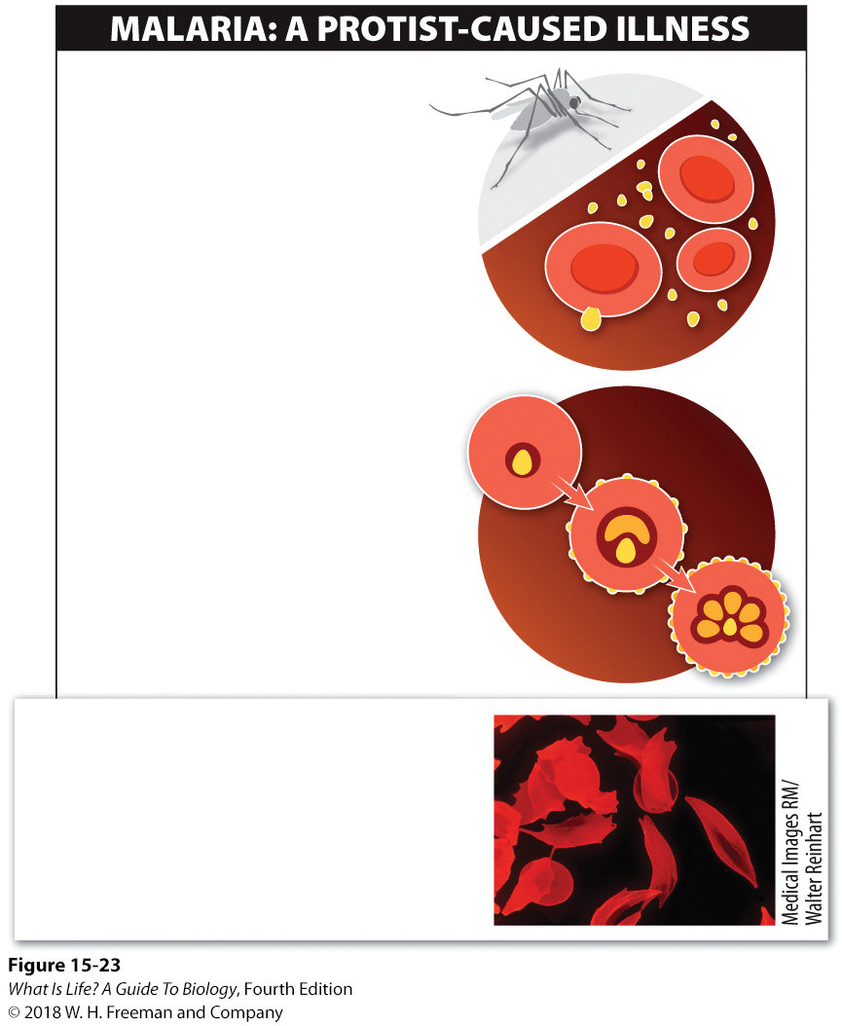
15.15 Some protists can make you very sick.
1
Following the bite of a Plasmodium-infected mosquito, malaria-causing protists take up residence in healthy red blood cells.
Parasites live on a host, causing harm.
Malaria is caused by the parasitic protist, Plasmodium.
Plasmodium first infects the liver then the red blood cells
Plasmodium parasite infecting a red blood cell
2
Once inside a red blood cell, Plasmodium cells modify the cell’s surface proteins, making it difficult for the immune system to fight the malarial infection.
RESISTANCE TO MALARIA
In individuals with sickle-cell trait, the sickle shape of some red blood cells makes the cells inhospitable to the protist. This makes these individuals resistant to malaria.
Notes:
A parasite is an organism that lives in or on another organism, called a host, and damages it.
A parasitic protist called Plasmodium that is transmitted by a mosquito is responsible for malaria. Malaria occurs in tropical parts of Africa, Asia, and Latin America, and it is common in the eastern Mediterranean as well. Between 350 million and 500 million people have clinical cases of malaria, and about 1 million people die of it each year. Malaria is the leading cause of death for children younger than 5 years old in sub-Saharan Africa. Somewhere on the African continent, about every 30 seconds, a child dies of malaria.
Neither the incidence of malaria nor the rate of mortality has changed very much since Plasmodium was identified as the cause of malaria nearly a century ago. The reason for the lack of progress is the changing nature of Plasmodium. The human immune system has a difficult time fighting a malarial infection because, to survive
from one generation to the next, Plasmodium parasites go through a series of distinct developmental stages. And as the Plasmodium cells change from one stage to another, the parasite produces different cell surface proteins. Plasmodium stays ahead of the human immune system by constantly changing the way it appears to immune system cells.
Although the immune system doesn’t usually have much success fighting malarial infection, some individuals produce red blood cells that are inhospitable to Plasmodium, conferring a resistance to the malaria-causing protist. These individuals carry an allele, called Hb^{S}, which (as we learned in Chapter 9) codes for a variant of adult hemoglobin that causes hemoglobin molecules to stick together in long chains that distort the red blood cell (see Figure 15-23), giving the cell a sickled shape. The sickled red blood cells leak substances that are essential to Plasmodium, making these cells inhospitable to the parasite. Although carrying a copy of the Hb^{S} allele confers resistance to malaria, individuals who carry two copies of the Hb^{S} allele suffer from sickle-cell anemia—a severely debilitating genetic disease. Individuals with a single Hb^{S} allele are said to have “sickle-cell trait.”
16

Slide 17
Take Home Message 15.15
Some protists cause debilitating diseases.
Plasmodium, the protist responsible for malaria, is one of these.
Plasmodium has characteristics that protect it from the human immune system, but some humans do have a defense against malaria: people with sickle-cell trait make red blood cells that are inhospitable to the parasite.

Slide 18
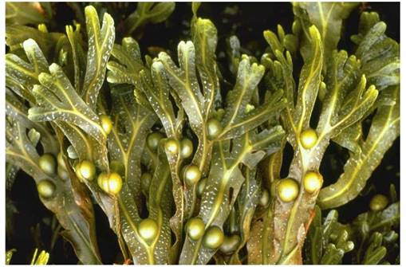
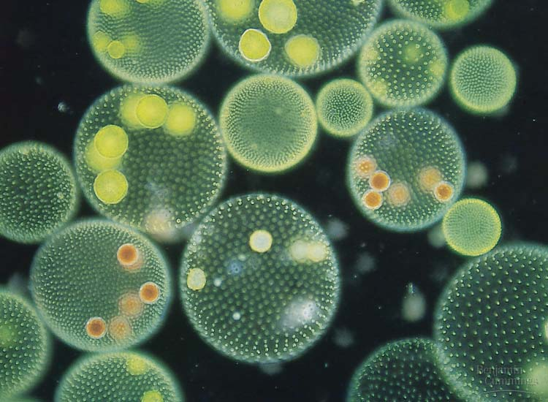
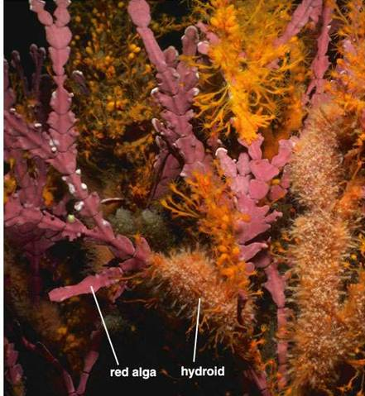
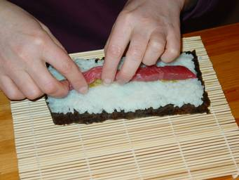
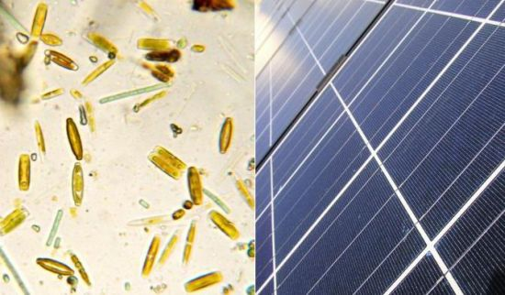
Beneficial protists
Brown algae
Green Algae:
Seaweeds, photosynthetic, ancestor to plants
Red algae
Algin: Thickener for icecream
Red algae: Agar, coral reefs, limestone deposits
Diatoms: help produce biofuel

Slide 19
Which feature below would help distinguish a protist from other microbes?
Only protists have organelles.
Protists only inhabit aquatic environments while bacteria and archeae live everywhere.
There are no pathogenic protists.
You cannot distinguish a protist from other microbes because they are physically similar
Notes:
Answer: A

